Slide 1


Leadership Effectiveness
Scale & Correlations

Slide 2
Leadership Effectiveness Scale Questions
ü
I am satisfied with the quality of leadership that
this leader provides.
ü
This leader is the kind of leader that others should
aspire to become.
ü
This leader is an example of an ideal leader.
ü
This leader's leadership helps this organization to thrive.
ü
Overall, this leader provides very effective leadership.
Notes:
Learning Objective 1: for participants to understand that when a person completes a LCP, they answer each of the 119 questions against the backdrop of their (perhaps unconscious) tacit belief in what makes someone an effective leader. The 5 questions explicitly ask evaluators to rate the leader directly against their picture of the ideal leadership.
Learning Objective 2: for participants to understand that these additional five questions constitute a “survey within a survey,” in that they answers are not used to compute any part of the graph other than this Leadership Effectiveness Scale.

Slide 3
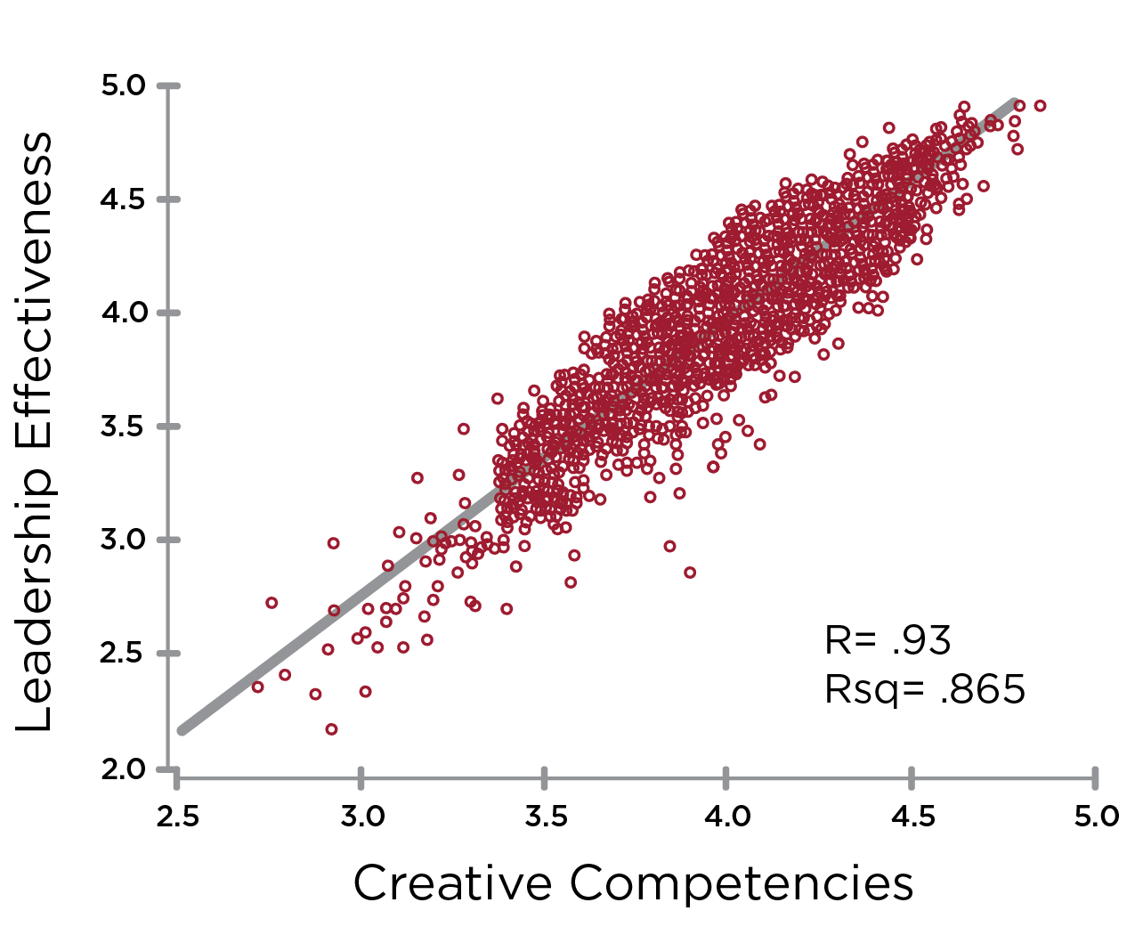
Leadership Effectiveness & Creative Competencies
Notes:
Learning Objective 1: for participants to understand that an initial research question was the degree to which the LCP model actually measured what is commonly understood to be effective leadership. We found a strong positive correlation between the Creative aspects of the LCP and the LE questions indicating that the battery of 18 Creative competencies in the LCP are tracking with what it takes to be an effective leader across many contexts.
Learning Objective 2: for participants to understand that r = the relationship between the two variables or the line of best fit through the data—so how much of the movement of one variable is described by movement of the other. In this case, r = 0.93 means that if the Average Creative Score increases 1.00 (one unit of measure), the Leadership Effectiveness score will likely increase on average by 0.93. This is a very strong correlation.
Learning Objective 3: for participants to understand that rsq = the degree to which the data tightly cluster around the line of best fit. A high rsq means that the data don’t vary much and fit tightly together around the line of best fit (the prediction of the model). A low rsq means that the data are more scattered around the line of best fit. (Technically, rsq measures the amount of variability among the data points that can be explained by the model or predicted by the line of best fit).

Slide 4
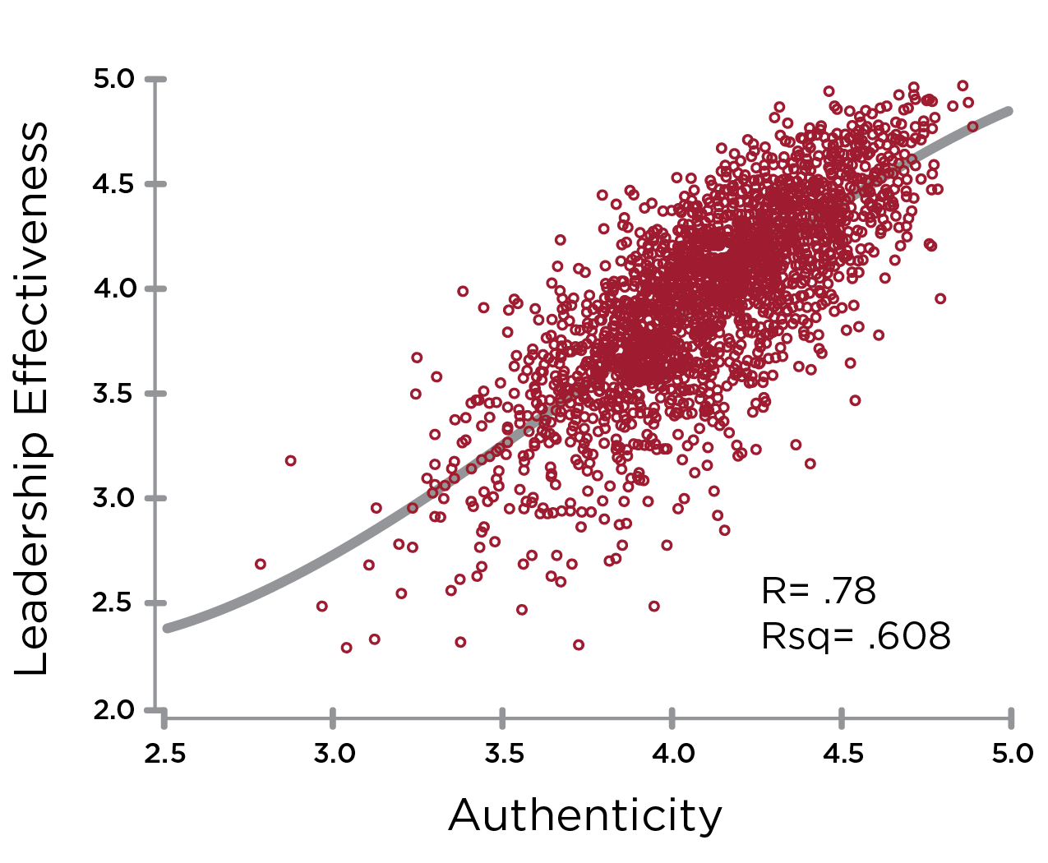
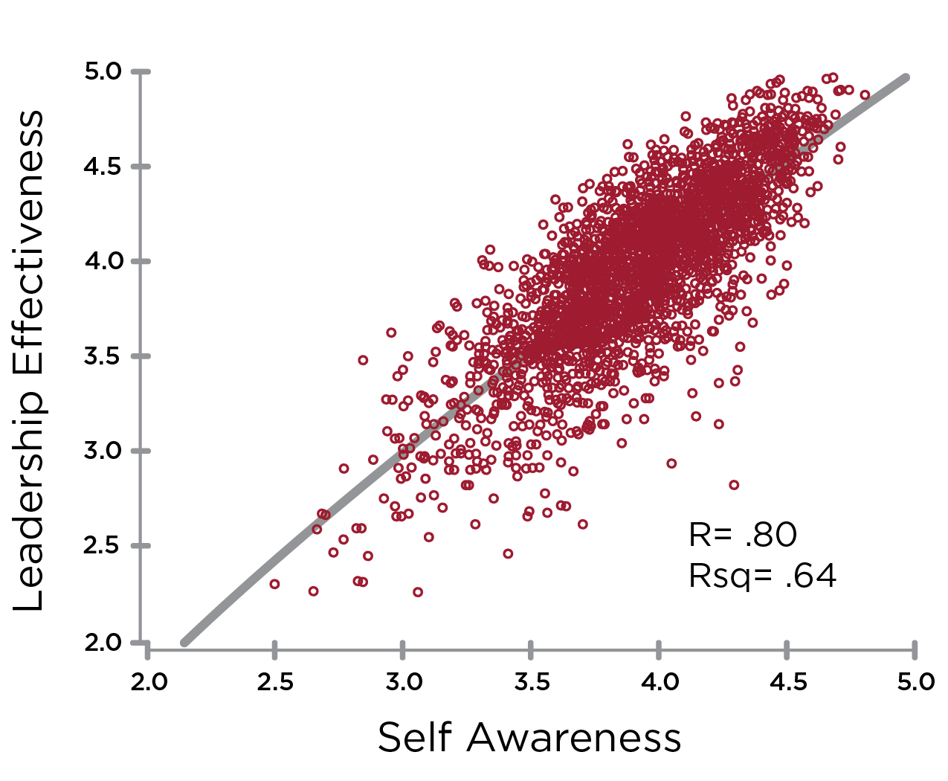
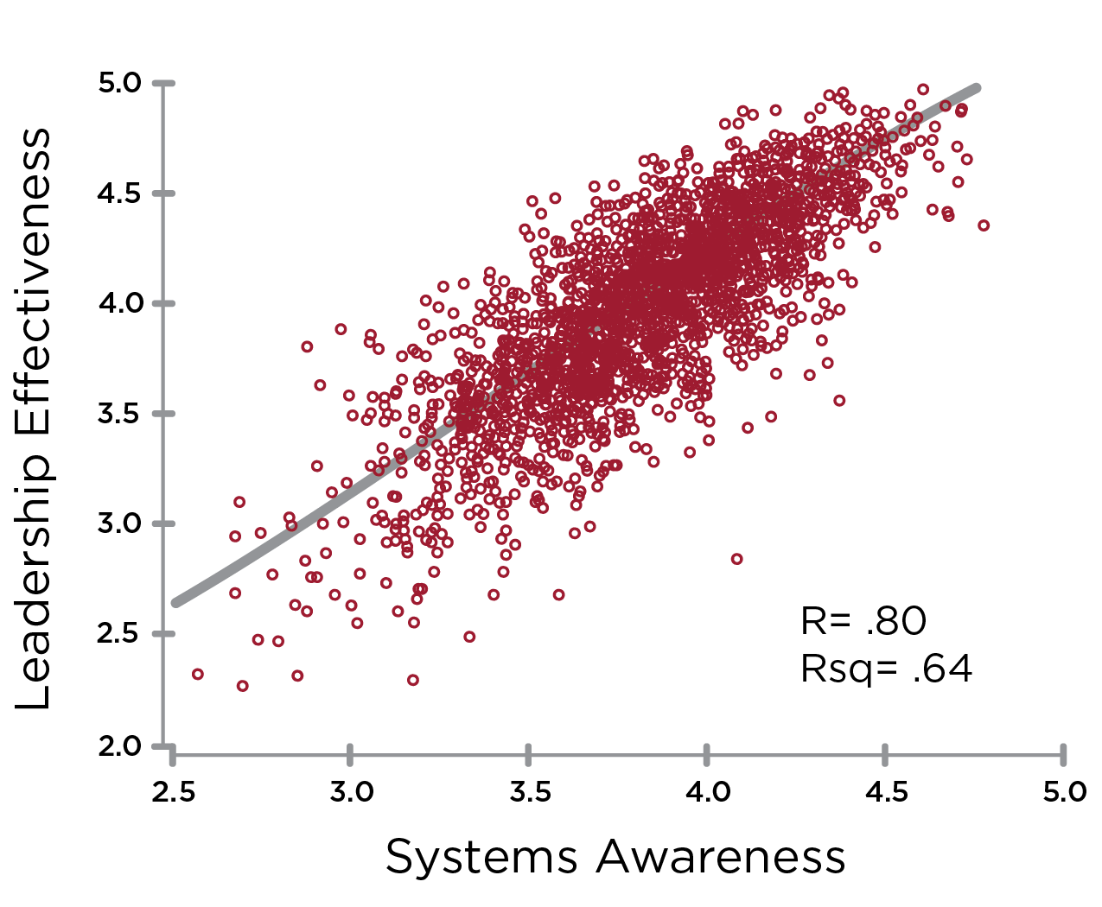
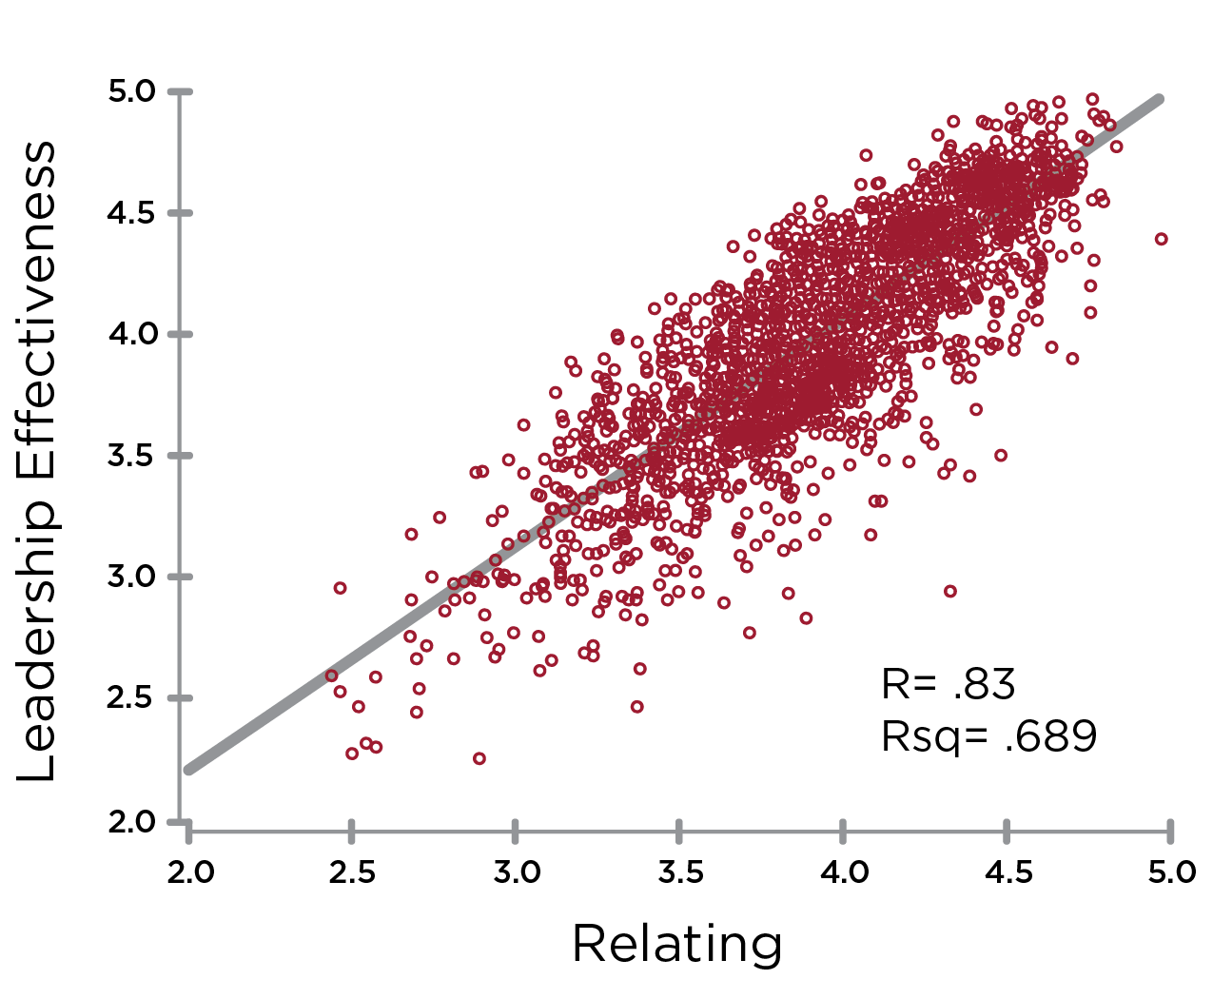
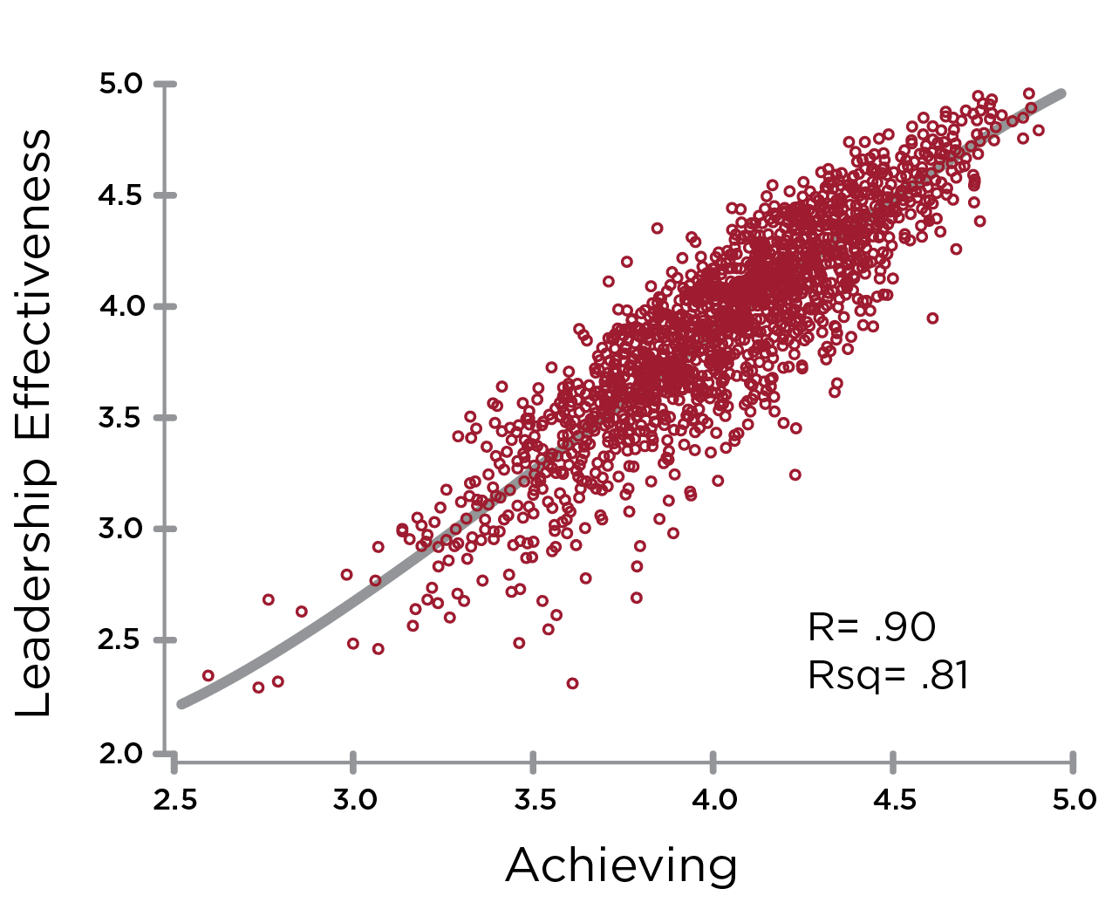
CREATIVE Correlations to
Leadership Effectiveness
R=.78
R=.80
R=.80
R=.83
R=.90
Notes:
Learning Objective 1: for participants to understand that perceptions of Leadership Effectiveness (the 5 questions on the scale) are strongly correlated with the Creative Competencies.

Slide 5
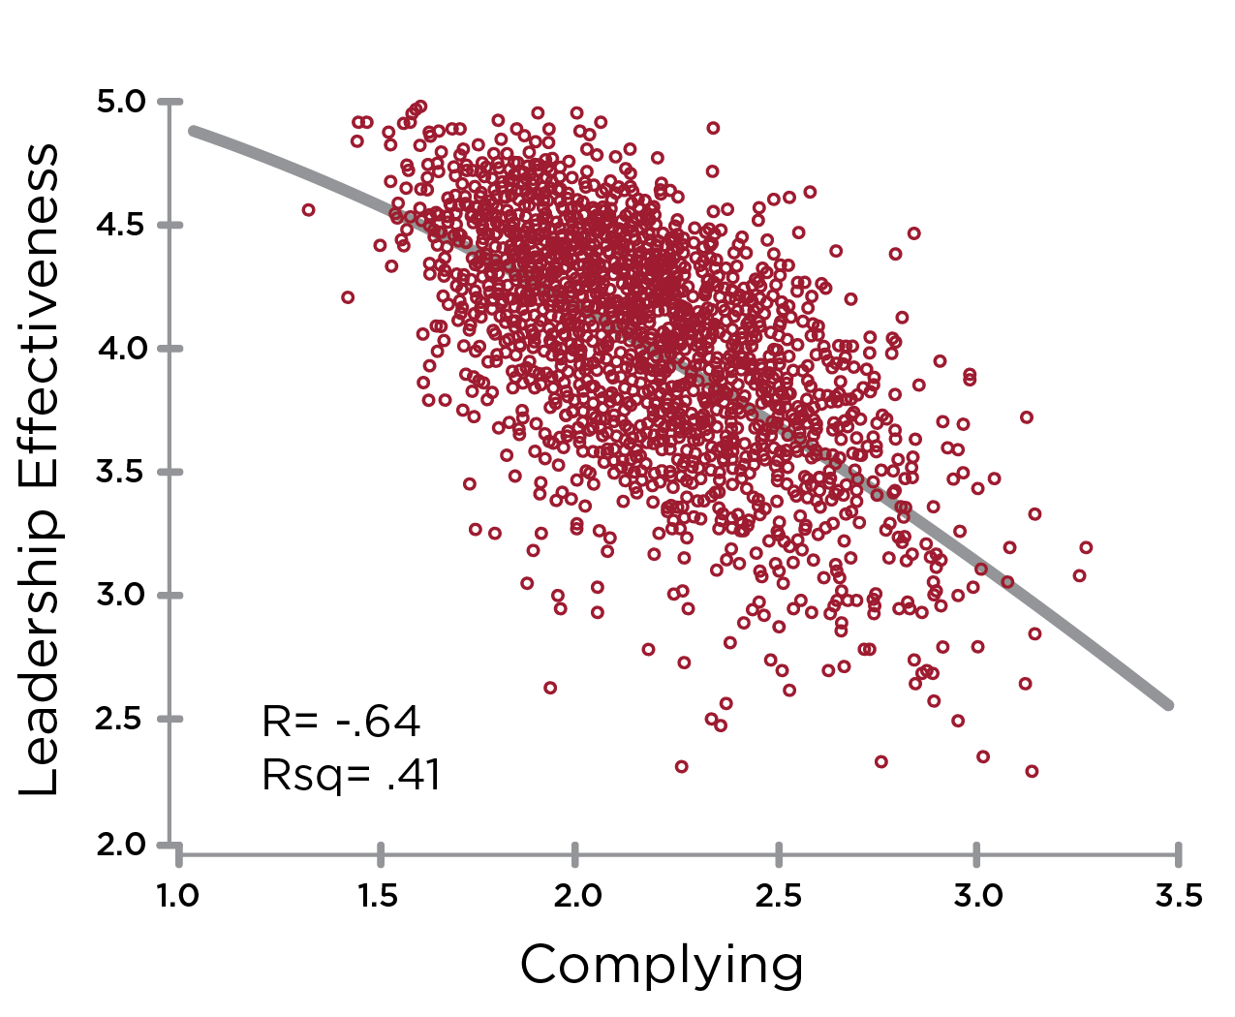
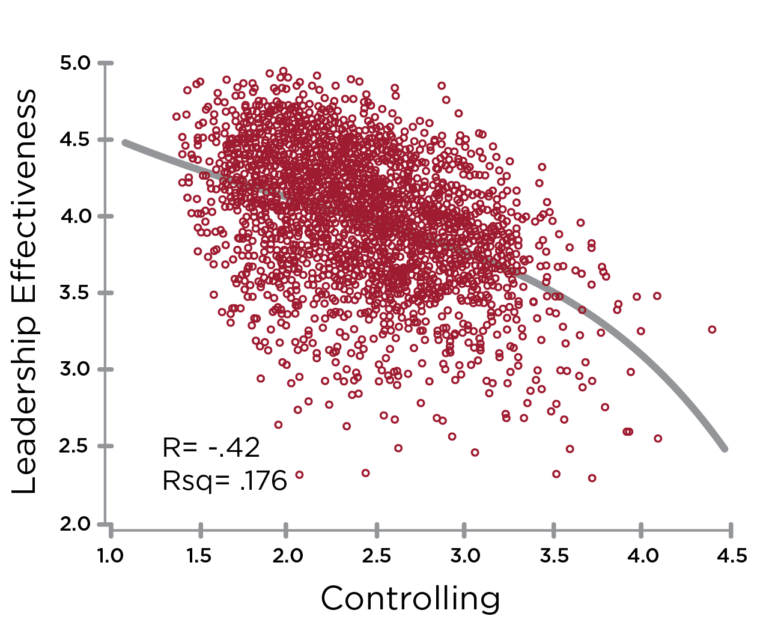
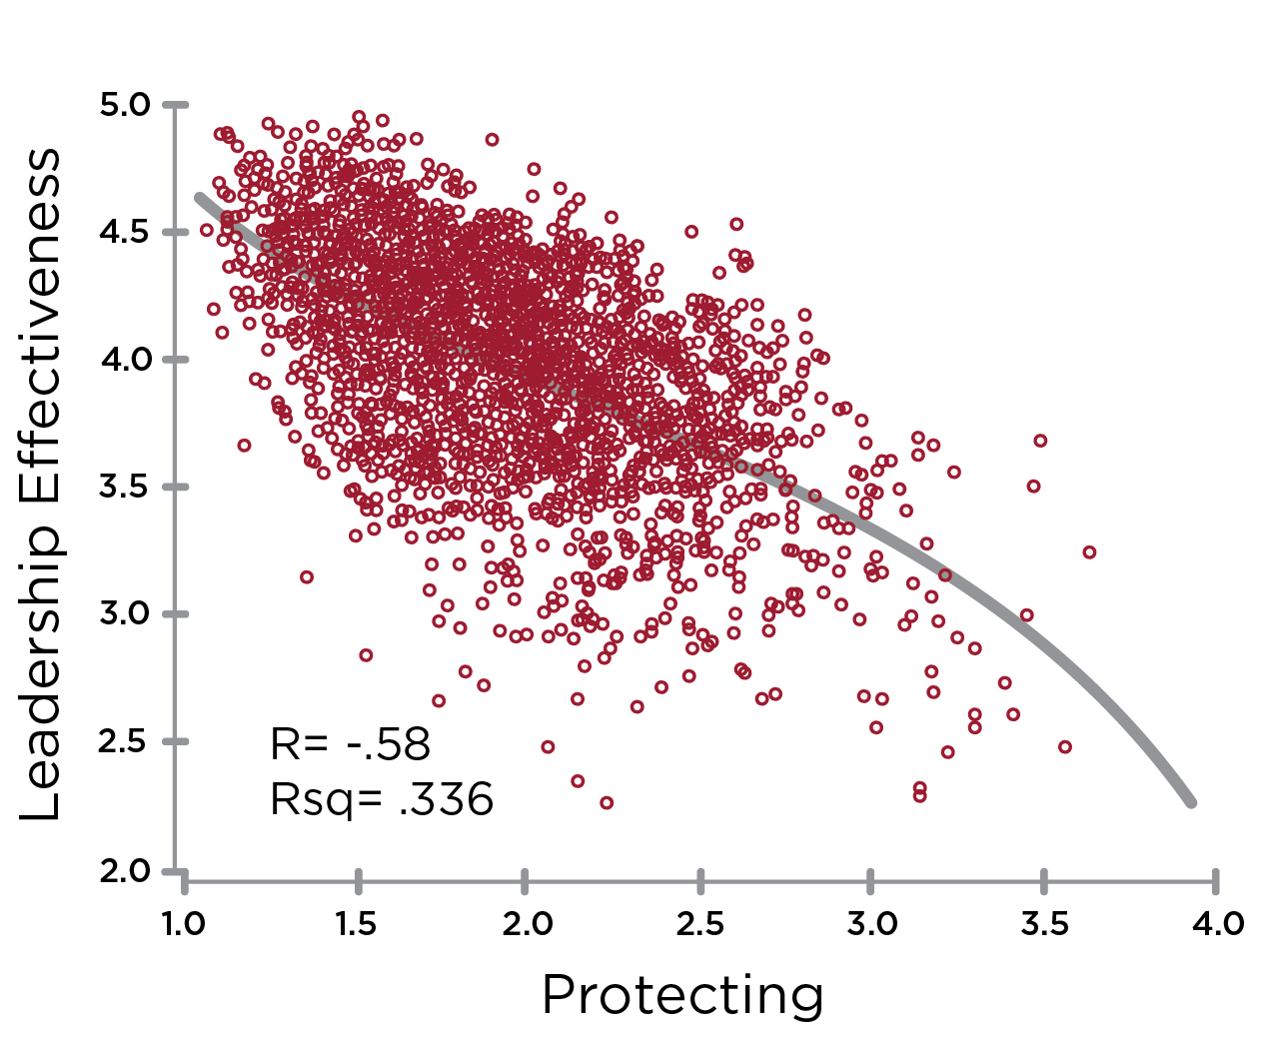
REACTIVE Correlations to
Leadership Effectiveness
R= -.64
R= -.42
R= -.58
Notes:
Learning Objective 1: for participants to understand that perceptions of Leadership Effectiveness (the 5 questions on the scale) are strongly correlated with the Creative Competencies.

Slide 6
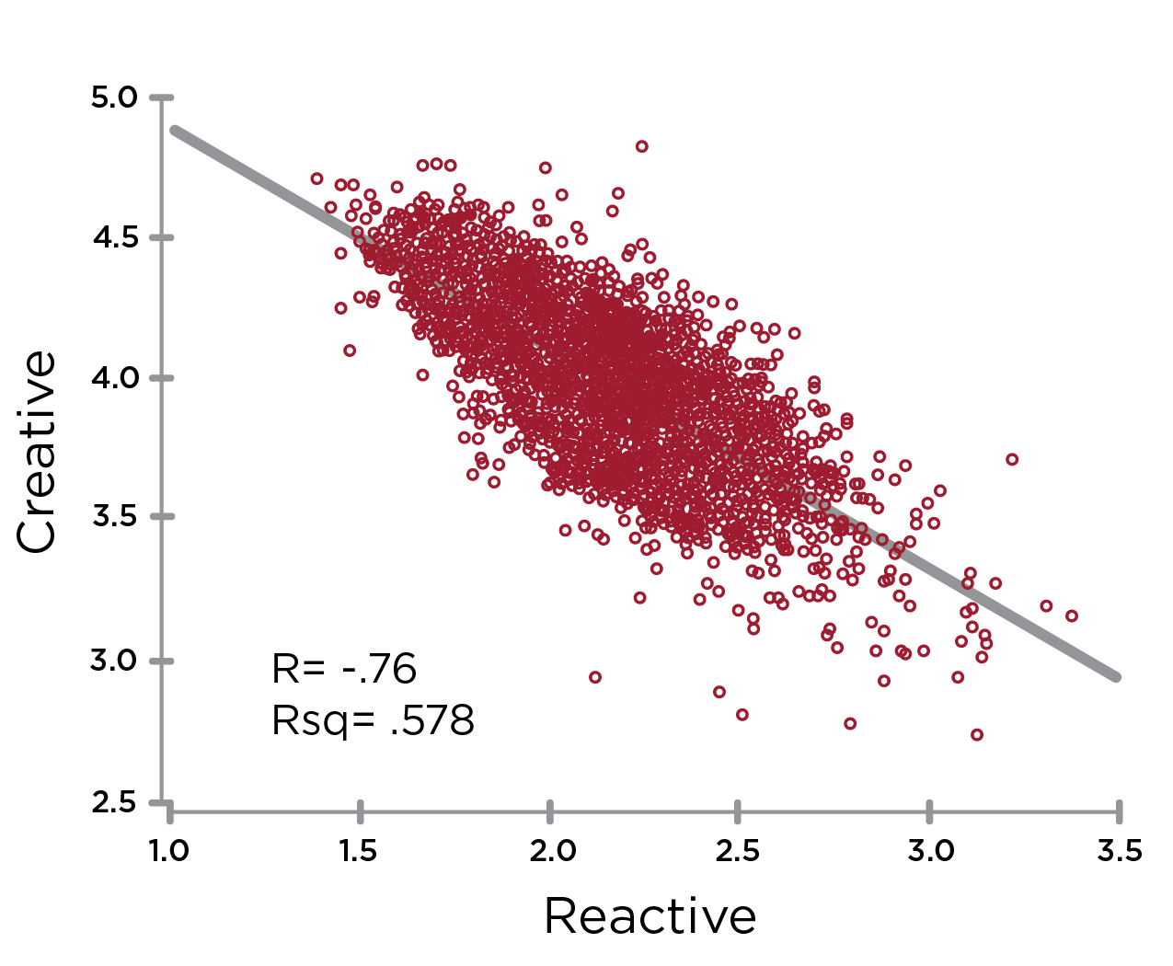
Creative Competencies & Reactive Tendencies
Notes:
Learning Objective 1: for participants to understand that the Creative Competencies are strongly negatively correlated (-.76) with the Reactive Tendencies.
Learning Objective 2: for participants to understand that the implication of this correlation is that Reactive Tendencies significantly block/cancel the expression of Creative Competencies.

Slide 7
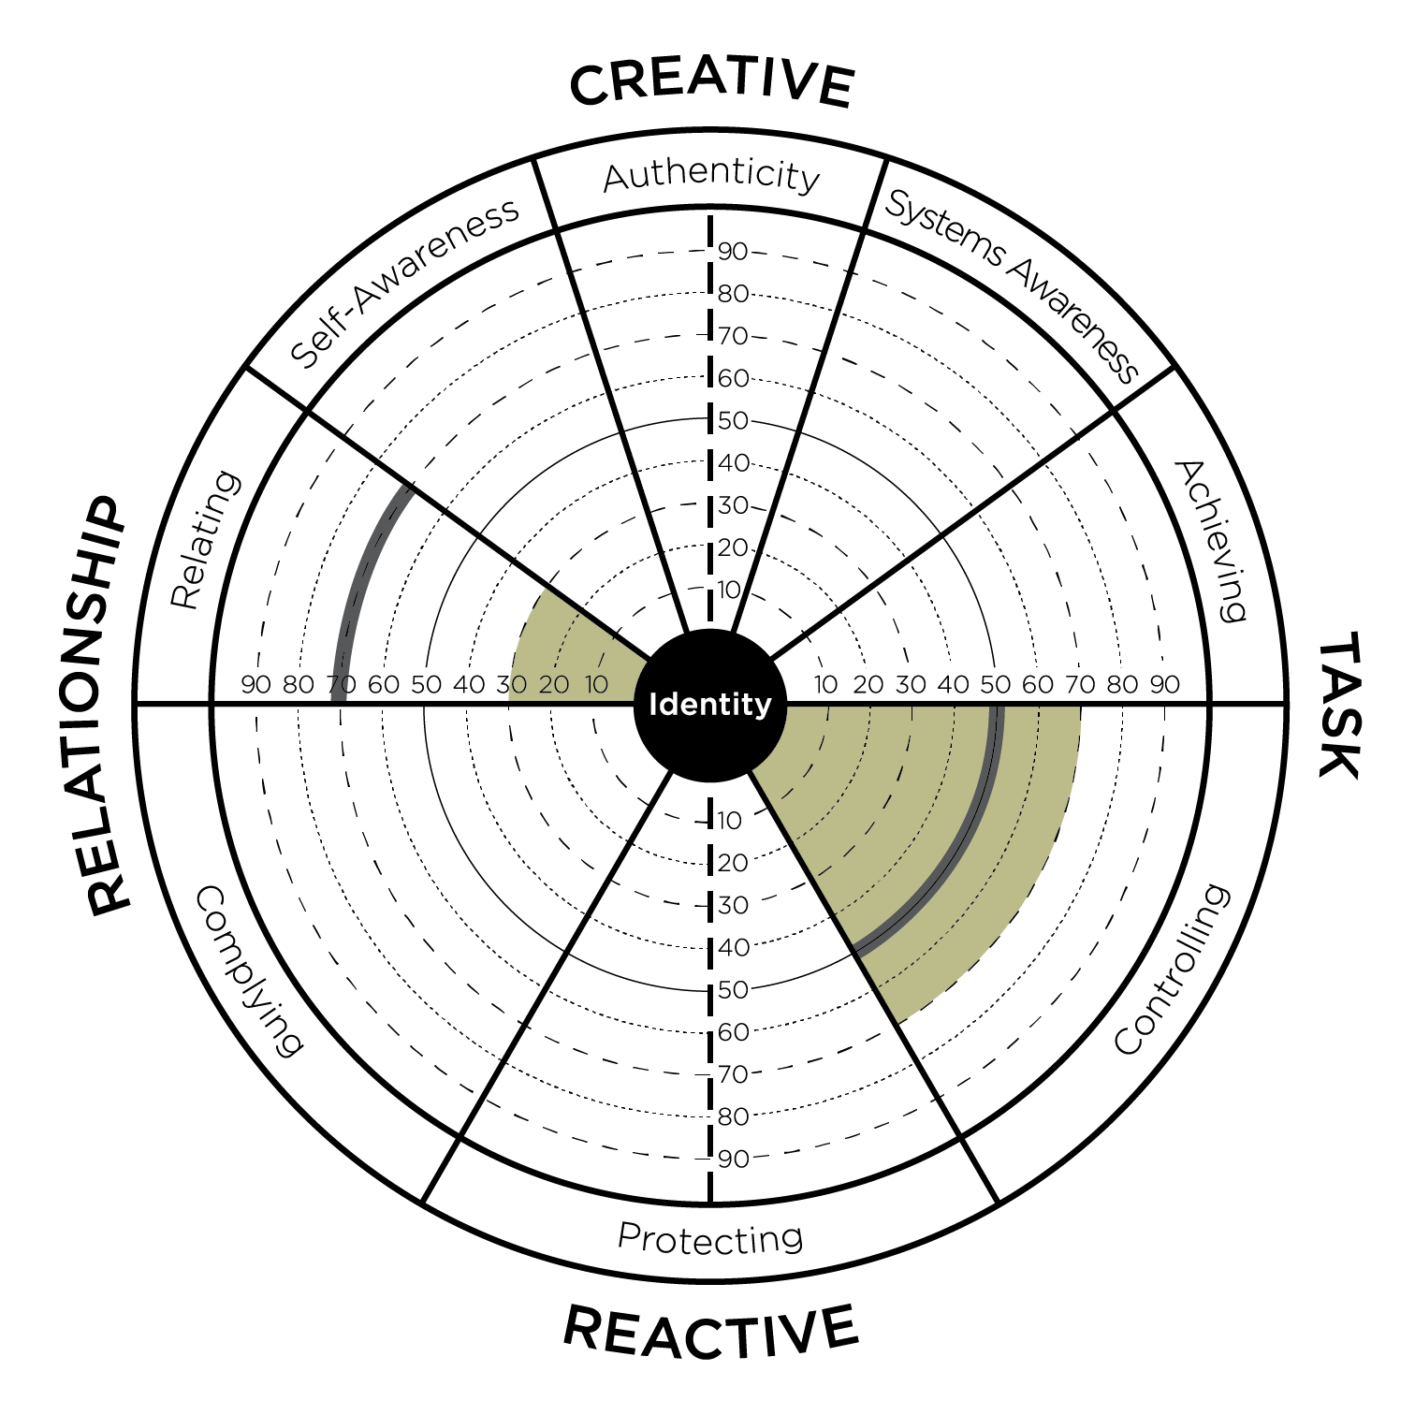
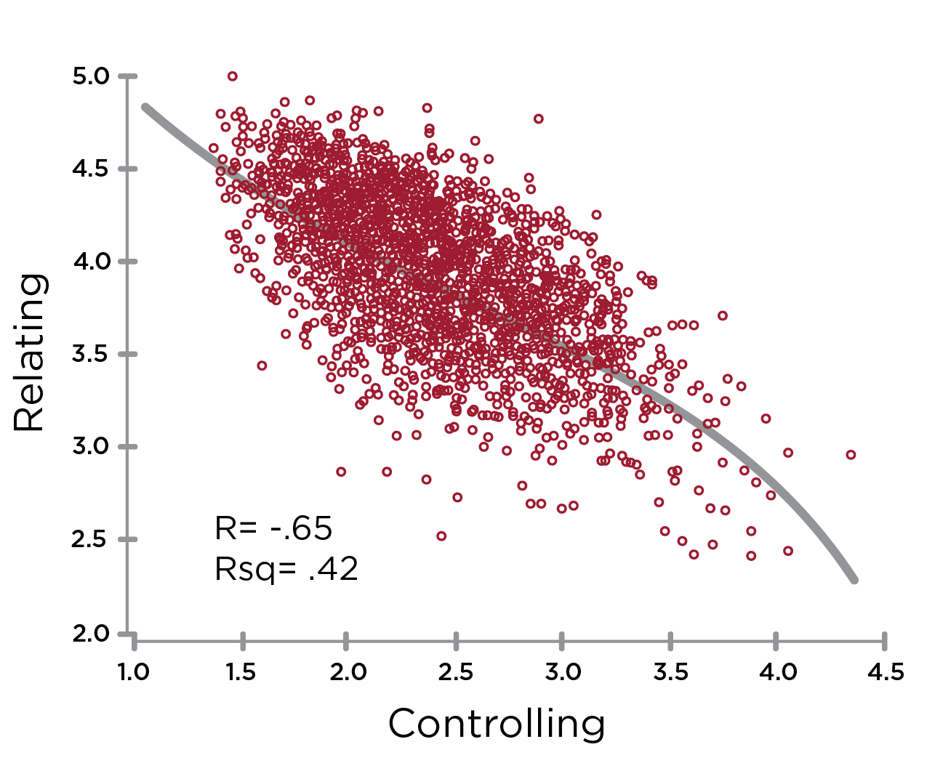
Opposites: Controlling & Relating
Notes:
Learning Objective 1: for participants to understand that Controlling has a large negative effect on Relating (-.65) and thus they are opposite one another on the graph.
Learning Objective 1: for participants to understand that Controlling also has a large negative effect on Self Awareness (-.66) and thus they are also opposite one another on the graph.
Learning Objective 3: for participants to understand that a typical developmental trajectory for someone with high Controlling would be up and across the graph working on improving Relating and/or improving Self Awareness.
Learning Objective 4: for participants to understand that Controlling is negatively correlated with Relating (-.65).

Slide 8
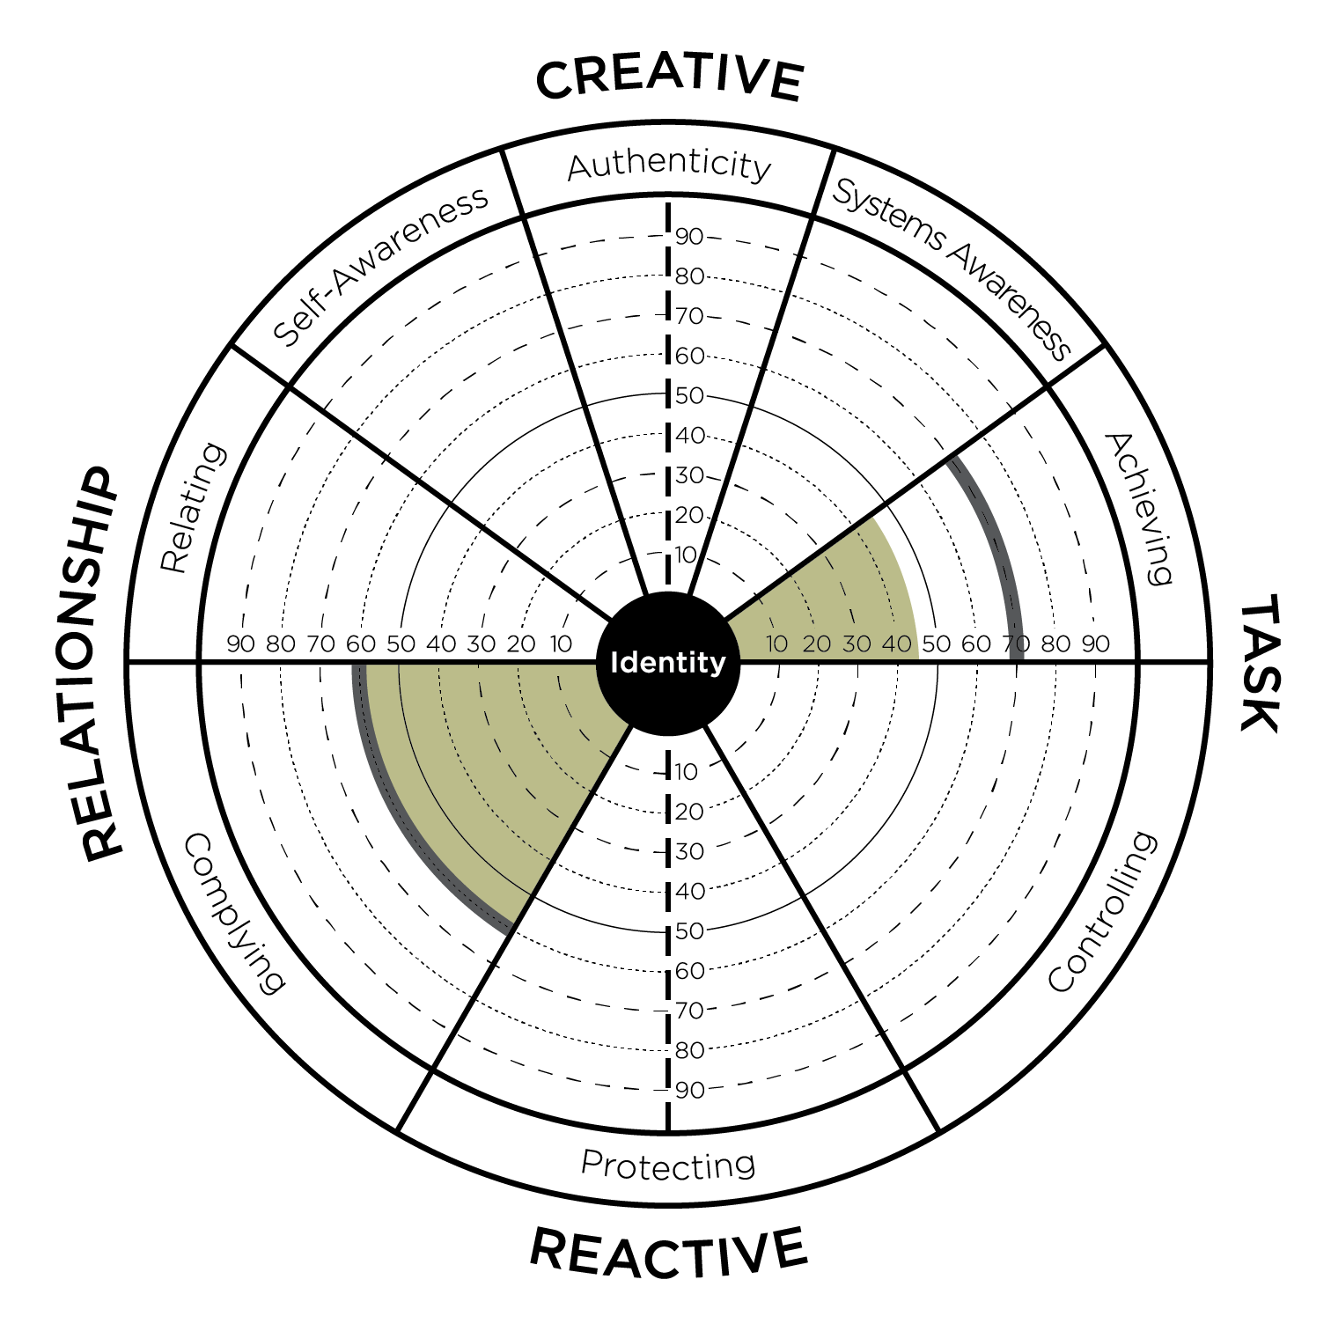
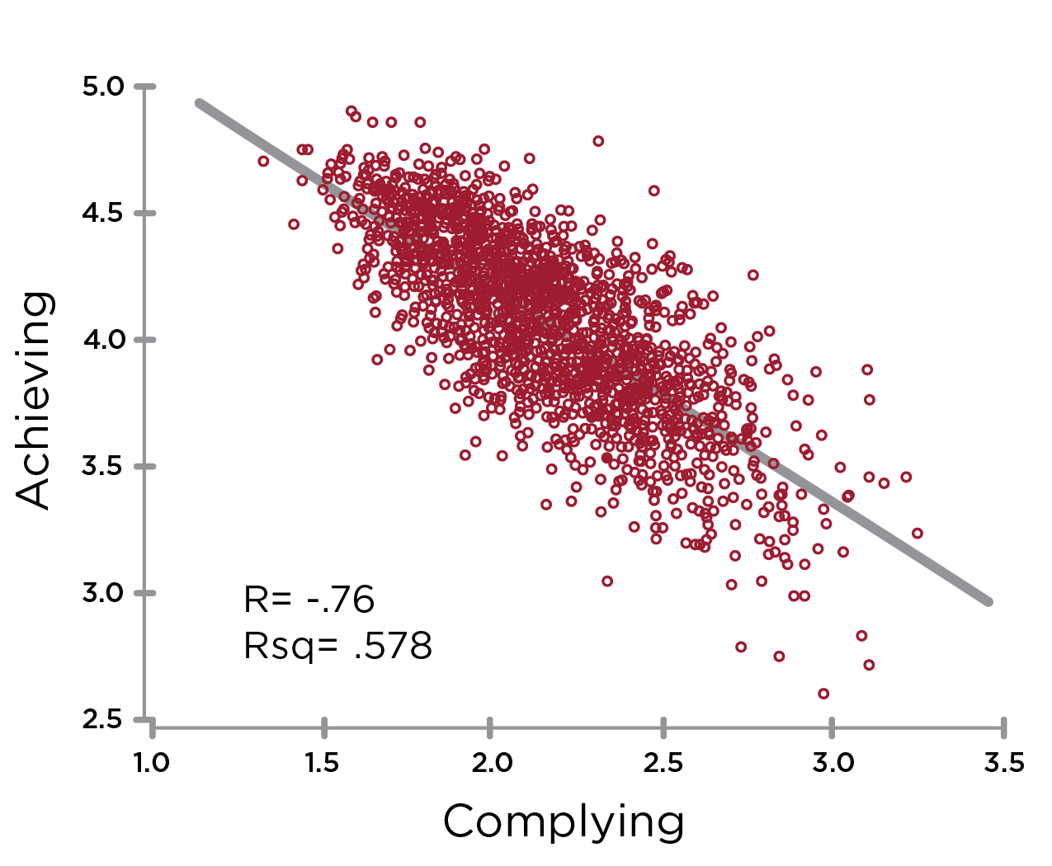
Opposites: Complying & Achieving
Notes:
Learning Objective 1: for participants to understand that Complying has its biggest negative effect on Achieving (-.76) and thus they are opposite one another on the graph.
Learning Objective 2: for participants to understand that a typical developmental trajectory for someone with high Complying would be up and across the graph working on improving Achieving.
Learning Objective 3: for participants to understand that Complying has its second biggest negative effect on Authenticity (-.62) and this is also another common developmental trajectory (particularly working on Courageous Authenticity).
Learning Objective 4: for participants to understand that Complying is negatively correlated with Achieving (-.76).

Slide 9
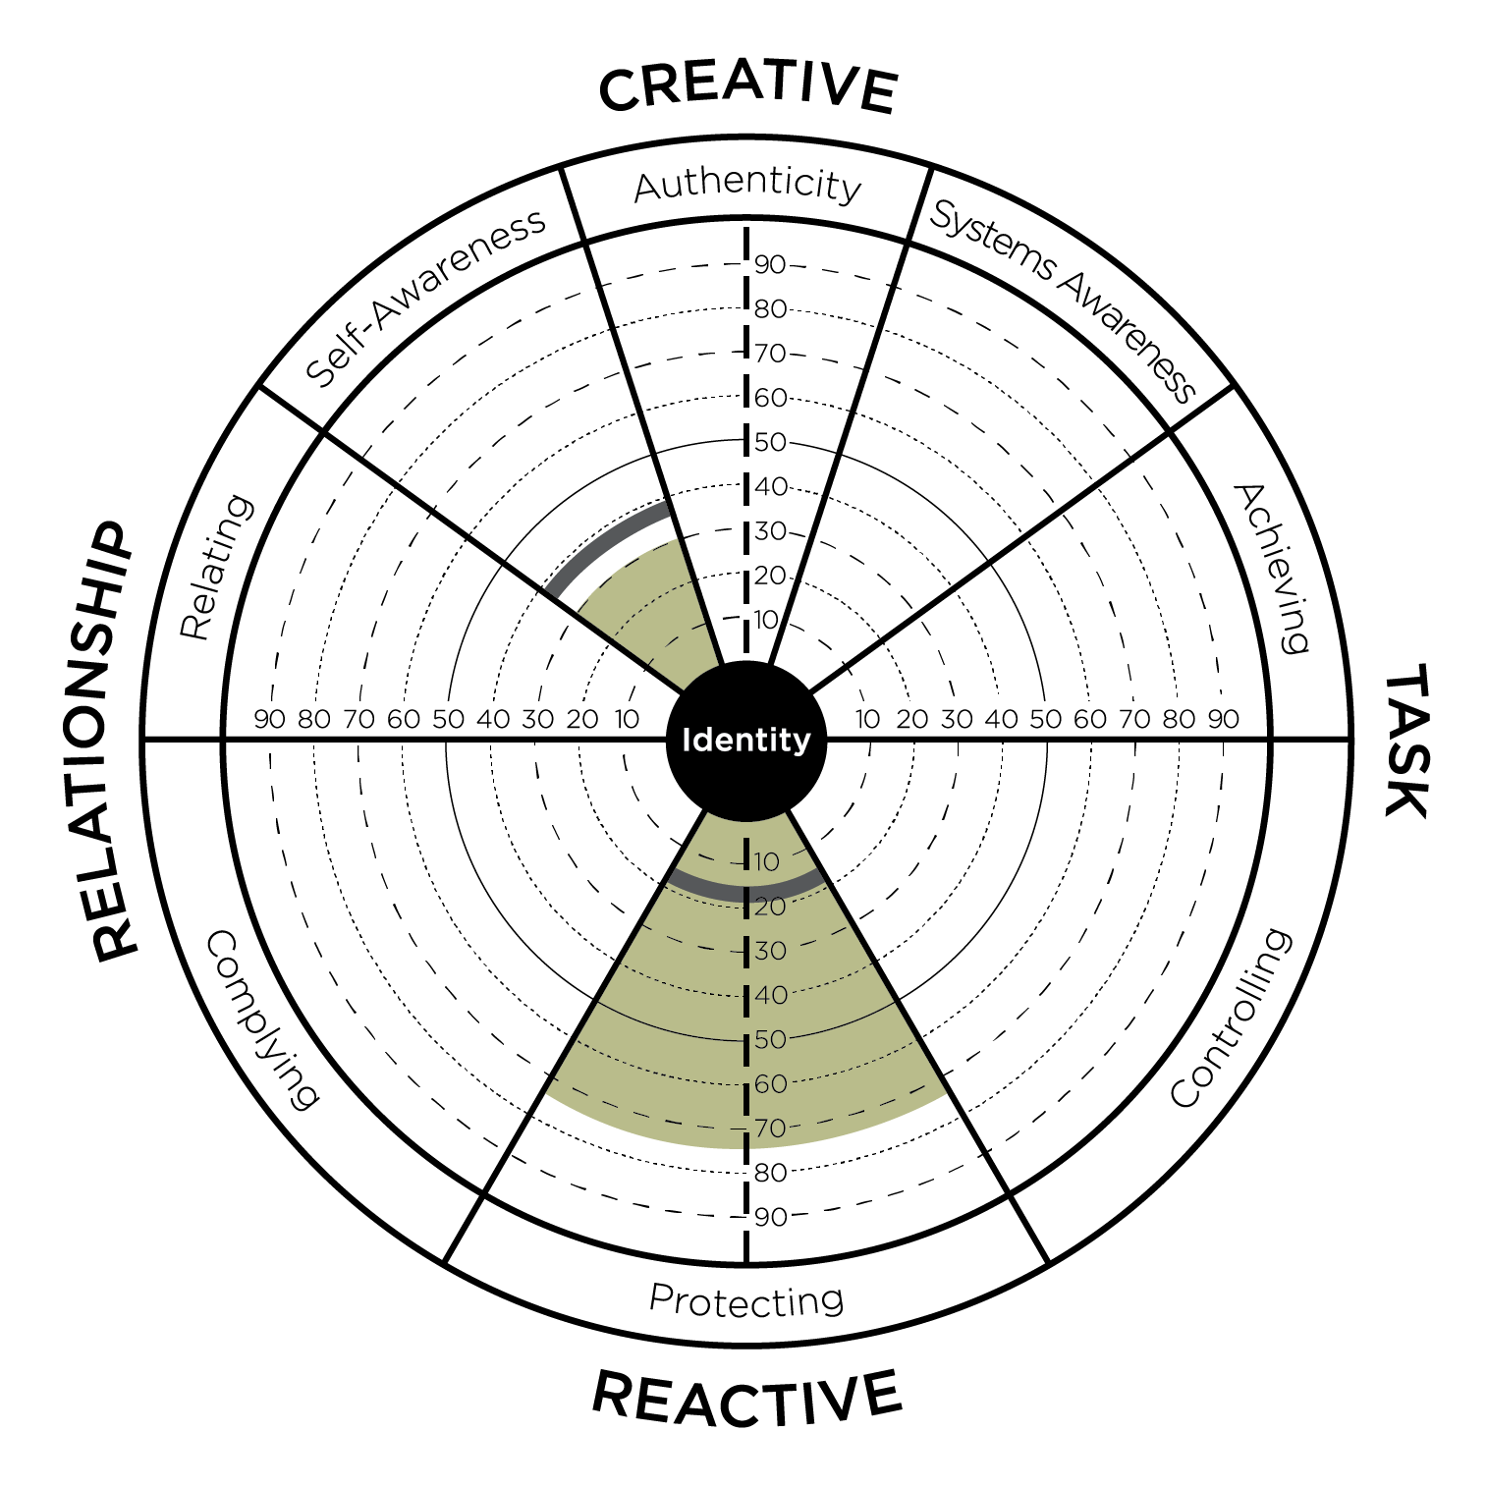
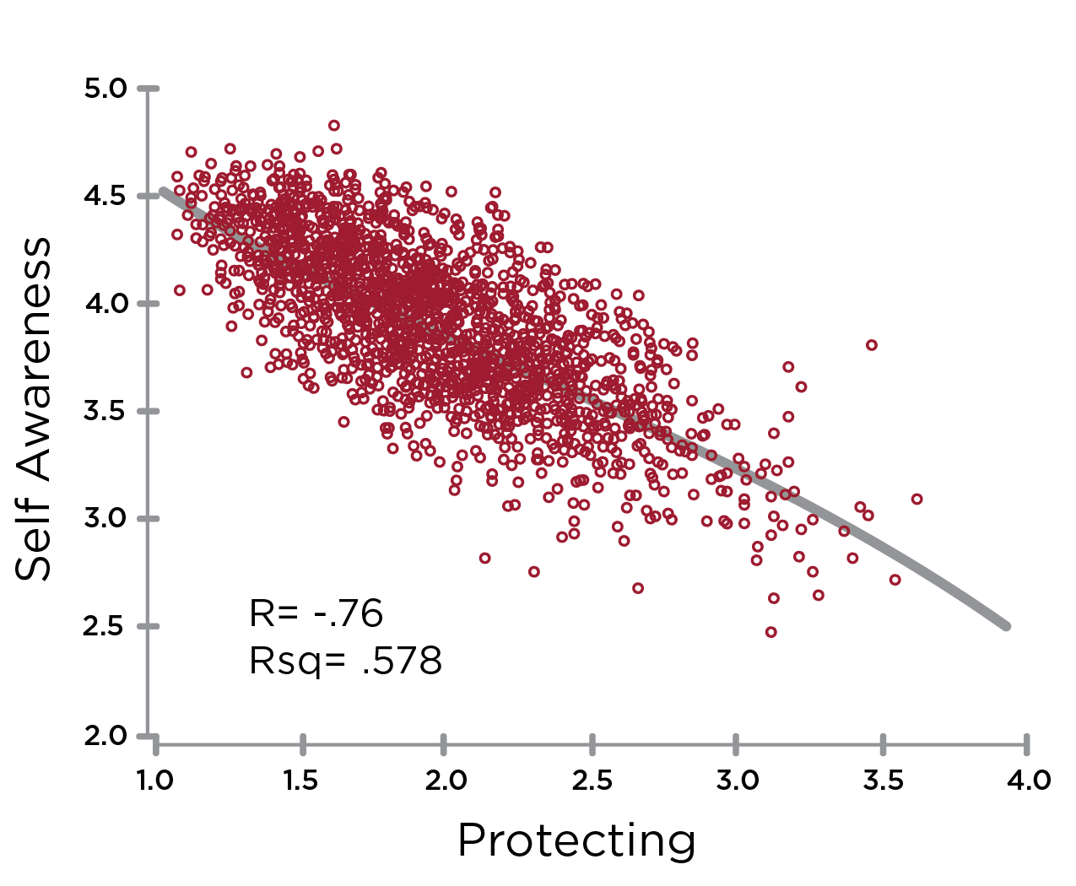
Opposites: Protecting & Self Awareness
Notes:
Learning Objective 1: for participants to understand that Protecting has a large negative effect on Self Awareness (-.70) and thus they opposite on the graph.
Learning Objective 2: for participants to understand that Protecting has a large negative effect on Relating as well (-.73).
Learning Objective 3: for participants to understand that a typical developmental trajectory for someone with high Protecting might be up and to the left across the graph working on improving Self Awareness and Relating.
Learning Objective 4: for participants to understand that Protecting is negatively correlated with Self Awareness (-.76).

Slide 10
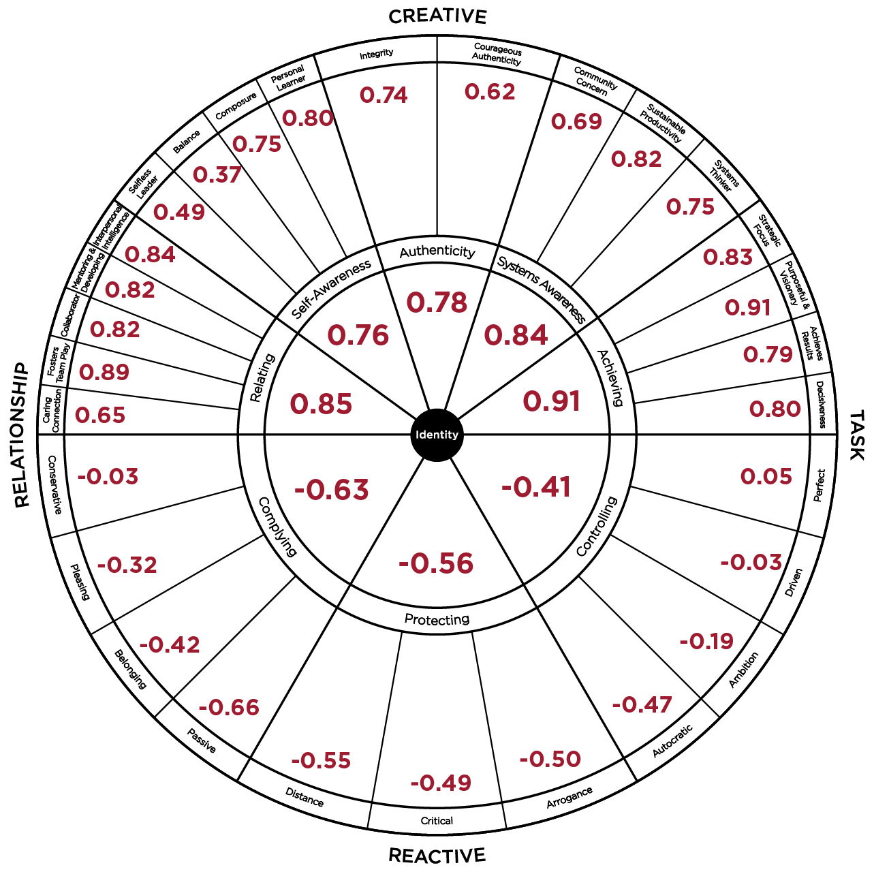
LCP Correlations to Leadership Effectiveness
ü
I am satisfied with the quality of leadership that
this leader provides.
ü
This leader is the kind of leader that others should
aspire to become.
ü
This leader is an example of an ideal leader.
ü
This leader’s leadership helps this organization to thrive.
ü
Overall, this leader provides very effective leadership.
Notes:
Learning Objective 1: for participants to understand that each of the 29 Creative/Reactive dimensions of the LCP have their own unique correlation to Leadership Effectiveness (the five Ideal Leader questions).
Learning Objective 2: for participants to look at their own LCP data through the lens of these more granular correlations to see if it generates any new developmental understanding or insight.
Learning Objective 2: for participants to imagine/brainstorm how they might use these correlations with their clients.

Slide 11
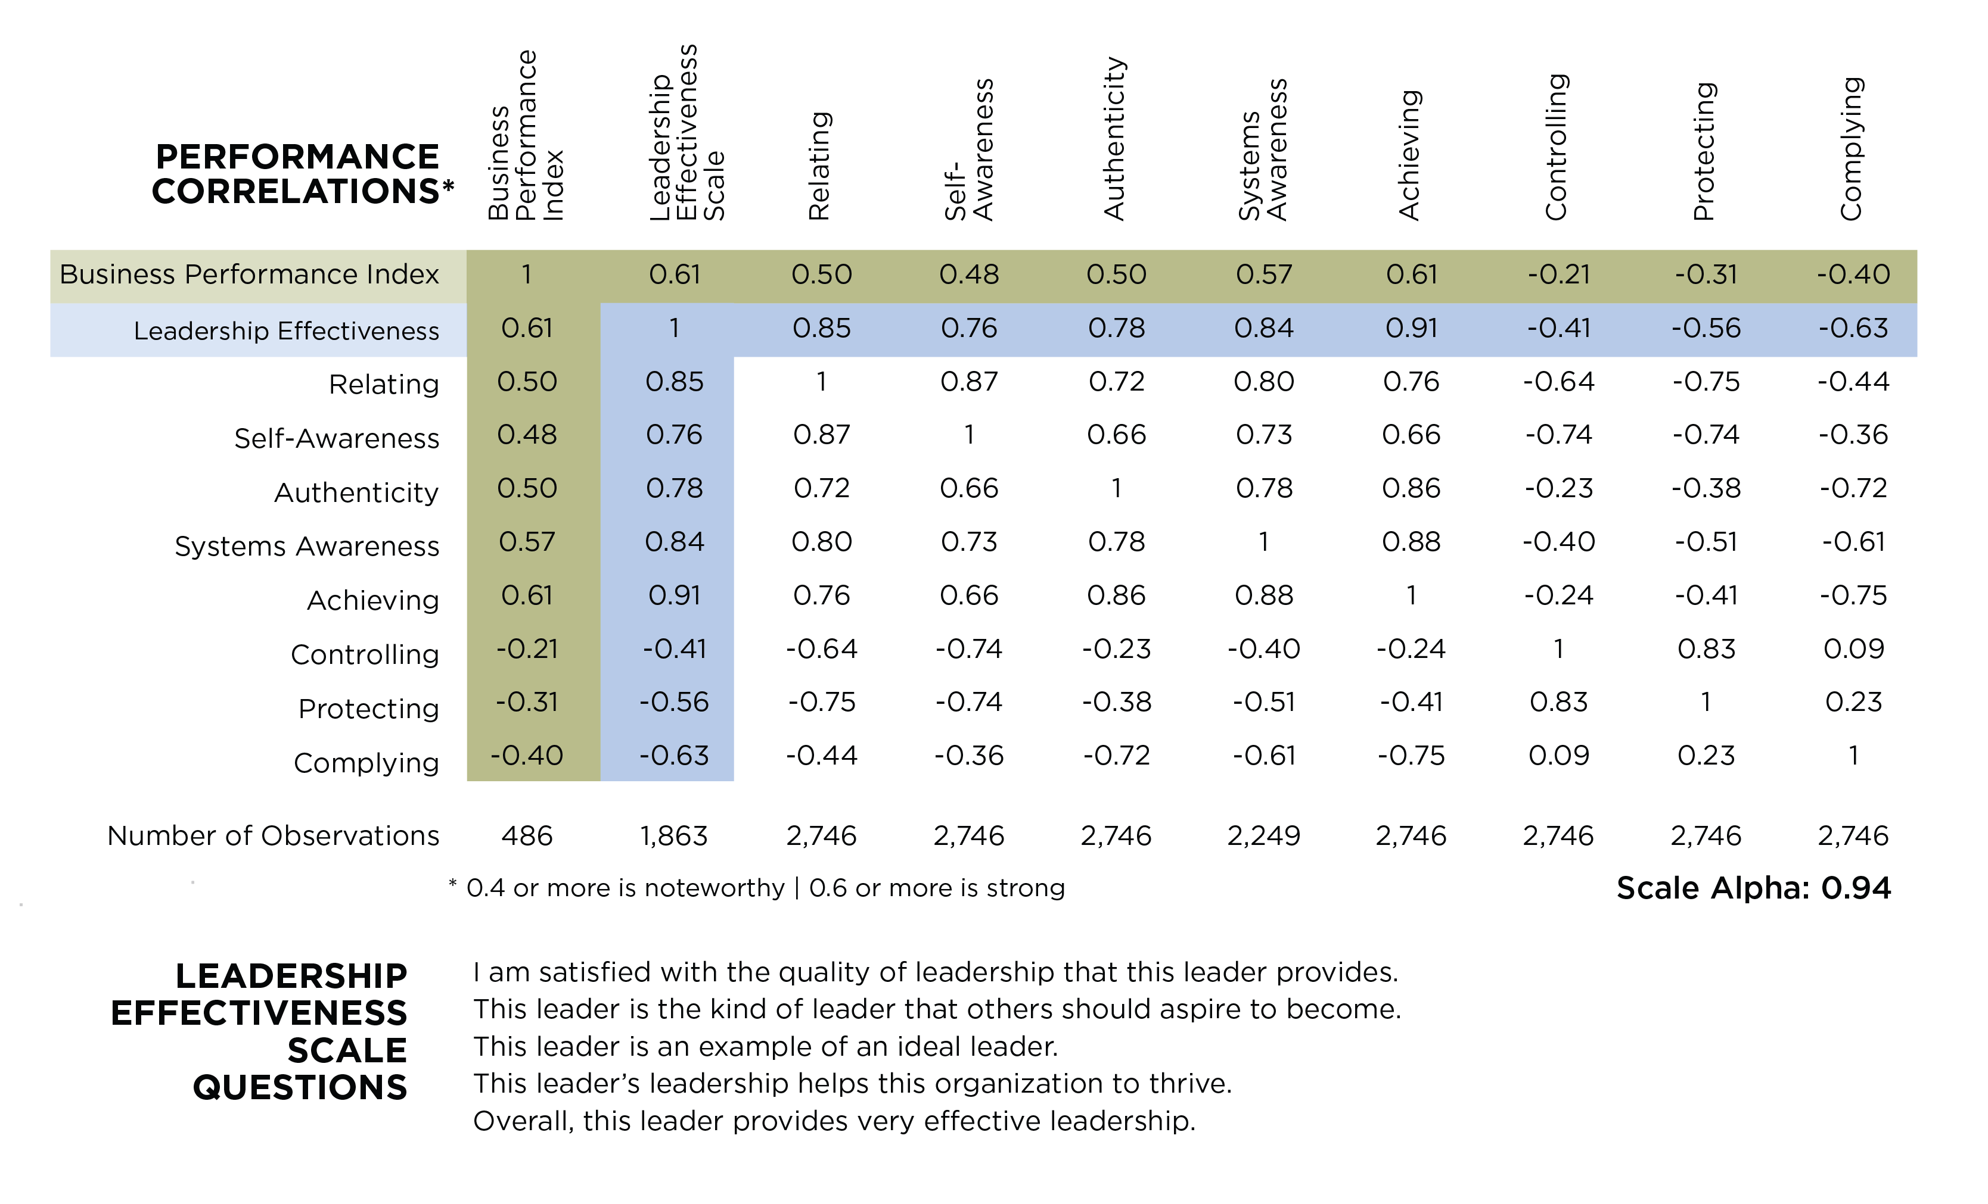
Notes:
Learning Objective 1: for participants to understand that each of the 29 Creative/Reactive dimensions of the LCP have their own unique correlation to Leadership Effectiveness (the five Ideal Leader questions).
Learning Objective 2: for participants to look at their own LCP data through the lens of these more granular correlations to see if it generates any new developmental understanding or insight.
Learning Objective 2: for participants to imagine/brainstorm how they might use these correlations with their clients.

Slide 12
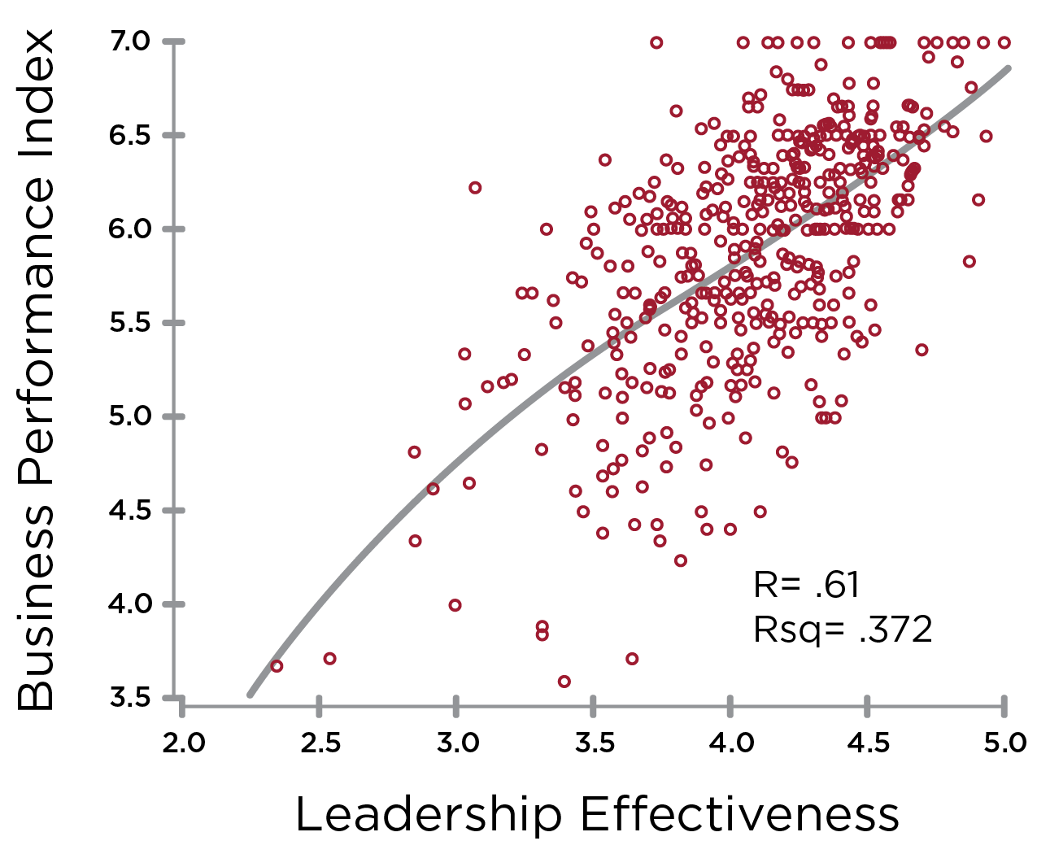
Leadership Effectiveness & Business Performance
Notes:
Learning Objective 1: for participants to understand the correlation between Leadership Effectiveness (measured by the five ideal leader questions) and Business Performance (measured by the six elements of the Business Performance Index).

