Slide 1
FEMA Region X Leadership Development Program
Group Session #2
Leading Through Change: Sustaining Energy
Mike O'Connor & Sandy Swider December 2020

Slide 2
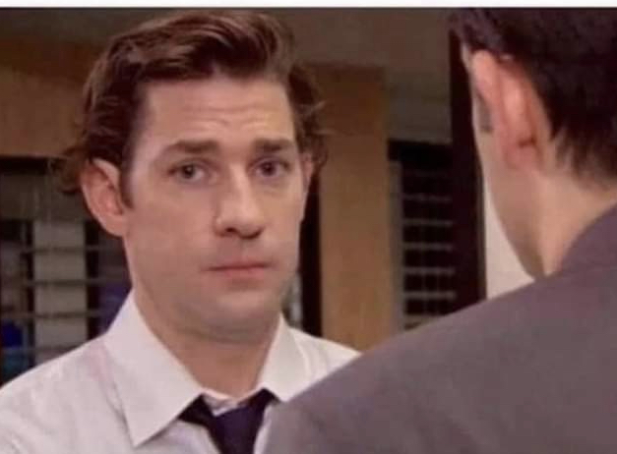
Every time someone uses the phrase “NEW NORMAL,” I look at an imaginary camera like this

Slide 3
Session Objectives:
Managing the Creative Tension that comes with change
Create intentional CREATIVE focus
Build energy to rally the team (and yourself)
Momentum
Alignment
Results
Notes:
INTRO….Group Sessions: Best Practices:
Best Practices
March 2020 – TLC moved all certifications to virtual.
Some of the lessons learned:
Mike REVEAL next slide…

Slide 4
Session Objectives:
Managing the Creative Tension that comes with change
Create intentional CREATIVE focus
Build energy to rally the team (and yourself)
Momentum
Alignment
Results
Explore “the differences that make the difference” in change-ready leaders
Notes:
INTRO….Group Sessions: Best Practices:
Best Practices
March 2020 – TLC moved all certifications to virtual.
Some of the lessons learned:
Mike REVEAL next slide…

Slide 5
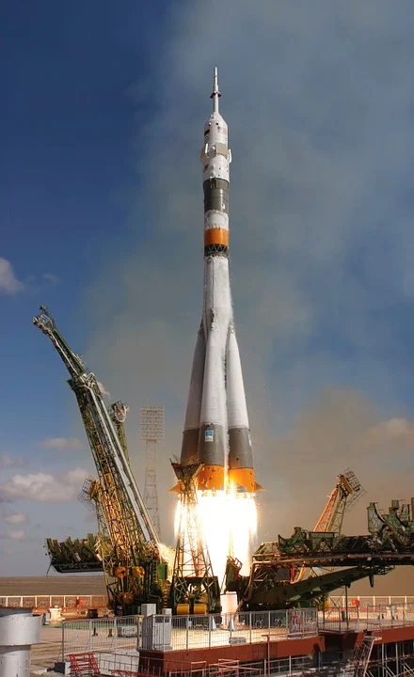
The Moonshot
Change requires leaning into two worlds, the current reality and the future.
The rocket is the metaphor for investing in Creative Leadership to get free of the gravity of your existing mindset or situation and get on course to reach the goal you desire – the moonshot!

Slide 6
The Moonshot
Change requires leaning into two worlds, the current reality and the future.
The rocket is the metaphor for investing in Creative Leadership to get free of the gravity of your existing mindset or situation and get on course to reach the goal you desire – the moonshot!
It’s an individual and collective mindset.
It’s an individual and collective transition.

Slide 7
Definition: Scaling Leadership: Creating the capability and capacity of the organization to create what matters most.

Slide 8
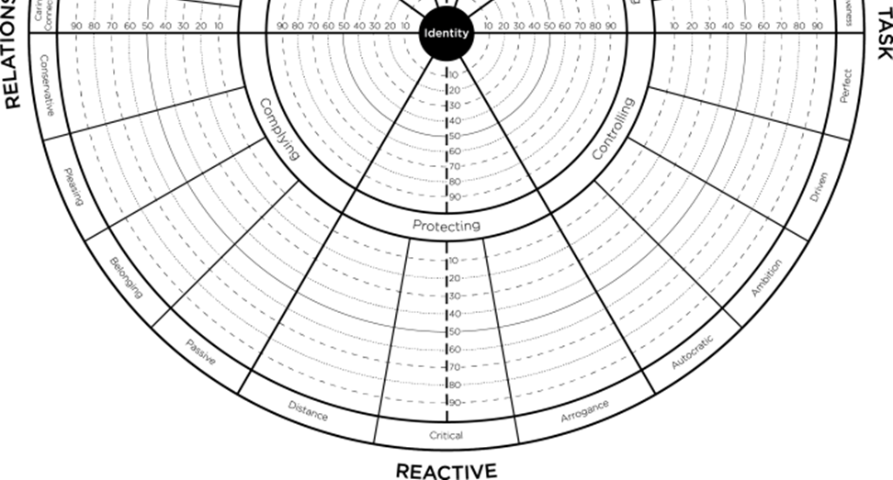
Reacting to Change
Complying
Protecting
Controlling

Slide 9
Tendencies: Self Talk
Reactive Mindset
Cling onto old stories or beliefs as a source of stability.
Martyr ourselves: get sucked into drama or negative self-talk.
Pretend that “this too shall pass”.

Slide 10
Tendencies: Self Talk
Reactive Mindset
Creative Mindset
Cling onto old stories or beliefs as a source of stability
Martyr ourselves: get sucked into drama, gossip or negative self-talk
Pretend that “this too shall pass”
Accept that old beliefs are no longer serving us (Systems Awareness)
Invest in our own resilience (mindset, health, interests) (Creative Mindset)
Confront the realities and plan accordingly (Authenticity)

Slide 11
Tendencies: Approach to Work
Reactive Mindset
Get swept along with the issue of the day
Tend to that which is right in front of you
Do it yourself, so it gets done right

Slide 12
Tendencies: Approach to Work
Reactive Mindset
Creative Mindset
Stay true to Vision and Purpose. Get clarity on the facts (Achieving)
Step back and look at long-term goals. Proactively tend to your energy levels (Systems Awareness).
Invest in others: Delegate, Train and Develop (Mentoring and Development)
Get swept along with the issue of the day
Tend to that which is right in front of you
Do it yourself, so it gets done right

Slide 13
Tendencies: Communication
Reactive Mindset
Wait until everything is settled down
Assume everyone gets it
Make decisions in isolation
Micromanage

Slide 14
Tendencies: Communication
Reactive Mindset
Creative Mindset
Wait until everything is settled down
Assume everyone gets it
Make decisions in isolation
Micromanage
Stay true to Vision and Purpose. Get clarity on the facts. Check in with team and share what is known. (Achieving)
Step back and look at long-term goals. Proactively tend to your energy levels (Systems Awareness).
Involve Others: Encourage diverse points of view (Sustainable Productivity)
Offer latitude: Define the destination, let others choose the route (Mentoring and Development)

Slide 15
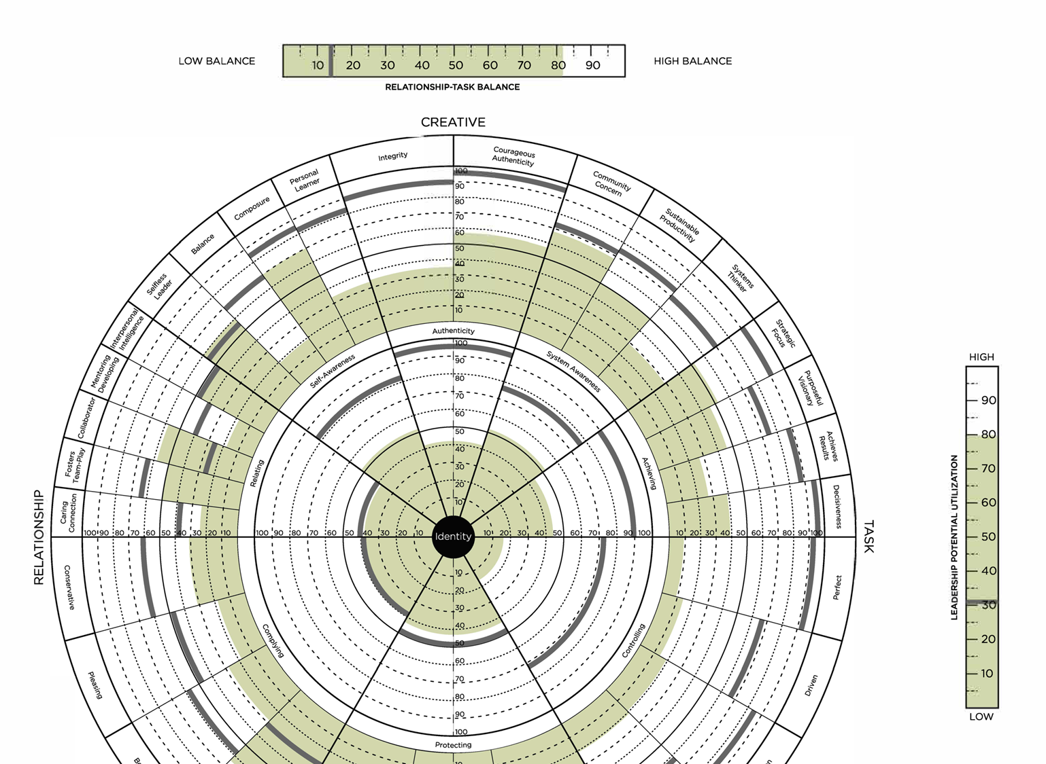
Small Group Breakouts:
Which Reactive Tendency is your “go to” when overwhelmed by change?
Which Creative Tendency could better serve?

Slide 16
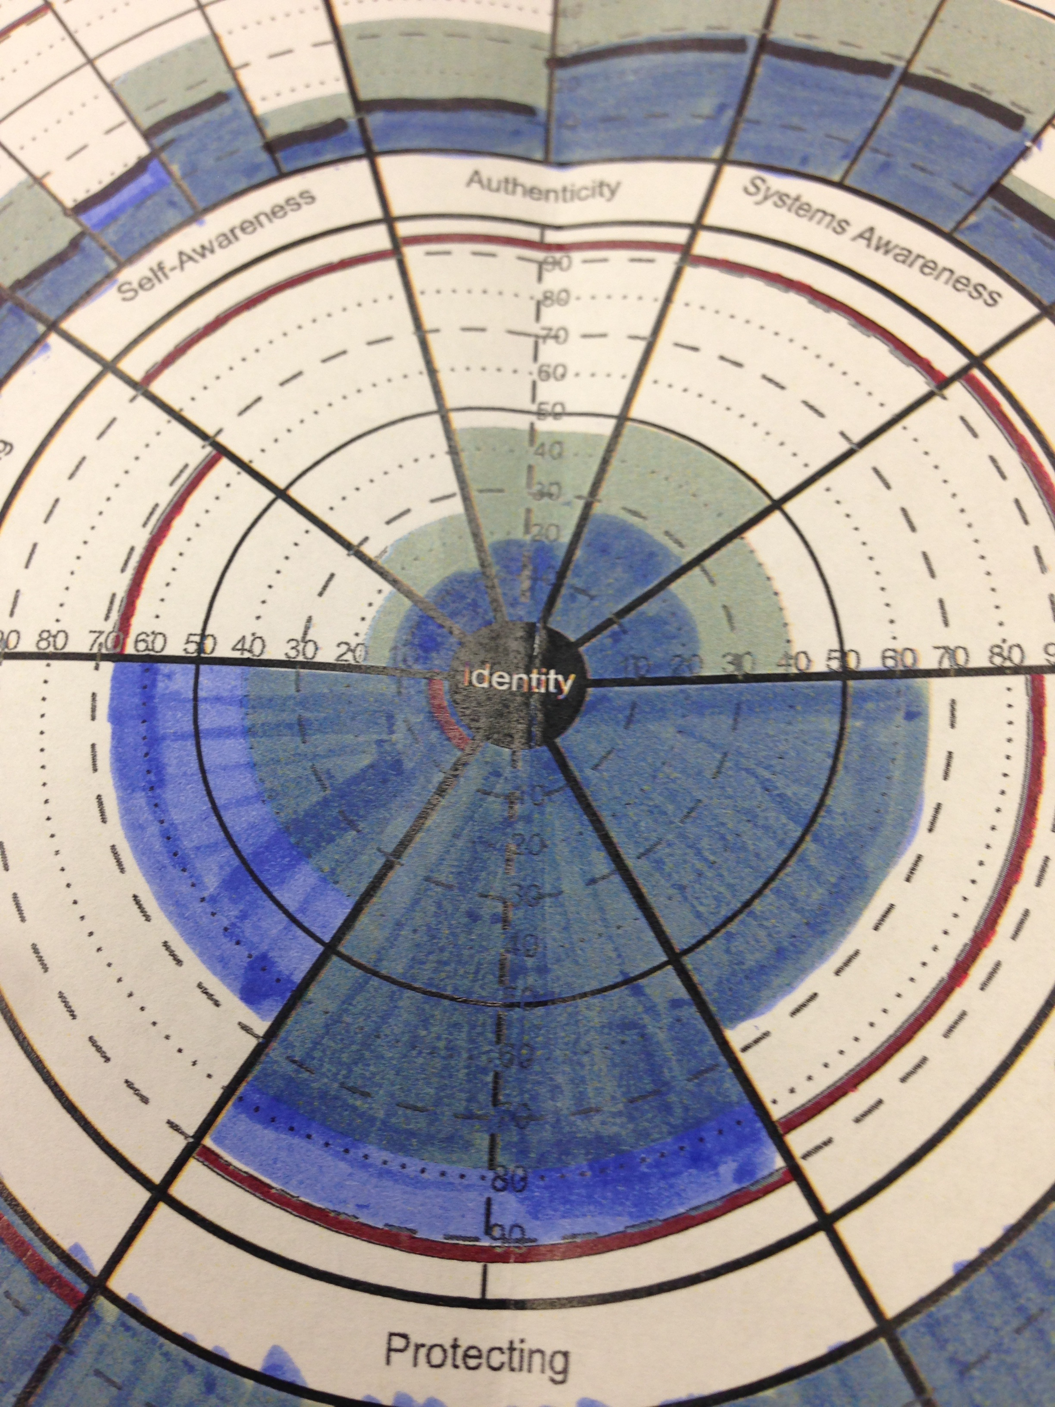
“As I was looking through my feedback last night, the angel of deathappeared…”
Notes:
Learning Objective 1: for participants to appreciate how humor can be a sign of some healthy Subject/Object differentiation (poking some fun at my own pattern). This can be useful in opening up more curiosity, compassion, and experimentation.

Slide 17
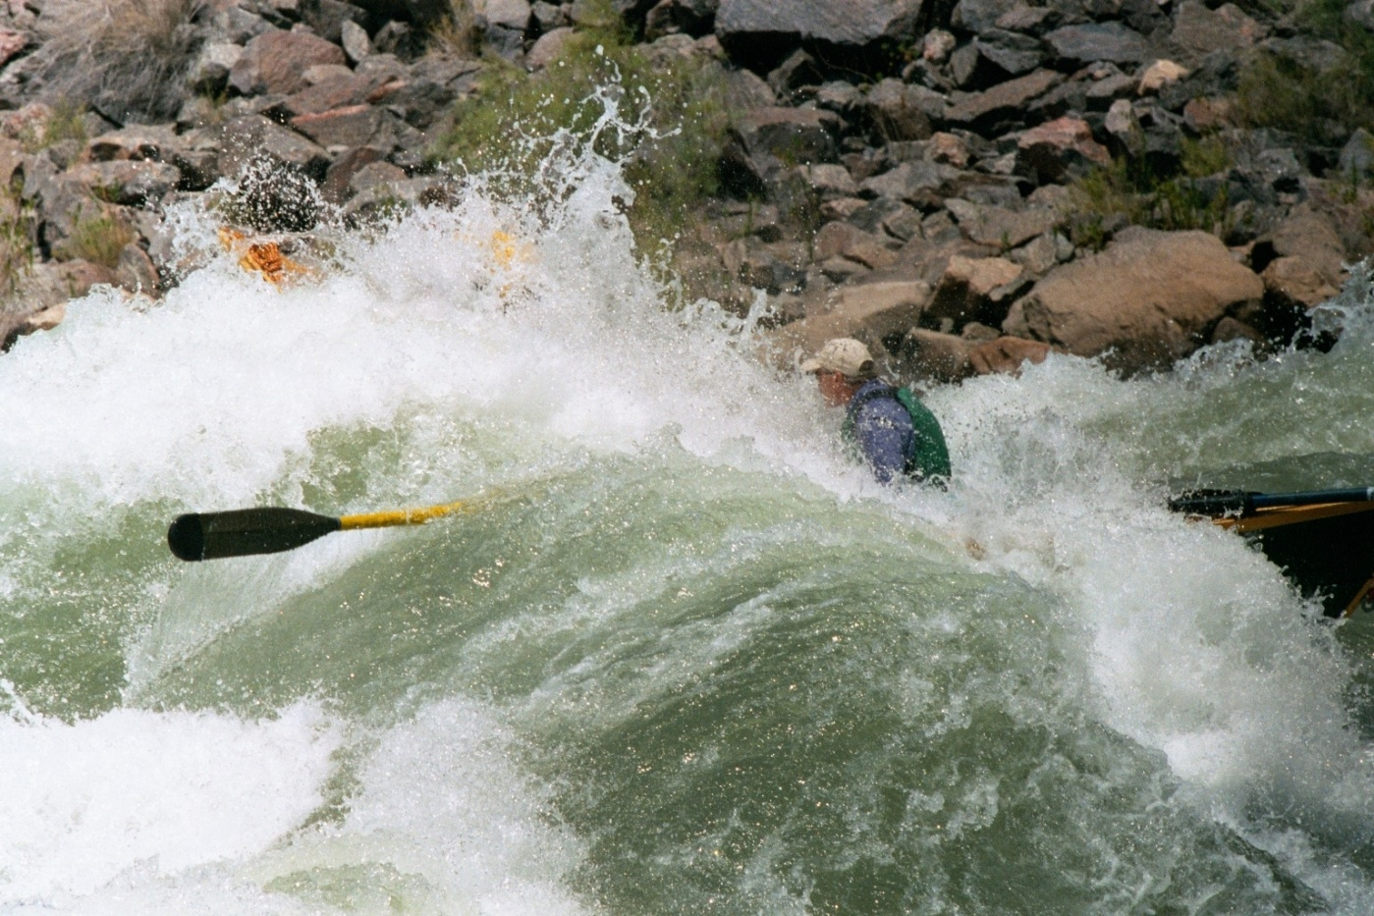
Sustaining Energy
Identify three things, activates, people or practices that give you energy.
> Plan to increase exposure here each day.
Identify three things that drain your energy.
> Make a plan to manage or eliminate.
Mindset: Think it into existence. The power of the mind is infinite.

Slide 18
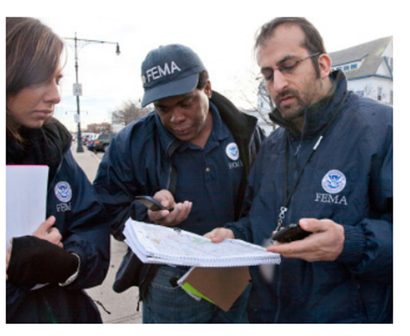
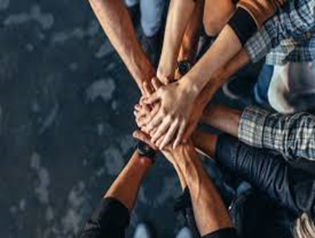
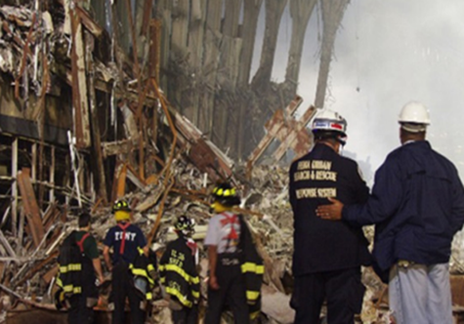
Energy Management Strategies
Create space to think
Say No
Catch people doing things right
Connect with the team
Find the “silver lining”
Assume positive intent
Reward successes, and good attempts
Decide when “good enough” is good enough

Slide 19
“One of the most sincere forms of respect is actually listening to what another person has to say” Bryant McGill
Notes:
One on One - Leadership Circle Debrief:
Orientation to Model Prior
Email Feedback Reports and Profile Interpretation Manual
Mike Screen Shot
Screen Sharing

Slide 20
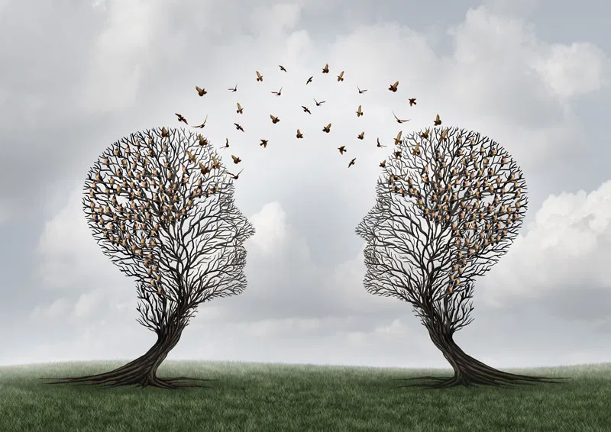
Four Levels of Listening
Distracted
Self-Centered
Active
Intuitive

Slide 21
Listening as a Leader
Mindset
Inquiry
Echoing
Empathizing
Clarifying
Summarizing

Slide 22
Listening as a Leader
While avoiding the Toxins:
- Criticism
- Contempt
- Defensiveness
- Stonewalling
Mindset
Inquiry
Echoing
Empathizing
Clarifying
Summarizing

Slide 23
Listening as a Leader
While avoiding the Toxins:
- Criticism
- Contempt
- Defensiveness
- Stonewalling
Capture your insights… for an
upcoming group discussion
Mindset
Inquiry
Echoing
Empathizing
Clarifying
Summarizing

Slide 24
Set intention to “seek to understand”
Be fully present, nonverbals
Withhold judgement
Do not think about your response
MINDSET
Complying
Conservative
Belonging
Pleasing
Passive
Leadership Circle

Slide 25
Invite speaker to elaborate
Ask open ended questions
Ask follow-up questions
INQUIRY
Complying
Conservative
Belonging
Pleasing
Passive
Leadership Circle

Slide 26
Restate the basic ideas
Remain neutral – don’t agree or disagree
Ensure your understanding
ECHOING
Complying
Conservative
Belonging
Pleasing
Passive
Leadership Circle

Slide 27
Acknowledge facts and feelings
Suspend judgement
Remain neutral
Promote cooperation
EMPATHIZING
Complying
Conservative
Belonging
Pleasing
Passive
Leadership Circle

Slide 28
Elicit additional information
Ask questions for understanding
Ask for examples, as needed
CLARIFYING
Complying
Conservative
Belonging
Pleasing
Passive
Leadership Circle

Slide 29
“The key theme of what you are sharing seems to me to be…”
“…. Is there anything else you’d like me to know?”
SUMMARIZING
Complying
Conservative
Belonging
Pleasing
Passive
Leadership Circle

Slide 30
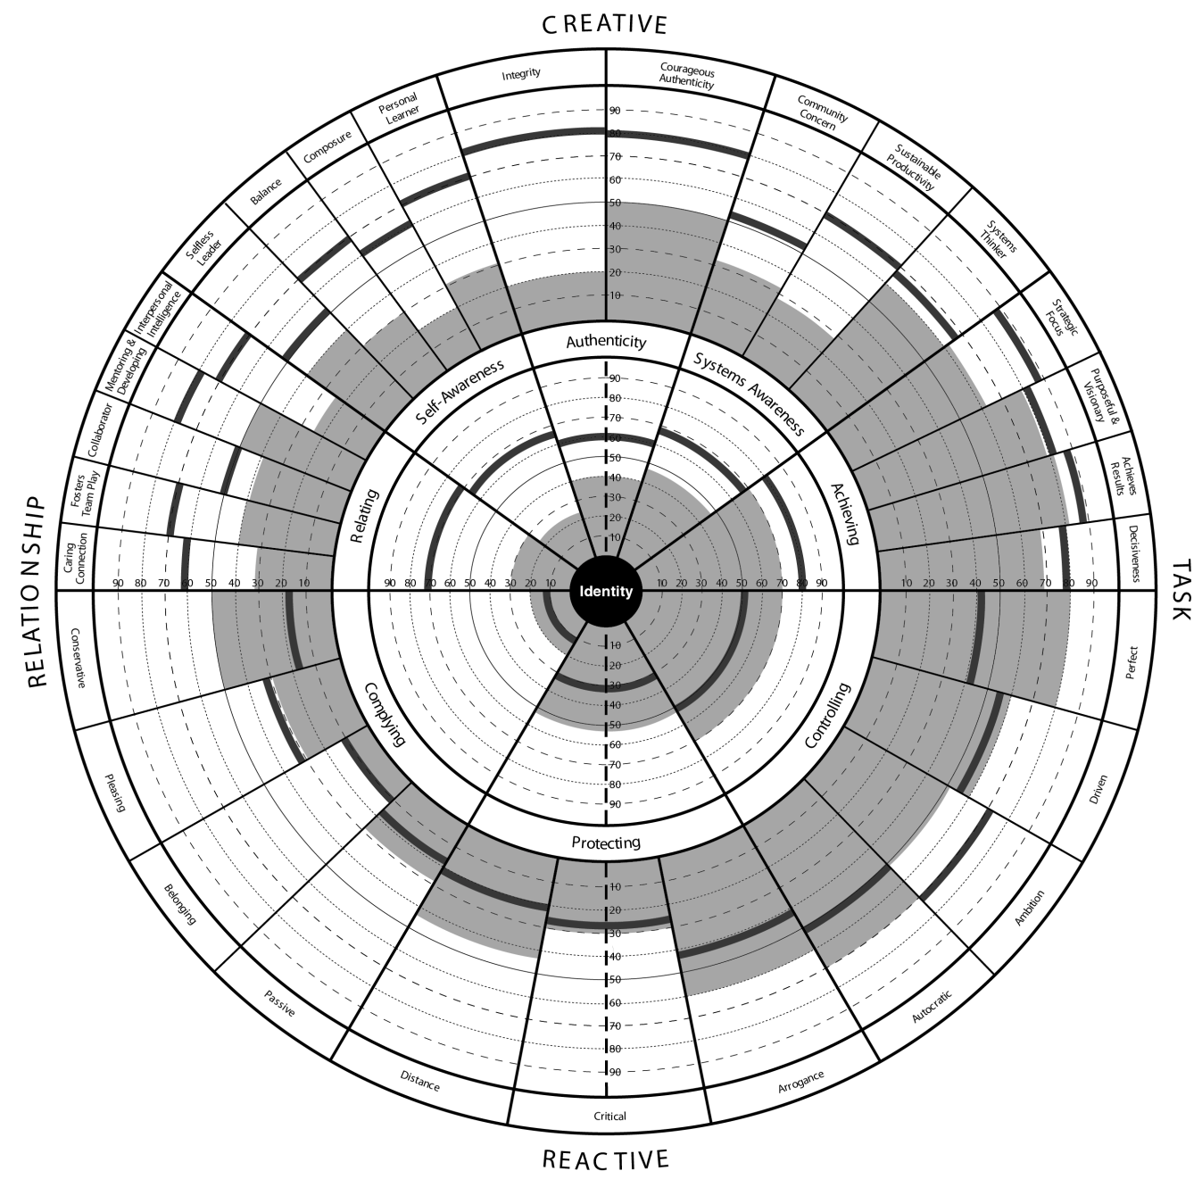
Breakout Discussion Think about an important upcoming discussion.

Slide 31
Breakout Discussion Think about an important upcoming discussion. > Which TOXIN do you intend to avoid? > Which listening strategies could best serve you?

Slide 32
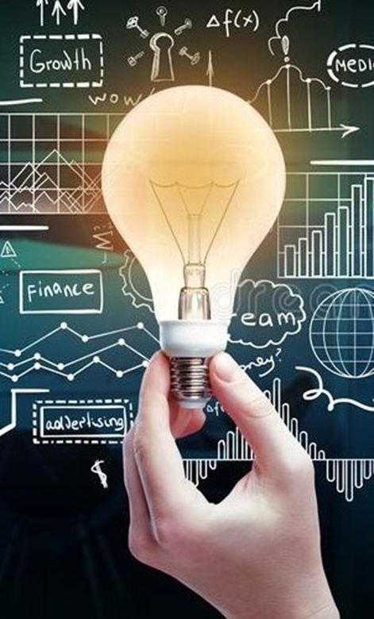
Insights?
Notes:
Learning Objective 1: for participants to appreciate how humor can be a sign of some healthy Subject/Object differentiation (poking some fun at my own pattern). This can be useful in opening up more curiosity, compassion, and experimentation.

Slide 33
Session Objectives:
Managing the Creative tension that comes with change
Create intentional CREATIVE focus
Build energy to rally the team (and yourself)
Momentum
Alignment
Results
Capture Key Insights in your Leadership Development Plan
Creative Mindset
Self Talk
Approach to Work
Communication
Energy Management
Listening
Utilize Resources on the FEMA Leadership Development Site

Slide 34
The energy required to create velocity.
The difference is that with the slingshot you are pulled back before you go forward and this is often true in life.
It is that often a setback that creates the energy to throw us forwards to bigger and better things.
We have a choice, to stay down or use that experience as the energy to project yourself forward

Slide 35
Thanks for showing up. Until next time…

Slide 36
Remaining Slides are for
Review Purposes

Slide 37
Creative Competencies
Authenticity
-Integrity
-Courageous Authenticity
Self Awareness
-Selfless Leader
-Balance
-Composure
-Personal Learner
Systems Awareness
-Community Concern
-Sustainable Productivity
-System Thinker
Relating
-Caring Connection
-Fosters Team Play
-Collaborator
-Mentoring & Developing
-Interpersonal Intelligence
Achieving
-Strategic Focus
-Purposeful & Visionary
-Achieves Results
-Decisiveness

Slide 38
Create your Story: Creative and Reactive
Creative:
When Creative, we are focused on Mission, Purpose, things we love and care about
Focus on long- term impact, truly scaling capacity and capability
We are working in collaboration with others and in a “playing to win” mindset (Engaging, Inspiring, Unleashing)
We are mindful of what people want or need in leadership
Less dependent on the outside for validation
We can work more autonomously in collaboration without all the fear, aggression or self-protection

Slide 39
Reactive Tendencies
Complying
Controlling
-Conservative
-Pleasing
-Belonging
-Passive
-Autocratic
-Ambition
-Driven
-Perfect
Protecting
-Distance
-Critical
-Arrogance

Slide 40
Create your Story: Creative and Reactive
Reactive:
The Reactive is running our strengths from a reactive place… a play it safe or “play not to lose” manner
One’s validation (safety, affirmation, self-worth) comes from OUTSIDE of them (from others, from results, from being in the know). “I am looking to you for validation”
There are gifts, much of it has been well earned and part of one’s journey; they have contributed to where a leader is today. One can take advantage of the “gifts” if used with intention
Will get short-term results (so, it has a place. And can be quite compelling during times of stress or uncertainty)
Here, we are still able to get results, but it comes from a place of fear, self-protection or risk aversion

Slide 42
Maintain or Grow?
Problem - Reacting
Outcome - Creating
Problem
Threat
Purpose
Vision
Passion
Fear
Passion
Fear
Action
Reaction
Action
Reaction
Effectiveness
Effectiveness
Time
Time
Containing
Unleashing

