Slide 1

Die bewusste Praxis der Führung entwickeln

Slide 2
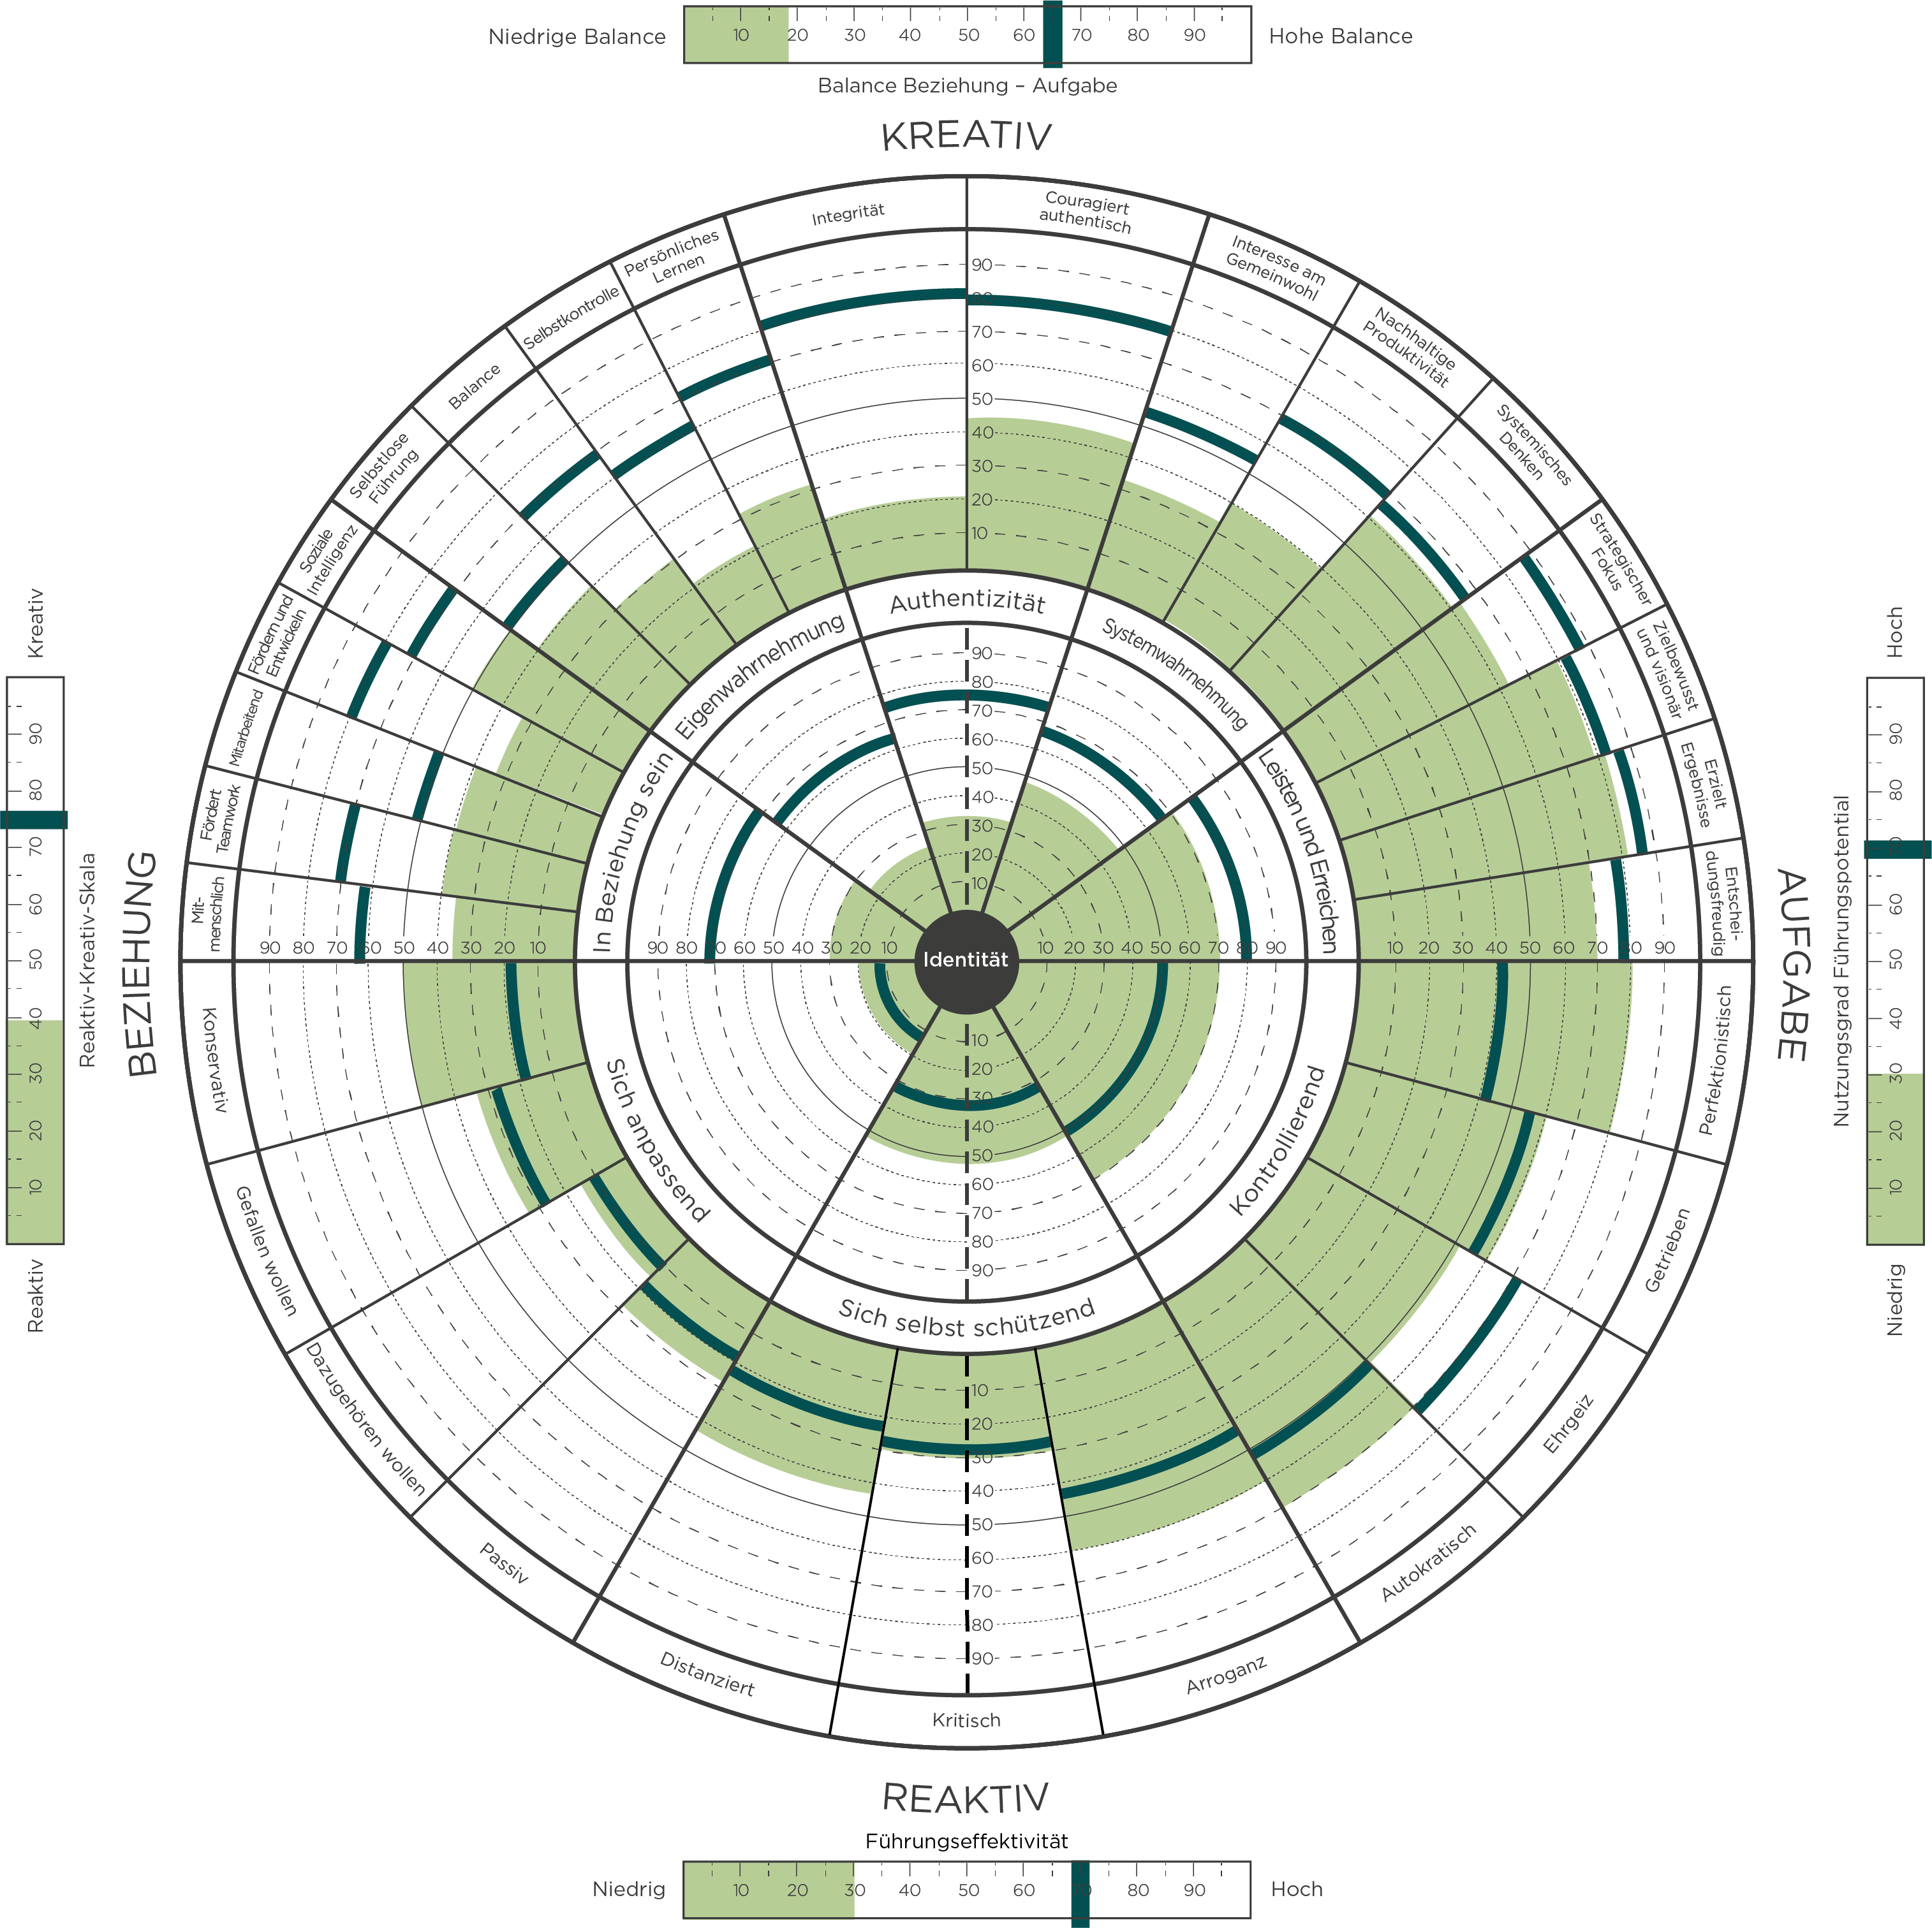

Notes:
Learning Objective 1: for participants to understand the Reactive Creative scale measures the degree that a person’s leadership is experienced by others primarily through their Creative Competencies (high score) or through their Reactive Tendencies (low score) or some combination of the two (medium score).
Learning Objective 2: for participants to understand that this summary measure is a good indication of where a person spends their leadership energy and bandwidth.
Learning Objective 3: for participants to understand that this score reflects the visual of the graph. Lots of green on the top with little green on the bottom (high score). Little green on the top with lots of green on the bottom (low score). Mix of green on both top and bottom (medium score).

Slide 3
Das Leadership Circle Profile
Universelles Leadership Beratungsmodell
Das weltweit einzige vollständig integrierte Führungsmodell und -instrument
Mehr als 125.000 Führungskräfte haben das Leadership Circle Profile in ihrer Entwicklung genutzt
Mehr als 14.000 zertifizierte Anwender weltweit
Mit Erfahrung in über 1.400 Organisationen weltweit, darunter Fortune 500-Unternehmen, gemeinnützige Organisationen und Unternehmen aller Branchen
Notes:
MO

Slide 4
360º Assessment Tool
Was ist ein 360º-Assessment?
Vorteile
Eine Bewertung auf Grundlage von in der Forschung nachgewiesenen Führungseigenschaften und -dimensionen
Ein Fragebogen, sowohl für die Führungskraft (sich selbst) als auch für andere (Bewerter)
Vertrauliches Feedback
Eine Grundlage für weiteres Coaching und Entwicklung
Konzentriert die Entwicklung auf Schlüsselkompetenzen
Identifiziert Stärken, um darauf aufzubauen
Zeigt die Auswirkung Ihres Führungsstils auf andere
Bringt Lücken in der Wahrnehmung zum Vorschein
Verknüpft Denken und Verhalten
Reduziert die Gefahr von Entgleisungen
Notes:
MO

Slide 5


Zwei Geistesstrukturen
Problemorientiert – Reagierend
Ergebnisorientiert – Erschaffend
Problem
Bedrohung
Ziel
Vision
Getrieben von Furcht
Bewahrt Identität
Setzt Potenzial frei
Entfaltet Identität
Reaktion
Angst
Aktion
Leiden
-schaft
Ergebnisse
Ergebnisse
Zeit
Zeit
Ausgleichende/Pendelnde Kurve
Wachstums / Produktive Kurve
Notes:
Learning Objective 1: for participants to understand the two structures of mind (metaphorically, the two operating systems) that generate very different experiences of life and leadership.
Learning Objective 2: for participants to see the pattern of reaction is what they just got a glimpse of in the Gravity Stick exercise (their particular physical, emotional, cognitive, behavioral, and narrative routine).
Learning Objective 3: for participants to understand that the core function of the Reactive iOS is to contain anxiety and the core function of the Creative iOS is to unleash potential.

Slide 6
Drei Leadership Assessment-Kategorien
Kompetenzen
Kompetenzen
Annahmen
Annahmen
Style-Type-Personality
Stil / Typ / Persönlichkeit
Notes:
First, You can measure Competencies—this is the most common choice for organizations.
Competencies tell you what is going on with key behaviors that impact your ability to achieve results. An example of a competency might be Strategic Focus or Collaboration. A competency describes a positive leadership behavior, but does not answer the question ‘”What it going on under the surface that supports or inhibits these key behaviors”? Examples of competency assessments include Benchmarks, PDI and Lominger.
(Click) The next choice for assessments measure what’s going on under the surface. These are self-awareness tools that measure the internal motivations that drive behavior. These tools are very useful if they help managers get insight into why they are behaving in certain ways. However, these tools seldom show any direct connection to competencies or measures of effectiveness in leadership. Tools in this category include Hogan, FIRO-B, and Emotional Intelligence.
(Click) And finally, in the third category you have Tools that measure Style and Personality. These tools are mostly used to help managers and teams understand their differences, but these tools fail to clarify how Style and Personality impacts competencies or business results. Tools in this category include Meyers Briggs or Disc.
With any of these tools, used separately, you are getting, at best, a third of the whole picture. If you are serious about leadership development—you need to help managers get the whole story. Otherwise, It’s like trying to see with one eye closed…. (CLICK) With the LCP you get the full picture of your leadership – 3 assessments in one

Slide 7
Was passiert
Warum passiert es
Der Weg zur Veränderung
Notes:
With the LCP you get the full picture of your leadership. At last, you see, in one assessment, what you are missing in all the others. TLC is unique because it measures
-- (Click) Leadership competencies
--(Click) Assumptions that drive Behavior
Assumptions that lead to effectively developing key leadership competencies
Assumptions that run reactive, self-limiting behavior.
-- (Click) and LCP reveals style and personality…all at the same time.

Slide 8

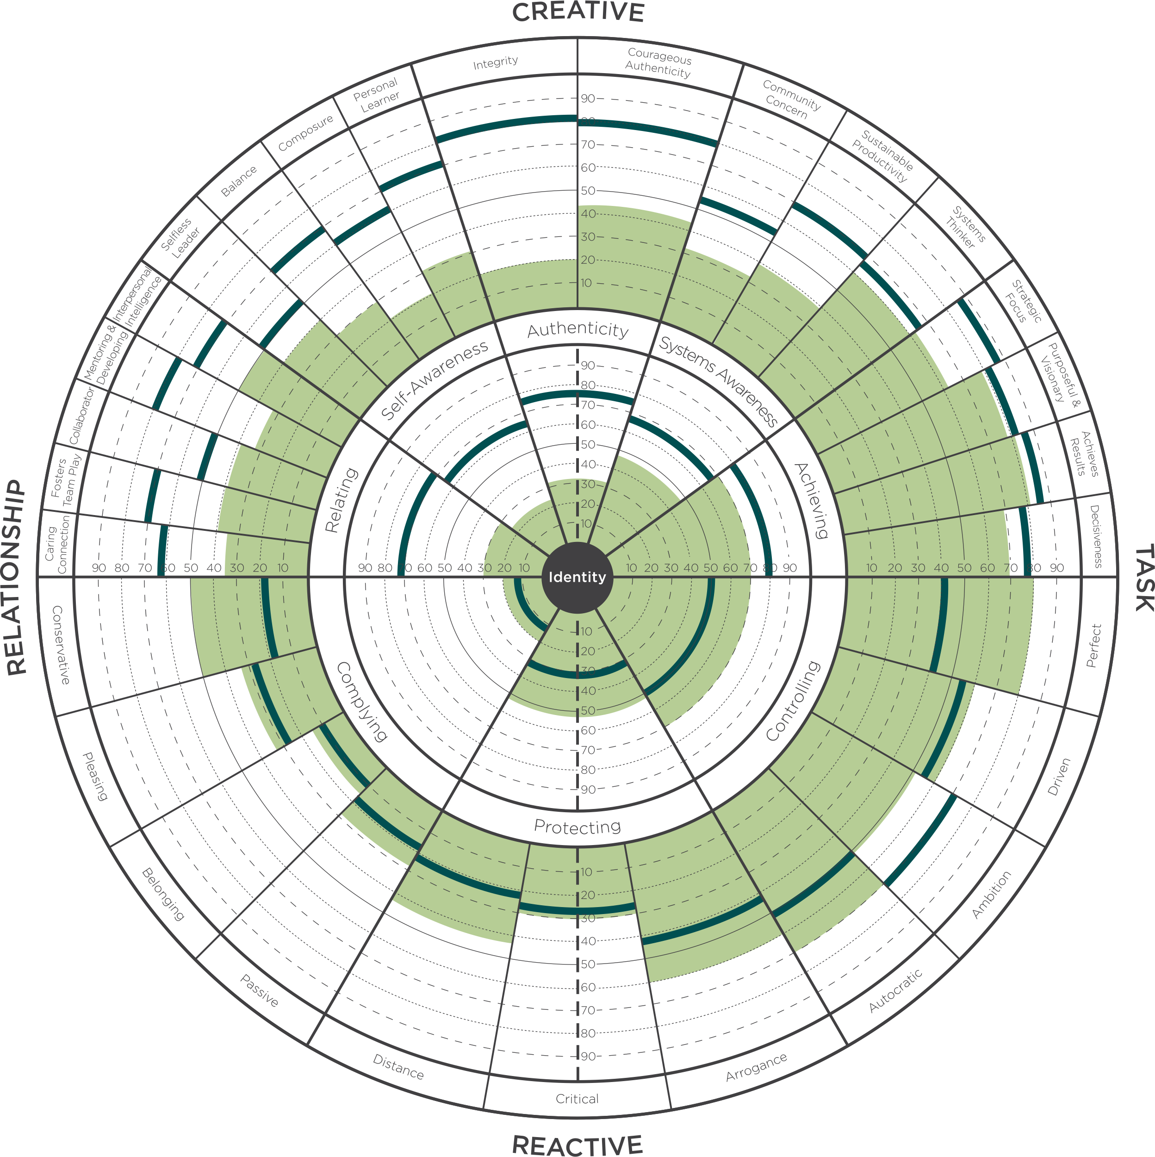
Die Modell-Grundlage: Zwei Geistesstrukturen

Slide 9
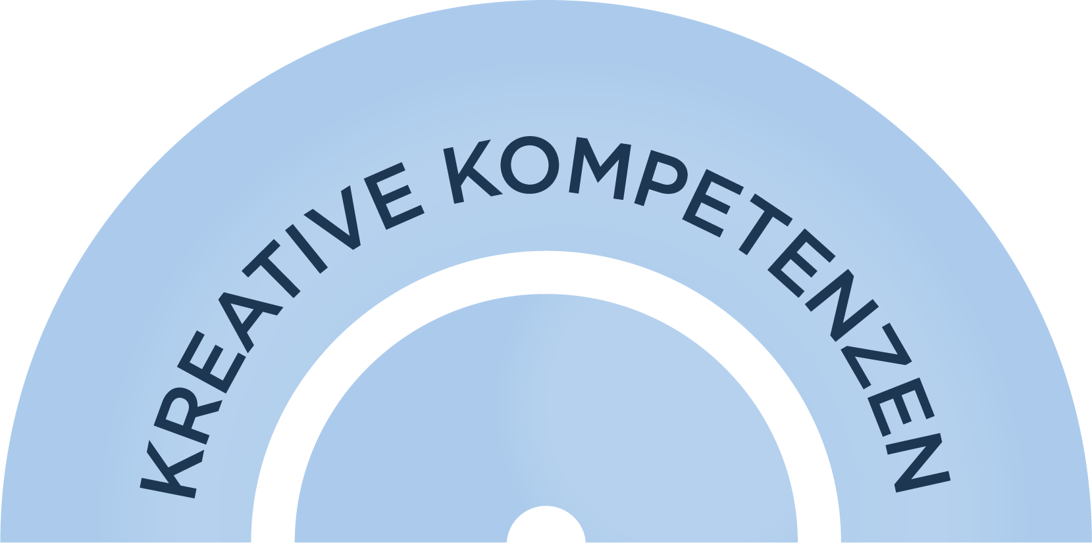

Kreative Kompetenzen
In Beziehung sein
Systemwahrnehmung
Mitmenschlich
Fördert Teamwork Mitarbeitend
Fördern und Entwickeln Soziale Intelligenz
Interesse am Gemeinwohl
Nachhaltige Produktivität
Systemisches Denken
Eigenwahrnehmung
Leisten und Erreichen
Selbstlose Führung
Balance
Selbstkontrolle
Persönliches Lernen
Strategischer Fokus
Zielbewusst und visionär
Erzielt Ergebnisse
Entscheidungsfreudig
Authenticity
Integrität
Couragiert authentisch

Slide 10



Reaktive Tendenzen
Sich anpassend
Konservativ
Gefallen wollen
Dazugehören wollen
Passiv
Sich selbst schützend
Distanziert
Kritisch
Arroganz
Kontrollierend
Autokratisch
Ehrgeiz
Getrieben
Perfektionistisch

Slide 11
Beziehung und Aufgabe

Slide 12
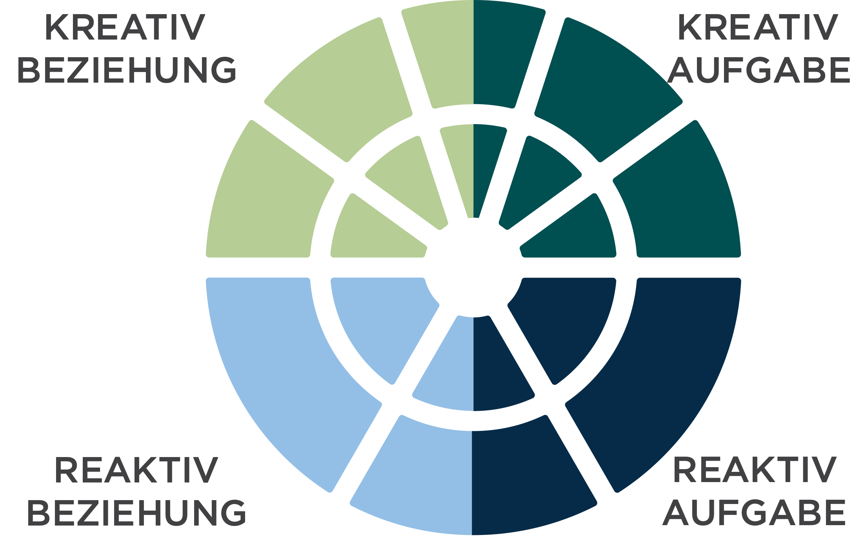
Vier
Quadranten

Slide 13
5 innerer Kreis
Kreative Zusammenfassende Dimensionen
18 äußerer Kreis
Kreative Führungskompetenzen

Slide 15
3 innerer Kreis
Reaktive Zusammenfassende Dimensionen
11 äußerer Kreis
Reaktive Tendenzen

Slide 17
Reaktiv-Kreativ
Skala
Notes:
Learning Objective 1: for participants to understand the Reactive Creative scale measures the degree that a person’s leadership is experienced by others primarily through their Creative Competencies (high score) or through their Reactive Tendencies (low score) or some combination of the two (medium score).
Learning Objective 2: for participants to understand that this summary measure is a good indication of where a person spends their leadership energy and bandwidth.
Learning Objective 3: for participants to understand that this score reflects the visual of the graph. Lots of green on the top with little green on the bottom (high score). Little green on the top with lots of green on the bottom (low score). Mix of green on both top and bottom (medium score).

Slide 18
Balance Beziehung – Aufgabe
Notes:
T
Learning Objective 1: for participants to understand the Relationship Task Balance Summary Scale, in particular, that the scale is measuring the relative balance between the Achieving competencies and the Relating competencies and it is not measuring the strength of either dimension.
Learning Objective 2: for participants to understand the sensitivity of this scale increases as the scores for Relating and Achieving reach the higher percentiles. A difference of a very small amount between those two dimensions at the higher ends of the percentile scale (80th percentile or above) will report what seems like an exaggerated lack of balance in the R-T scale. In these cases, it is easy to just look at the inner circle graph and look at Achieving and Relating.

Slide 19
Nutzungsgrad Führungspotential
Notes:
A
Learning Objective 1: for participants to understand that Scoring high here means that when all the dimensions are taken together, the strengths outweigh the weaknesses. High scores indicate there is significant strength in the Creative dimensions and relatively low scores in the Reactive dimensions as well as good balance between people competencies and task competencies. Scoring low suggests that when all the dimensions are taken together, the weaknesses outweigh the strengths. It means that there is more energy going in the reactive direction than in the creative and/or that there is an imbalance in people and task competencies.
Learning Objective 2: for participants to understand the Leadership Potential Utilization Scale is mathematically derived by multiplying the Relationship Task Balance score by the Reactive Creative score and showing the result as a percentile.
Learning Objective 3: for participants to understand that a useful developmental lens on this score is how much development should I consider in my current role? A low score suggests there are lots of developmental opportunities in current role and the challenge will be choosing the most relevant ones. A middle score suggests there are a few critical areas of development that if leveraged successfully would make a big difference in leadership effectiveness in the current role. A high score here may indicate that it would be beneficial to imagine the challenges of the next role (one with more scale, scope, and complexity) and focus developmental effort there.

Slide 20
Skala
Führungseffektivität
Notes:
T
Learning Objective 1: for participants to understand the Leadership Effectiveness Scale reflects the answers to the five ideal leader questions on page 86 of the Profile Interpretation Manual and Slide 57 in this deck. The raw scores are shown on page 2 of the LCP report and the percentile scores are shown on page 3 of the LCP report.
Learning Objective 2: for participants to understand that this score is often a significant attention getter in a debrief particularly when the Self score is significantly different from the All Evaluators score and/or when the score is quite low.

Slide 21
Führungseffektivität & Geschäftsergebnisse

Slide 22







Reaktive und Kreative
Führung
UNITIV
Im Bezug auf Entwicklung im Erwachsenenalter
INTEGRAL
Sich selbst transformierender Geist
KREATIV
Sich selbst hervorbringender Geist
REAKTIV
Zwischenmenschlicher Geist
EGOZENTRISCH
Notes:
These notes below complement those in the Appendix II in the Leaders’ Guide. Please study: 1) the Leaders’ Guide Appendix; 2) the notes below; and 3) the Mastering Leadership book (pp.61-86). The quotes below are lifted directly from the book as an aid to enriching your lecture.
*Note: Each advancement in the journey from one stage to the next transcends and includes the previous stages
Stage 2: Egocentric (Self-Sovereign Mind)
Roughly from 8 years of age until adolescence ends in early adulthood
“This identity does not notice other’ (often competing) needs.” (p.63)
“Kegan calls this stage “Self-Sovereign” because at this stage our needs are primary (Kegan and Lahey, 2009)” (p.63)
“The strength of egocentricity is the capacity to get our needs met and gain independence. We can defer impulse gratification long enough to plan and organize to meet our needs.” (p.63)
“Meeting our own needs is subject, meaning, we are not aware that we are defined by meeting our needs.” (p.63)
“We are not yet separate from our own needs to manage them—they manage us.” (p.63)
“We do not make decisions based on the impact of our behaviour on others with whom we are in relationship (no Mutual Perspective Taking). We make decisions primarily on what will happen to us if we please or displease others. For example, if we tell a lie, our concern is not about the loss of trust or the feeling of others, but about the consequences to us if they catch us in the lie and whether or not we can risk those consequences.” (pp.63-64)
“The absence of a shared reality is the structural limit of this phase.” (p.64)
“Growth at this phase is taking other’s needs and expectations into account…As this happens, our needs move from subject to object…A subject-object shift moves that to which we were formerly subject to an object of reflection. We are then no longer subject to that limited understanding of ourselves and the world…More behavioural options are available.” (pp.64-65)
“About 5% of leaders who do not fully make this transition and continue to operate with an Egocentric Mind tent to be autocratic and controlling—‘My way or the highway.’” (p.65)
“Unquestioned loyalty to the leader, not the organization, is the first priority. The organization and its employees exist to serve them.” (p.65)
Stage 3: Reactive (Socialized Self) – Kegan “Triumph of development”
As people transition from the Egocentric stage into the Reactive stage, the learn that “…if they want to get on in the world, they need to take on its rules, values, expectations, and ways of operating.” (p.66)
“The developmental challenge of the Reactive Mind is to merge with society.” (p.66)
“This ability to take up membership, to work and live co-relationally with others and within organizations, is the triumph of this stage of development. It enables us to build a life of meaning, self-worth, and security. This is the strength of this stage, and also the liability.” (p.66)
“As we embrace the Reactive Mind, we build our new identity by living up to and into the expectations of others and the culture. Messages and expectations from key influences, institutions and individuals shape who and what we become. …We craft our identity in harmony with these expectations. We internalize them and define our personal worth and security by living up to them.” (pp.66-67)
“We define ourselves, not from the inside out, but from the outside in. Our externally validated sense of self-worth and security are in others’ hands; thus, we must live up to their expectation in order to feel successful, safe, and worthwhile.” (p.67) (External locus of control
“My worth and security = X (where X is a strength) (p.70
I am my work. I am my relationships. They define me. I am my house, my car, my clothes, my achievements.
Lots of achievements: building domain expertise, skills and competencies, influence, momentum, etc. Very positive phase of growth.
75% of managers operate out of a Reactive iOS
The transition from Reactive to Creative is the Hero’s Journey* and requires the shedding of “…some old assumptions that have been running us all our lives; and second, we initiate a more authentic version of ourselves as we shift from Reactive to Creative.” (p.75)
Stage 4: Creative (Self-Authoring Mind)
“By shedding well-patterned assumptions, we start to see the habitual ways of thinking that we adopted while growing up that were socialized into us. These embedded habits of thought form the core of the Reactive iOS. They have served us well and are now reaching operational limits. They are not complex enough for the complexity of life and leadership into which we have grown.” (p.75)
“The central questions of the Independent, Self-Authoring, Creative Mind are: ‘Who am I? What do I care most about? What do I stand for? How can I make my life and my leadership a creative expression of what matters most?’ (p.75)
This stage marks the shift to an internal locus of control.
“We begin to orient our life and leadership less on what we assumed was expected of us as we grew up and more out of our own deeper sense of personal purpose and vision. Transitioning to the Creative Self is the major transition in adult life and leadership.” (p.76-77)
This new self is configured from the inside out, rather than outside in, for the first time.
“Vision springs from within. Action becomes an authentic expression of an emerging sense of inner purpose.” (p.77)
“Creative leadership [based on a Creative iOS] is the minimum level required to create lean, engaged, innovative, visionary, creative, agile, high-involvement, high-fulfillment organizations and to evolve adaptive organizational designs and cultures that can thrive today.” (p.80)
Kegan says that most leadership literature is written for Stage 4 (e.g., on vision, collaboration, dialogue, partnership, etc.).
However, only 20% (roughly speaking) of managers operate primarily at this level.
Stage 5: Integral (Self-Transforming Mind)
In the transition to Integral Mind, “…the hard-earned authentic, self-authoring, visionary, creative self, with which we are identified at the Creative Stage, begins to fray. We begin to realize that not only are we this authentic visionary person; we are also its opposite.” (p. 82)
Here is the first taste of our meaning-making as an illusion created by our stories—narratives about our self.
“…a deeper engagement of the shadow side of the self—the parts of us that we have ignored and not developed. Shadow does not mean dark or bad, but ignored or left behind.” (p.83) We begin to see an integration of all aspects of personality: light and shadow.
“As we embrace our partialness, we no longer need to pretend completeness and can move toward the unacknowledged aspects of ourselves with compassion and curiosity.” (p.83)
“We see others this way—as complex multi-dimensional beings.” (p.83)
“Integral mind is built for complexity. It is a level of mind and leadership that can lead through the redundant polarities and problems that make up complex challenges. Integral Mind can hold opposites in tension without reactive to resolve them quickly (superficially). (p. 82)
“It can hold conflicting visions of the future within a diverse set of stakeholders without championing one over the other. It looks for the merits of all perspectives and works toward synergistic synthesis.” (p.82)
It is open to feedback from all directions, and diversity of thought from all.
For all these reasons, integral Mind is best suited to lead the transformation of complex systems.
Only about 5% of adults develop Integral Mind.
Unitive stage (Note…some would say this the Unitive is not a true stage, but a level of consciousness that is on another plane)
“In the spiritual literature, there is a progression of awareness that moves through sequential stages, up to the highest level of sacred union with All that Is.” (p.85)
“Up to this point, the self has seen itself as a separate self, as located within the body-mind. Now the self realizes that ‘I am not the body, nor the mind.’ In the early phases of the Unitive stage, we identify with the ‘soul’—an essential self in communion with the Divine Reality.” (p.85)
“The Integral self is not discarded. That richly nuanced self is used to act in the world. It is highly functional and effective. It becomes a useful tool of the spirit.” (p.85)
“Leaders at this level function as global visionaries and enact world service for the universal good. From the perspective of Unity, we are all each other.” (p.85)
Less than 1% of the population configures primarily at this level of consciousness, however many of us have experienced Unitive states—peak experiences that connect us to a greater whole.

Slide 23
Reaktive und Kreative
Führung
UNITIV
Im Bezug auf Entwicklung im Erwachsenenalter
INTEGRAL
Sich selbst transformierender Geist
5%
INTEGRAL
KREATIV
Sich selbst hervorbringender Geist
15%
KREATIV
Führungseffektivität
REAKTIV
REAKTIV
Zwischenmenschlicher Geist
80%
EGOZENTRISCH
Führungskraftniveau
Notes:
These notes below complement those in the Appendix II in the Leaders’ Guide. Please study: 1) the Leaders’ Guide Appendix; 2) the notes below; and 3) the Mastering Leadership book (pp.61-86). The quotes below are lifted directly from the book as an aid to enriching your lecture.
*Note: Each advancement in the journey from one stage to the next transcends and includes the previous stages
Stage 2: Egocentric (Self-Sovereign Mind)
Roughly from 8 years of age until adolescence ends in early adulthood
“This identity does not notice other’ (often competing) needs.” (p.63)
“Kegan calls this stage “Self-Sovereign” because at this stage our needs are primary (Kegan and Lahey, 2009)” (p.63)
“The strength of egocentricity is the capacity to get our needs met and gain independence. We can defer impulse gratification long enough to plan and organize to meet our needs.” (p.63)
“Meeting our own needs is subject, meaning, we are not aware that we are defined by meeting our needs.” (p.63)
“We are not yet separate from our own needs to manage them—they manage us.” (p.63)
“We do not make decisions based on the impact of our behaviour on others with whom we are in relationship (no Mutual Perspective Taking). We make decisions primarily on what will happen to us if we please or displease others. For example, if we tell a lie, our concern is not about the loss of trust or the feeling of others, but about the consequences to us if they catch us in the lie and whether or not we can risk those consequences.” (pp.63-64)
“The absence of a shared reality is the structural limit of this phase.” (p.64)
“Growth at this phase is taking other’s needs and expectations into account…As this happens, our needs move from subject to object…A subject-object shift moves that to which we were formerly subject to an object of reflection. We are then no longer subject to that limited understanding of ourselves and the world…More behavioural options are available.” (pp.64-65)
“About 5% of leaders who do not fully make this transition and continue to operate with an Egocentric Mind tent to be autocratic and controlling—‘My way or the highway.’” (p.65)
“Unquestioned loyalty to the leader, not the organization, is the first priority. The organization and its employees exist to serve them.” (p.65)
Stage 3: Reactive (Socialized Self) – Kegan “Triumph of development”
As people transition from the Egocentric stage into the Reactive stage, the learn that “…if they want to get on in the world, they need to take on its rules, values, expectations, and ways of operating.” (p.66)
“The developmental challenge of the Reactive Mind is to merge with society.” (p.66)
“This ability to take up membership, to work and live co-relationally with others and within organizations, is the triumph of this stage of development. It enables us to build a life of meaning, self-worth, and security. This is the strength of this stage, and also the liability.” (p.66)
“As we embrace the Reactive Mind, we build our new identity by living up to and into the expectations of others and the culture. Messages and expectations from key influences, institutions and individuals shape who and what we become. …We craft our identity in harmony with these expectations. We internalize them and define our personal worth and security by living up to them.” (pp.66-67)
“We define ourselves, not from the inside out, but from the outside in. Our externally validated sense of self-worth and security are in others’ hands; thus, we must live up to their expectation in order to feel successful, safe, and worthwhile.” (p.67) (External locus of control
“My worth and security = X (where X is a strength) (p.70
I am my work. I am my relationships. They define me. I am my house, my car, my clothes, my achievements.
Lots of achievements: building domain expertise, skills and competencies, influence, momentum, etc. Very positive phase of growth.
75% of managers operate out of a Reactive iOS
The transition from Reactive to Creative is the Hero’s Journey* and requires the shedding of “…some old assumptions that have been running us all our lives; and second, we initiate a more authentic version of ourselves as we shift from Reactive to Creative.” (p.75)
Stage 4: Creative (Self-Authoring Mind)
“By shedding well-patterned assumptions, we start to see the habitual ways of thinking that we adopted while growing up that were socialized into us. These embedded habits of thought form the core of the Reactive iOS. They have served us well and are now reaching operational limits. They are not complex enough for the complexity of life and leadership into which we have grown.” (p.75)
“The central questions of the Independent, Self-Authoring, Creative Mind are: ‘Who am I? What do I care most about? What do I stand for? How can I make my life and my leadership a creative expression of what matters most?’ (p.75)
This stage marks the shift to an internal locus of control.
“We begin to orient our life and leadership less on what we assumed was expected of us as we grew up and more out of our own deeper sense of personal purpose and vision. Transitioning to the Creative Self is the major transition in adult life and leadership.” (p.76-77)
This new self is configured from the inside out, rather than outside in, for the first time.
“Vision springs from within. Action becomes an authentic expression of an emerging sense of inner purpose.” (p.77)
“Creative leadership [based on a Creative iOS] is the minimum level required to create lean, engaged, innovative, visionary, creative, agile, high-involvement, high-fulfillment organizations and to evolve adaptive organizational designs and cultures that can thrive today.” (p.80)
Kegan says that most leadership literature is written for Stage 4 (e.g., on vision, collaboration, dialogue, partnership, etc.).
However, only 20% (roughly speaking) of managers operate primarily at this level.
Stage 5: Integral (Self-Transforming Mind)
In the transition to Integral Mind, “…the hard-earned authentic, self-authoring, visionary, creative self, with which we are identified at the Creative Stage, begins to fray. We begin to realize that not only are we this authentic visionary person; we are also its opposite.” (p. 82)
Here is the first taste of our meaning-making as an illusion created by our stories—narratives about our self.
“…a deeper engagement of the shadow side of the self—the parts of us that we have ignored and not developed. Shadow does not mean dark or bad, but ignored or left behind.” (p.83) We begin to see an integration of all aspects of personality: light and shadow.
“As we embrace our partialness, we no longer need to pretend completeness and can move toward the unacknowledged aspects of ourselves with compassion and curiosity.” (p.83)
“We see others this way—as complex multi-dimensional beings.” (p.83)
“Integral mind is built for complexity. It is a level of mind and leadership that can lead through the redundant polarities and problems that make up complex challenges. Integral Mind can hold opposites in tension without reactive to resolve them quickly (superficially). (p. 82)
“It can hold conflicting visions of the future within a diverse set of stakeholders without championing one over the other. It looks for the merits of all perspectives and works toward synergistic synthesis.” (p.82)
It is open to feedback from all directions, and diversity of thought from all.
For all these reasons, integral Mind is best suited to lead the transformation of complex systems.
Only about 5% of adults develop Integral Mind.
Unitive stage (Note…some would say this the Unitive is not a true stage, but a level of consciousness that is on another plane)
“In the spiritual literature, there is a progression of awareness that moves through sequential stages, up to the highest level of sacred union with All that Is.” (p.85)
“Up to this point, the self has seen itself as a separate self, as located within the body-mind. Now the self realizes that ‘I am not the body, nor the mind.’ In the early phases of the Unitive stage, we identify with the ‘soul’—an essential self in communion with the Divine Reality.” (p.85)
“The Integral self is not discarded. That richly nuanced self is used to act in the world. It is highly functional and effective. It becomes a useful tool of the spirit.” (p.85)
“Leaders at this level function as global visionaries and enact world service for the universal good. From the perspective of Unity, we are all each other.” (p.85)
Less than 1% of the population configures primarily at this level of consciousness, however many of us have experienced Unitive states—peak experiences that connect us to a greater whole.

Slide 24
Skala Führungseffektivität – Fragen
Ich bin mit der Qualität seiner/ihrer Führung zufrieden.
Er/Sie ist die Art von Führungskraft, die sich andere zum Vorbild nehmen sollten.
Er/Sie ist ein gutes Beispiel für eine ideale Führungskraft.
Seine/Ihre Führung verhilft dieser Organisation zum Erfolg.
Insgesamt ist seine/ihre Führung sehr effektiv.
Notes:
Learning Objective 1: for participants to understand that when a person completes a LCP, they answer each of the 119 questions against the backdrop of their (perhaps unconscious) tacit belief in what makes someone an effective leader. The 5 questions explicitly ask evaluators to rate the leader directly against their picture of the ideal leadership.
Learning Objective 2: for participants to understand that these additional five questions constitute a “survey within a survey,” in that they answers are not used to compute any part of the graph other than this Leadership Effectiveness Scale.

Slide 25
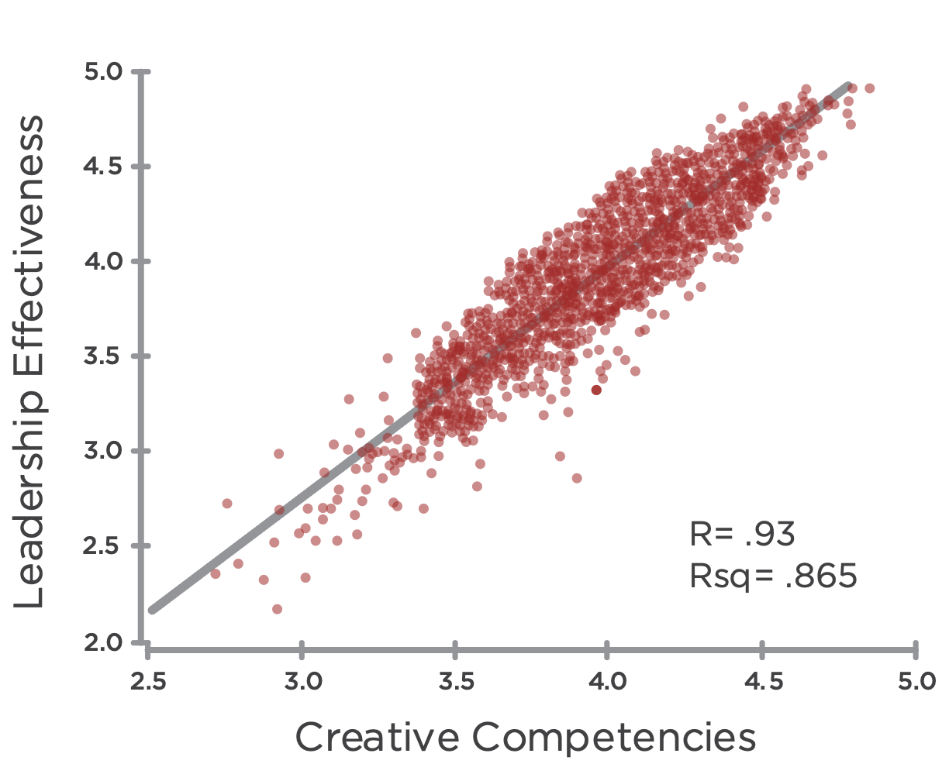
Führungseffektivität & Kreative Kompetenzen
Führungseffektivität
Kreative Kompetenzen
Notes:
Learning Objective 1: for participants to understand that an initial research question was the degree to which the LCP model actually measured what is commonly understood to be effective leadership. We found a strong positive correlation between the Creative aspects of the LCP and the LE questions indicating that the battery of 18 Creative competencies in the LCP are tracking with what it takes to be an effective leader across many contexts.
Learning Objective 2: for participants to understand that r = the relationship between the two variables or the line of best fit through the data—so how much of the movement of one variable is described by movement of the other. In this case, r = 0.93 means that if the Average Creative Score increases 1.00 (one unit of measure), the Leadership Effectiveness score will likely increase on average by 0.93. This is a very strong correlation.
Learning Objective 3: for participants to understand that rsq = the degree to which the data tightly cluster around the line of best fit. A high rsq means that the data don’t vary much and fit tightly together around the line of best fit (the prediction of the model). A low rsq means that the data are more scattered around the line of best fit. (Technically, rsq measures the amount of variability among the data points that can be explained by the model or predicted by the line of best fit).

Slide 26
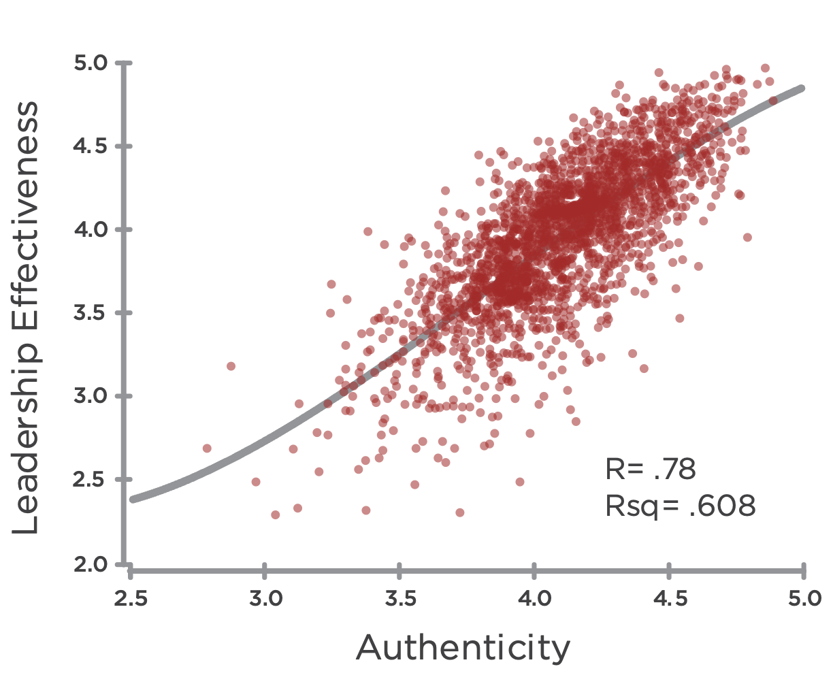
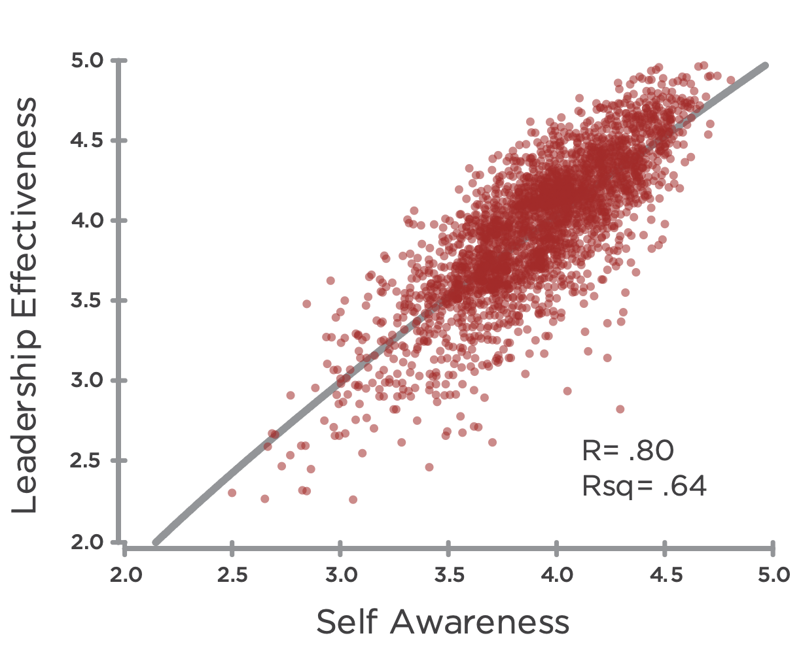
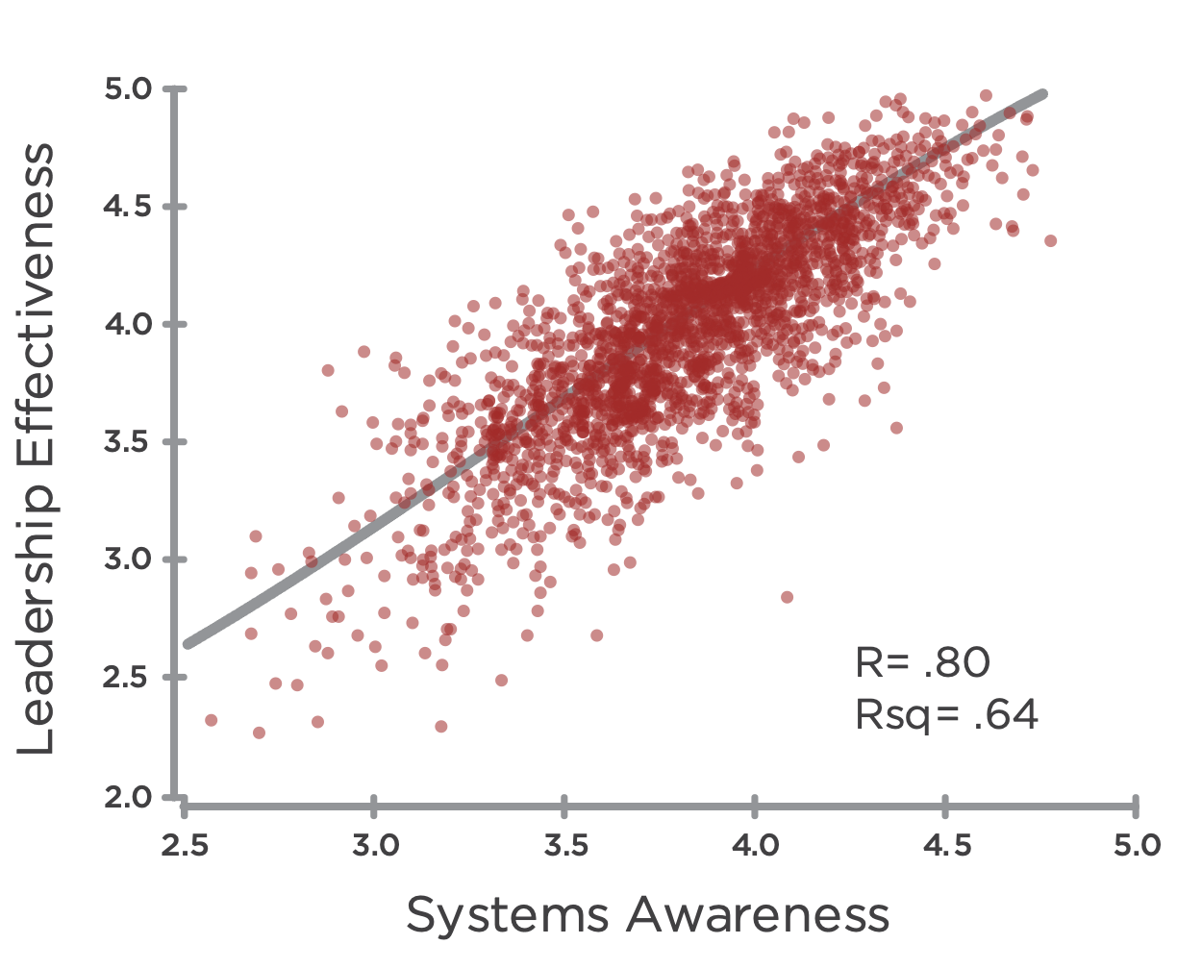
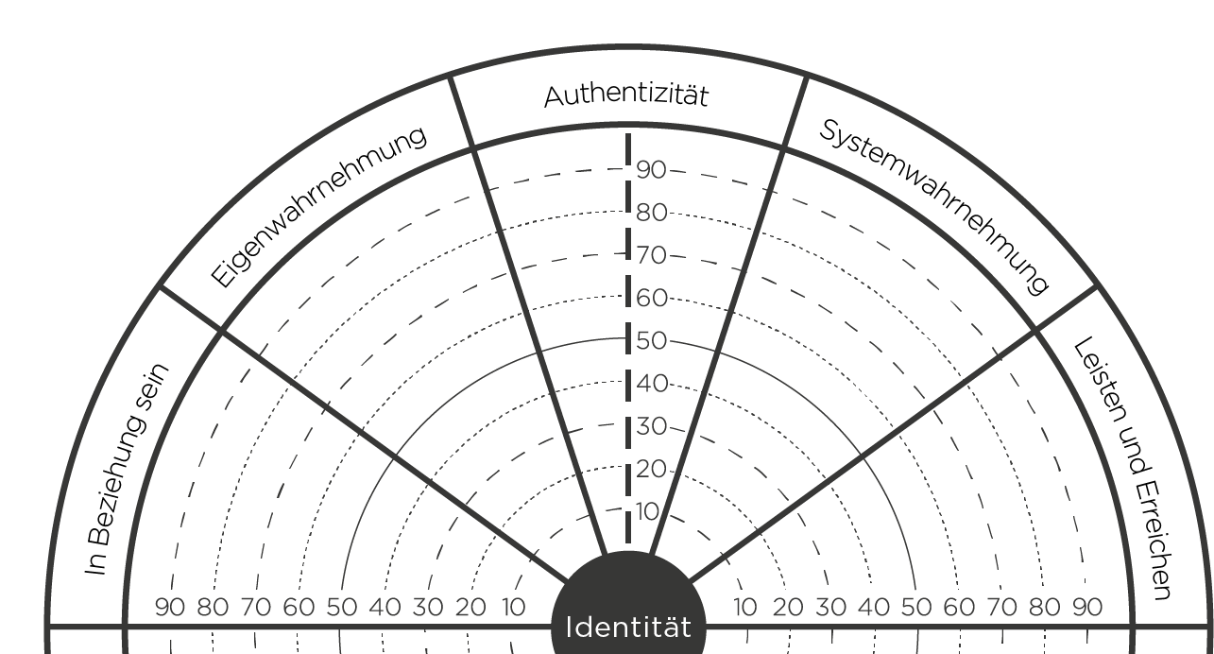
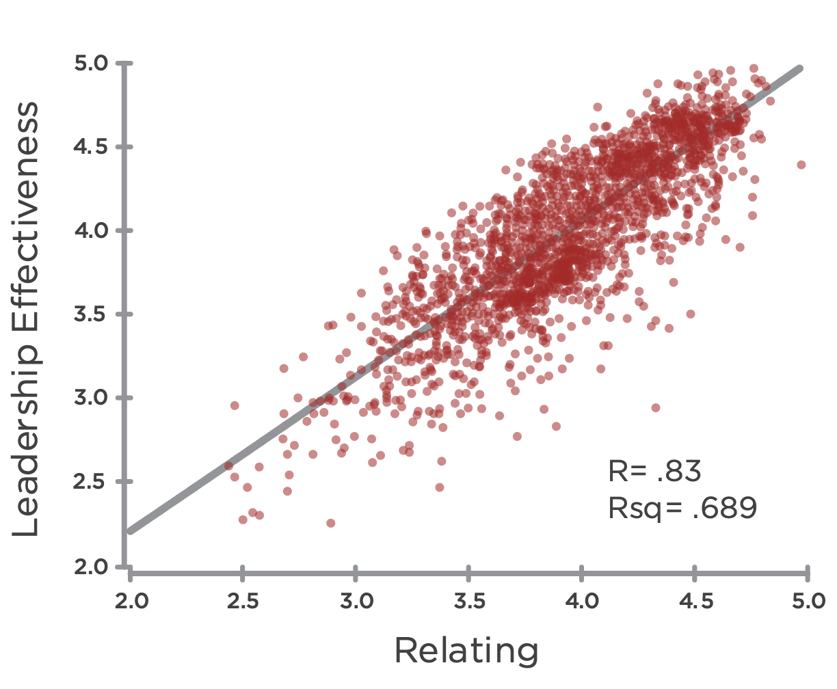
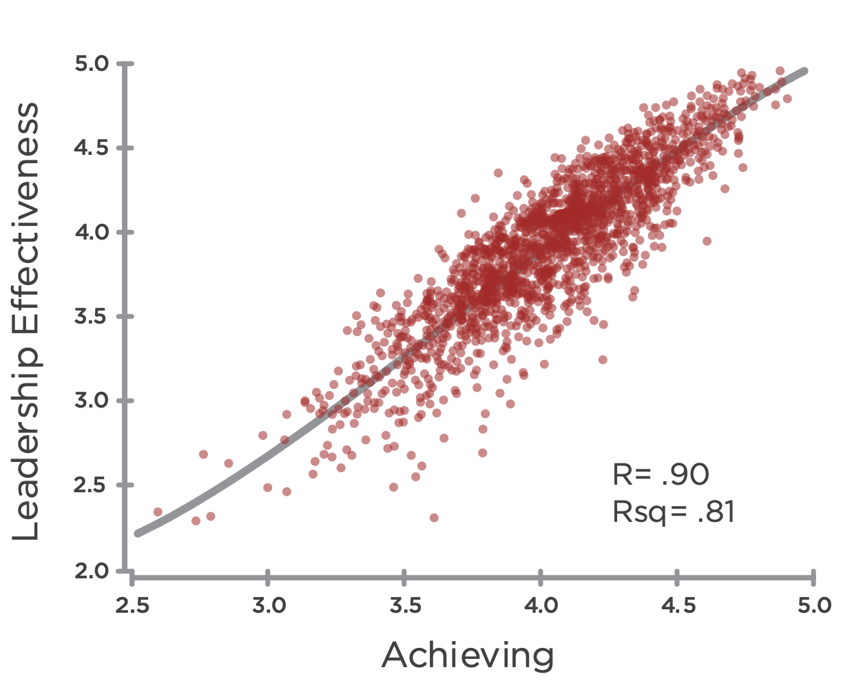
KREATIVE DIMENSIONEN:
Korrelationen mit Führungseffektivität
Führungseffektivität
Führungseffektivität
Führungseffektivität
R=.78
Authentizität
R=.76
R=.84
Eigenwahrnehmung
Systemwahrnehmung
Führungseffektivität
Führungseffektivität
R=.85
R=.91
In Beziehung Sein
Leisten und Erreichen
Notes:
Learning Objective 1: for participants to understand that perceptions of Leadership Effectiveness (the 5 questions on the scale) are strongly correlated with the Creative Competencies.

Slide 27
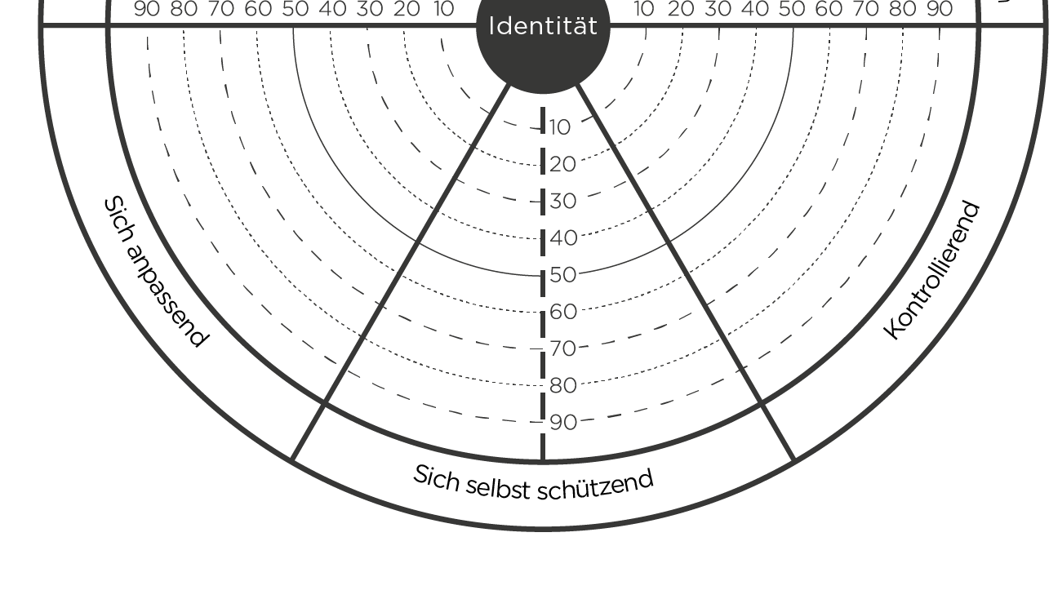
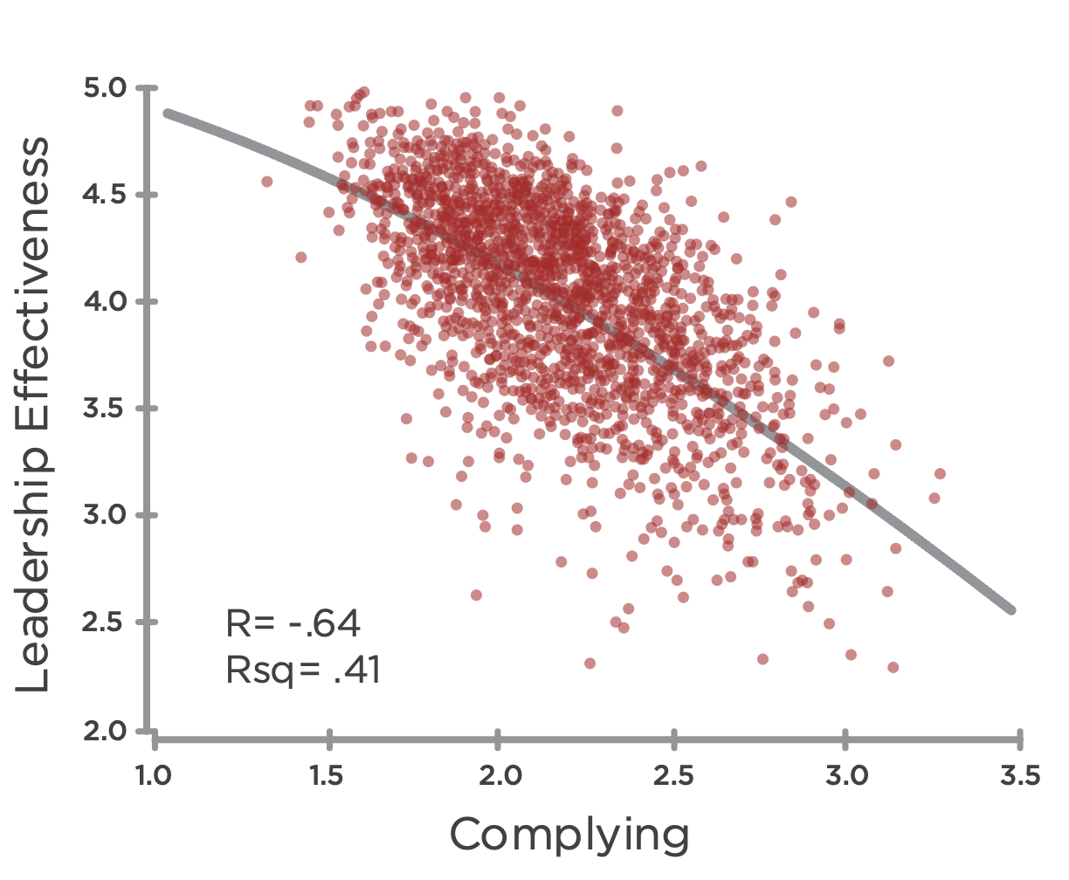
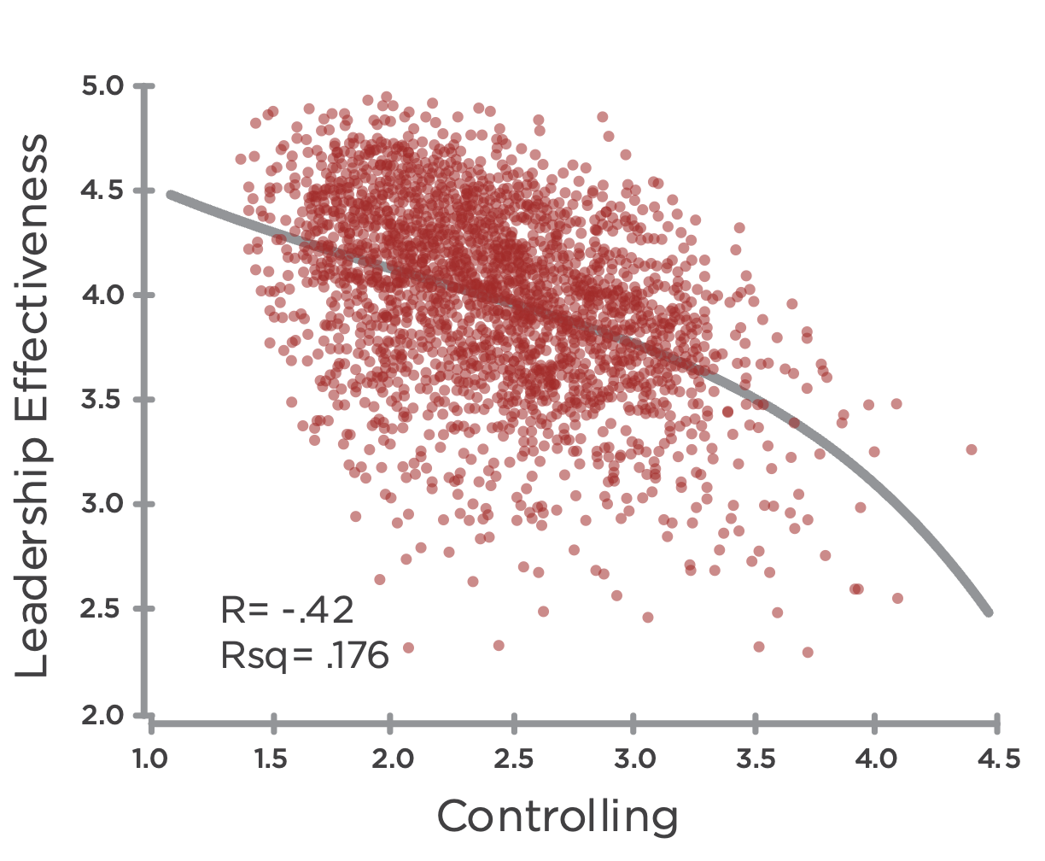
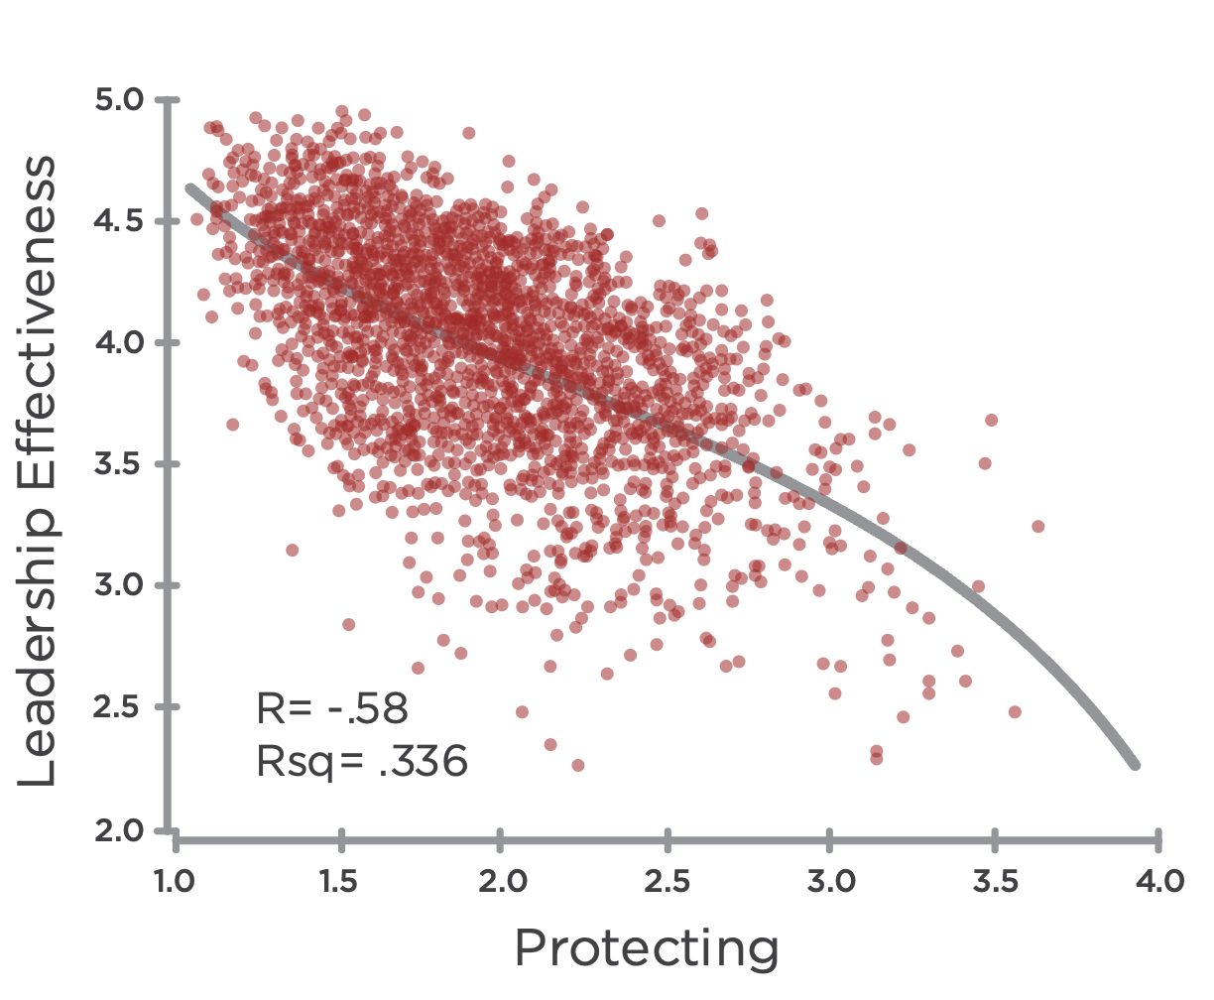
REAKTIVE DIMENSIONEN:
Korrelationen mit Führungseffektivität
Führungseffektivität
Führungseffektivität
R= -.63
R= -.41
Führungseffektivität
Sich anpassend
Kontrollierend
R= -.56
Sich selbst schützend
Notes:
Learning Objective 1: for participants to understand that perceptions of Leadership Effectiveness (the 5 questions on the scale) are strongly correlated with the Creative Competencies.

Slide 28
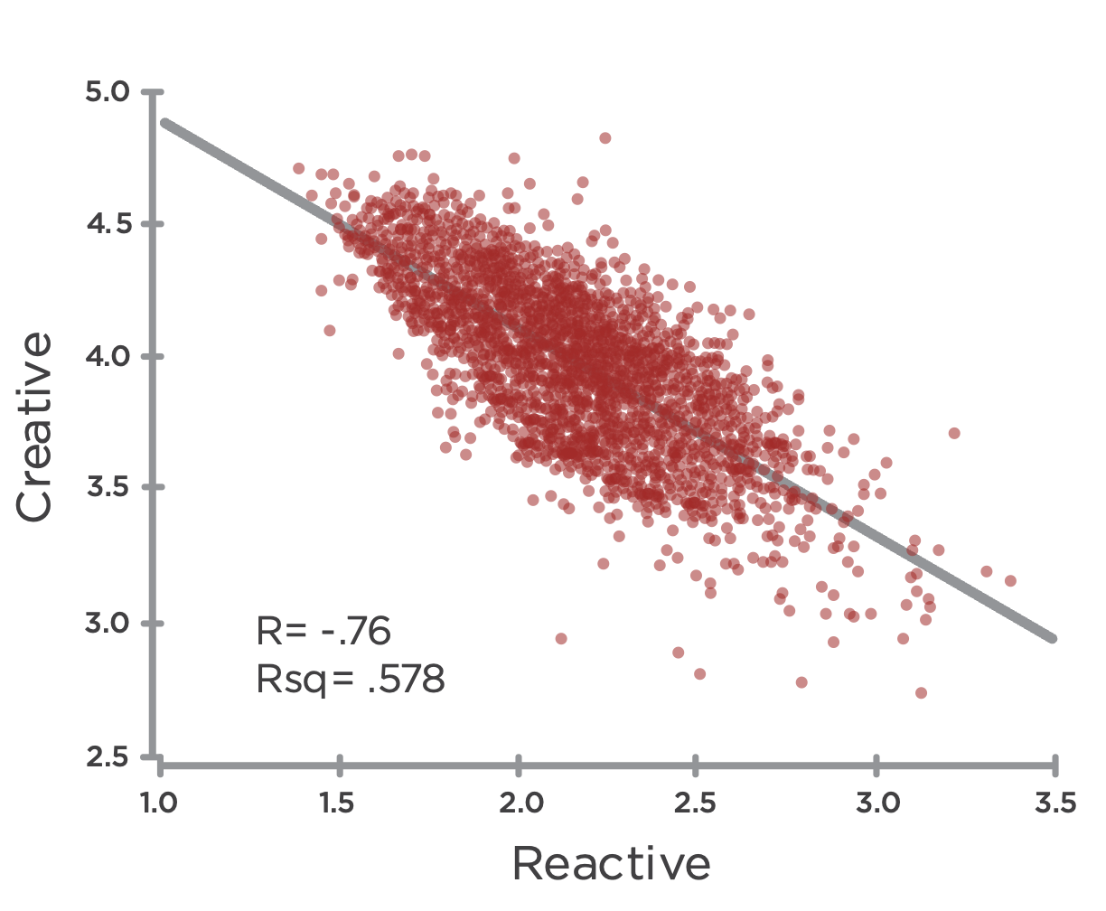
Kreative Kompetenzen & Reaktive Tendenzen
Kreativ
Reaktiv
Notes:
Learning Objective 1: for participants to understand that the Creative Competencies are strongly negatively correlated (-.76) with the Reactive Tendencies.
Learning Objective 2: for participants to understand that the implication of this correlation is that Reactive Tendencies significantly block/cancel the expression of Creative Competencies.

Slide 29



Nachbarn-Dimensionen
Notes:
Do neighbor slide and then move to the mat – opposites on the mat
Learning Objective 1: for participants to understand that the elements right across the border from each other (Neighbors) are Relating-Complying, Protecting-Authenticity, Achieving-Controlling. These are anchored in the same kind of energy (heart, head, will) and have lower negative correlations than other relationships across the graph.

Slide 30
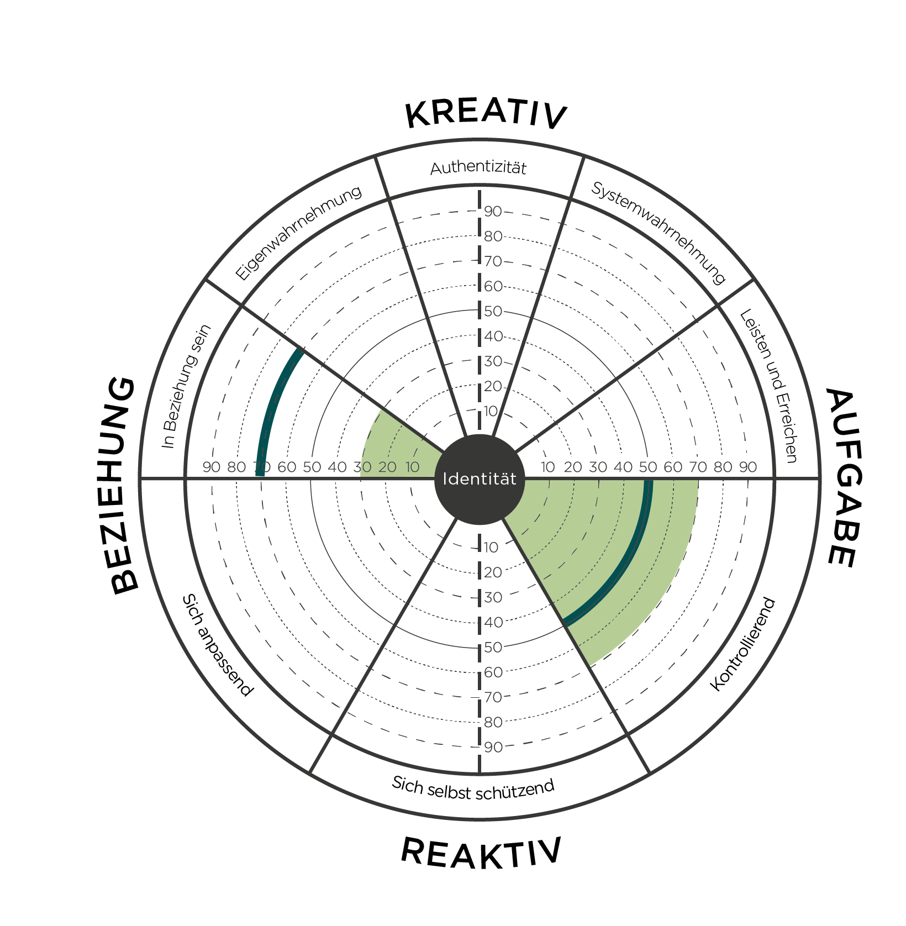
Gegenüber: Kontrollierend & In Beziehung sein
In Beziehung sein
Kontrollierend
Notes:
Learning Objective 1: for participants to understand that Controlling has a large negative effect on Relating (-.65) and thus they are opposite one another on the graph.
Learning Objective 1: for participants to understand that Controlling also has a large negative effect on Self Awareness (-.66) and thus they are also opposite one another on the graph.
Learning Objective 3: for participants to understand that a typical developmental trajectory for someone with high Controlling would be up and across the graph working on improving Relating and/or improving Self Awareness.
Learning Objective 4: for participants to understand that Controlling is negatively correlated with Relating (-.65).

Slide 31
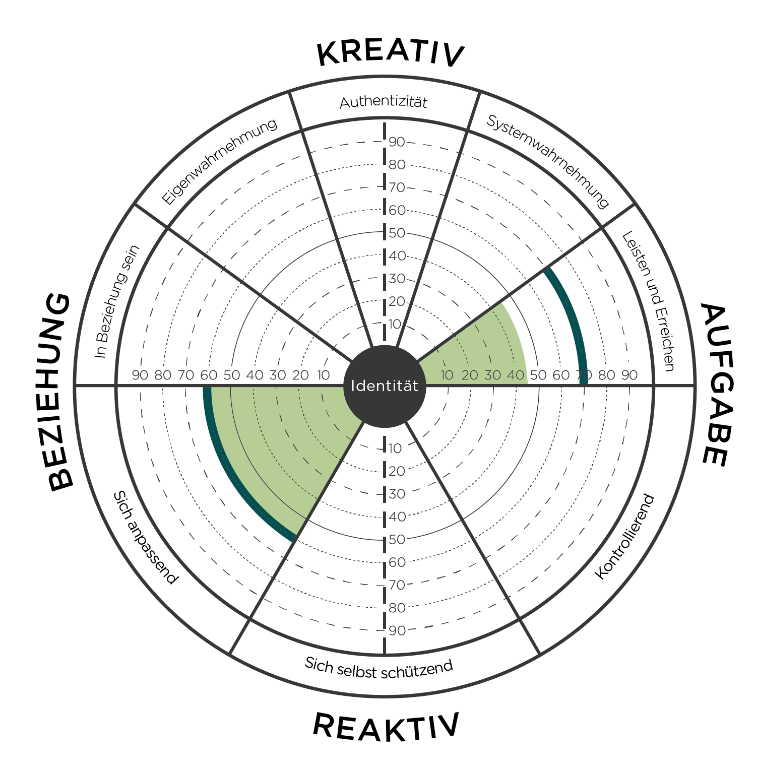
Gegenüber: Leisten und erreichen & Sich anpassend
Leisten und erreichen
Sich anpassend
Notes:
Learning Objective 1: for participants to understand that Complying has its biggest negative effect on Achieving (-.76) and thus they are opposite one another on the graph.
Learning Objective 2: for participants to understand that a typical developmental trajectory for someone with high Complying would be up and across the graph working on improving Achieving.
Learning Objective 3: for participants to understand that Complying has its second biggest negative effect on Authenticity (-.62) and this is also another common developmental trajectory (particularly working on Courageous Authenticity).
Learning Objective 4: for participants to understand that Complying is negatively correlated with Achieving (-.76).

Slide 32
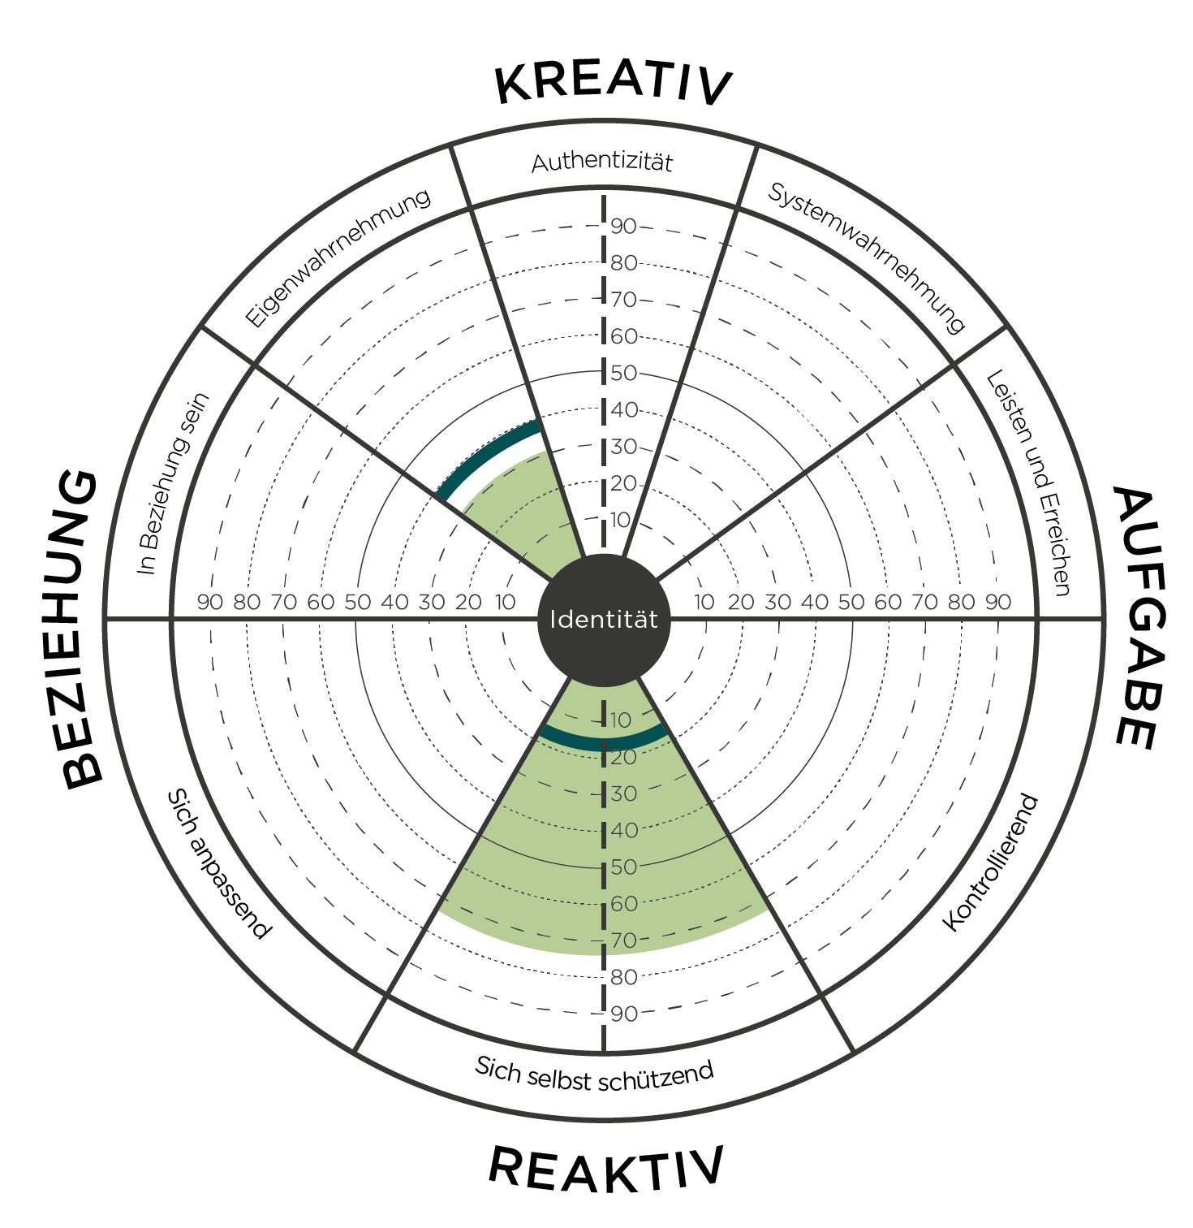
Gegenüber : Sich selbst schützend & Eigenwahrnehmung
Eigenwahrnehmung
Sich selbst schützend
Notes:
Learning Objective 1: for participants to understand that Protecting has a large negative effect on Self Awareness (-.70) and thus they opposite on the graph.
Learning Objective 2: for participants to understand that Protecting has a large negative effect on Relating as well (-.73).
Learning Objective 3: for participants to understand that a typical developmental trajectory for someone with high Protecting might be up and to the left across the graph working on improving Self Awareness and Relating.
Learning Objective 4: for participants to understand that Protecting is negatively correlated with Self Awareness (-.76).

Slide 33
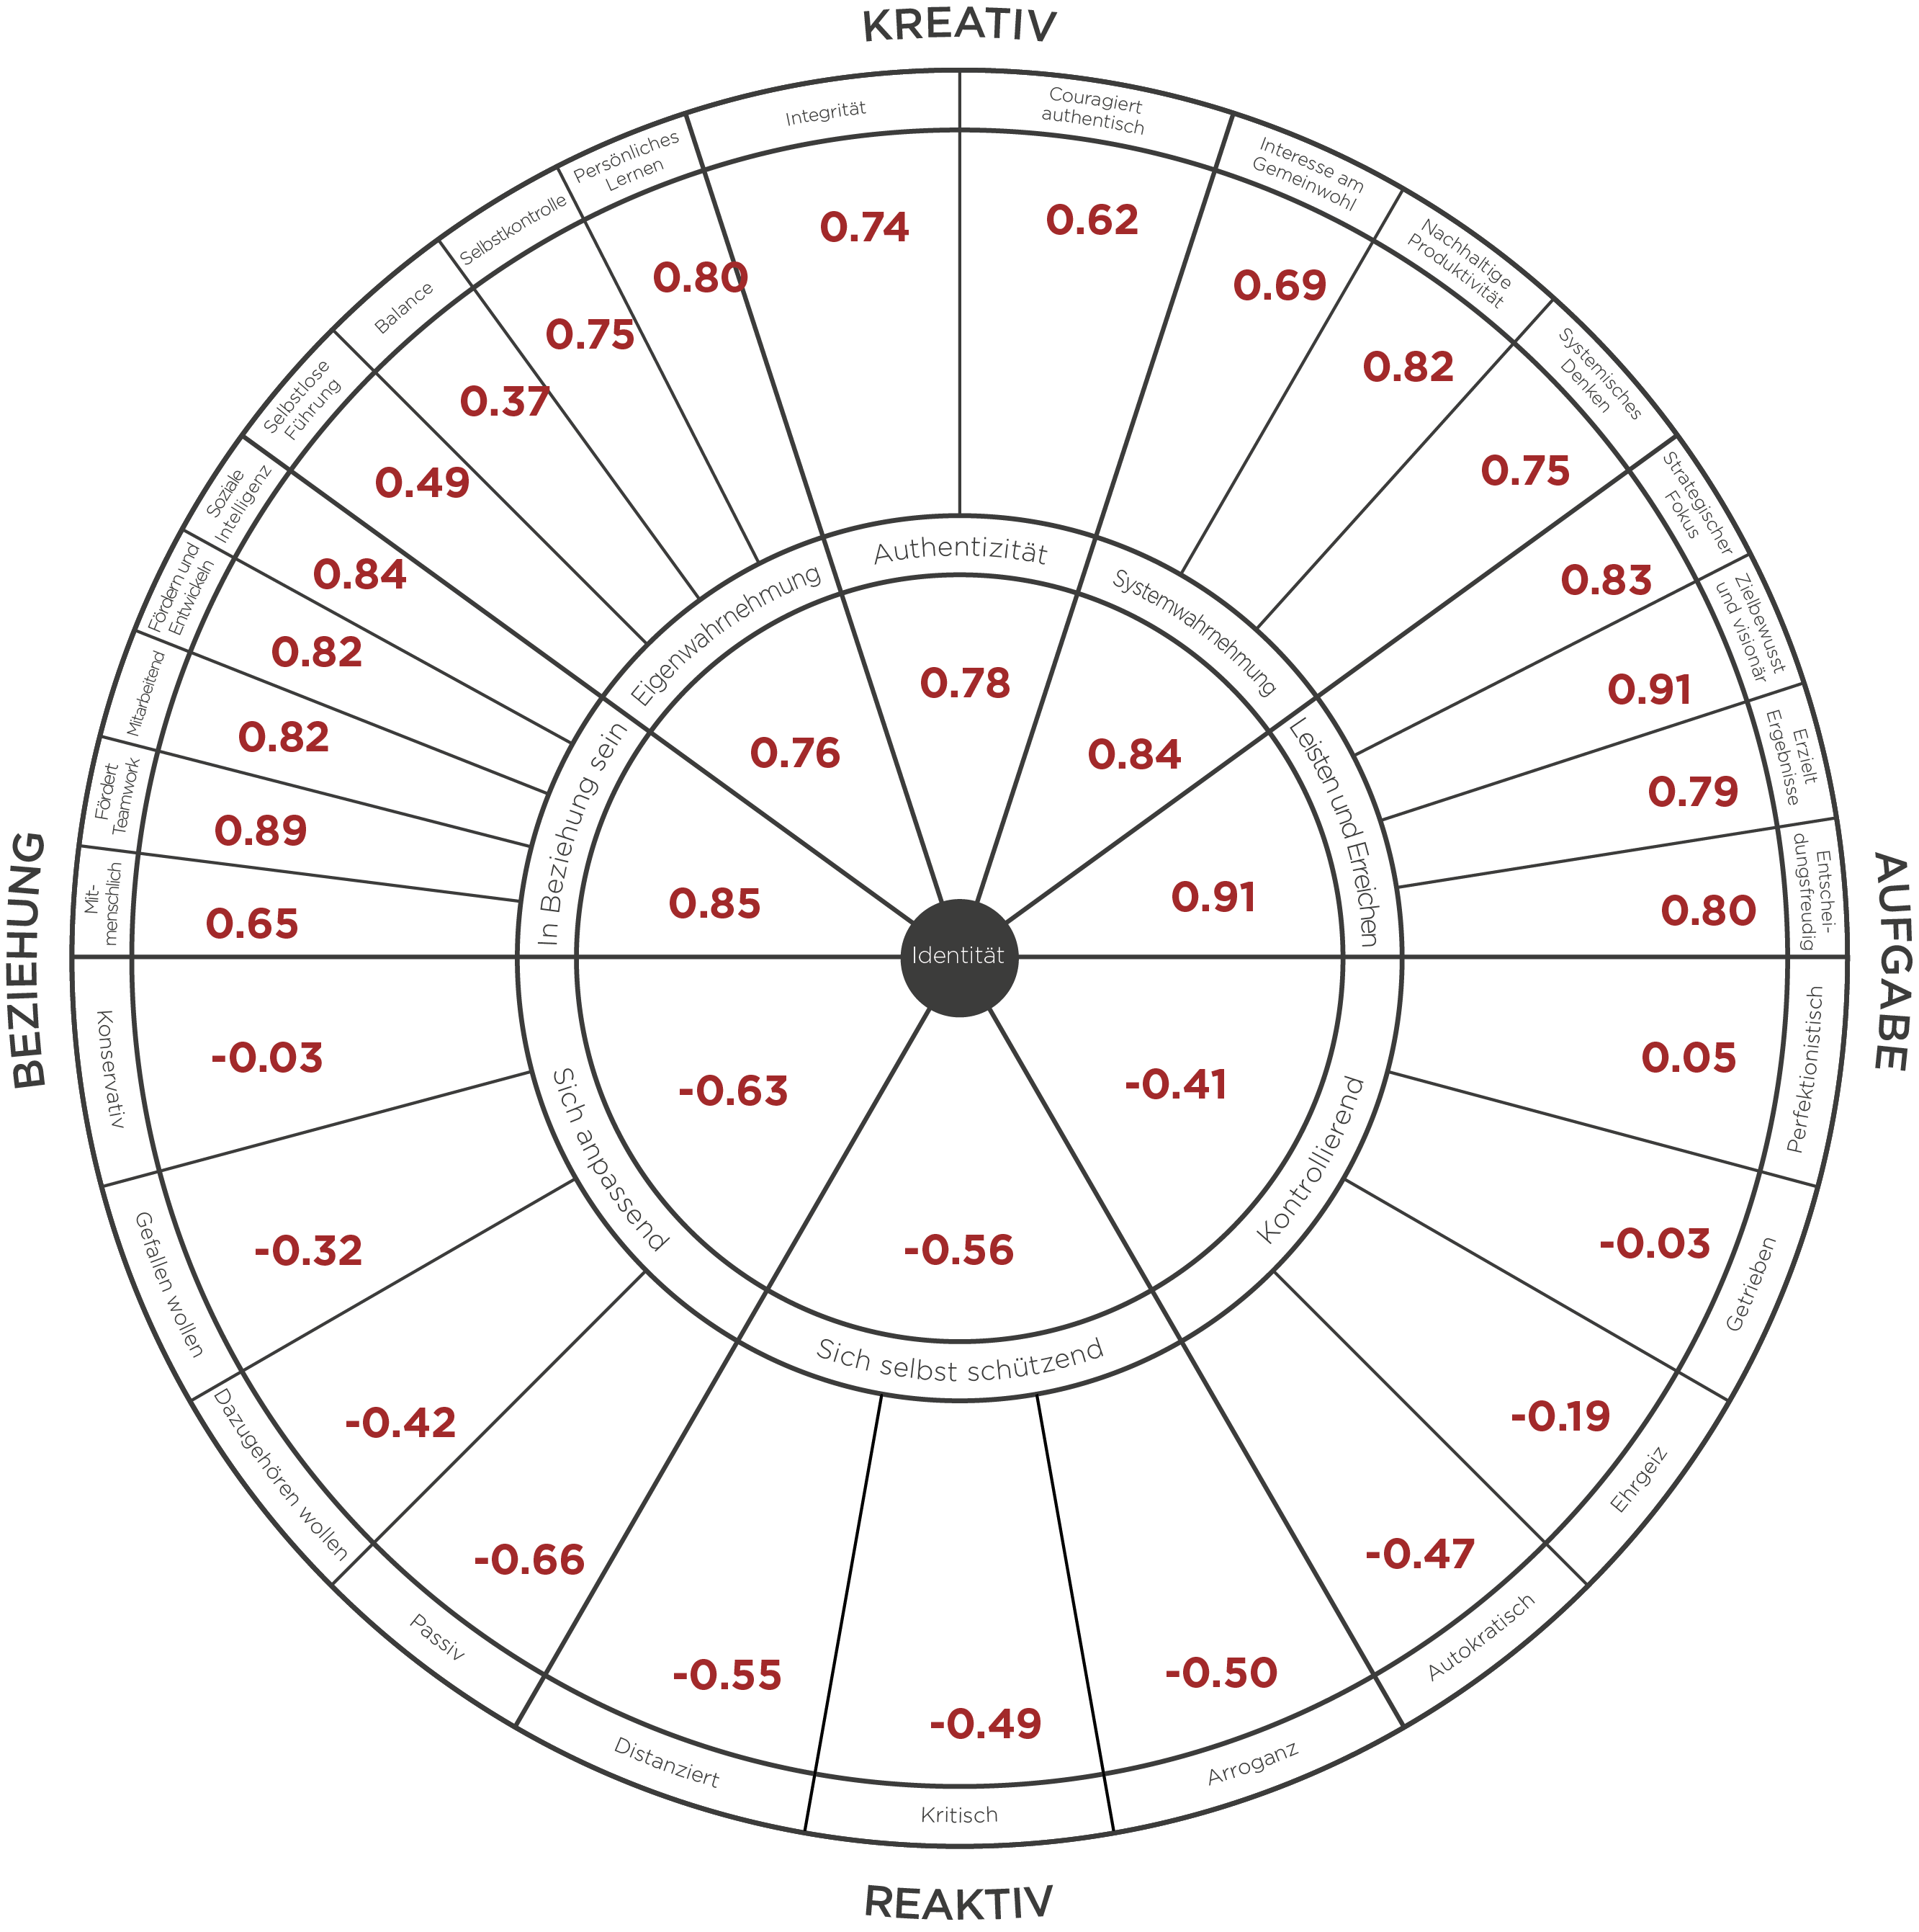

Korrelationen LCP Dimensionen & Führungseffektivität
Ich bin mit der Qualität seiner/ihrer Führung zufrieden.
Er/Sie ist die Art von Führungskraft, die sich andere zum Vorbild nehmen sollten.
Er/Sie ist ein gutes Beispiel für eine ideale Führungskraft.
Seine/Ihre Führung verhilft dieser Organisation zum Erfolg.
Insgesamt ist seine/ihre Führung sehr effektiv.
Notes:
Before moving into the debrief practice, ground them in the correlations one more time using this slide (refer to back of slim-print. This helps them get ready for why this matters in their debriefs. Validity will be discussed at the end of the day – as time permits. (also all available in adeption workouts post cohort session.
Learning Objective 1: for participants to understand that each of the 29 Creative/Reactive dimensions of the LCP have their own unique correlation to Leadership Effectiveness (the five Ideal Leader questions).
Learning Objective 2: for participants to look at their own LCP data through the lens of these more granular correlations to see if it generates any new developmental understanding or insight.
Learning Objective 2: for participants to imagine/brainstorm how they might use these correlations with their clients.

Slide 34
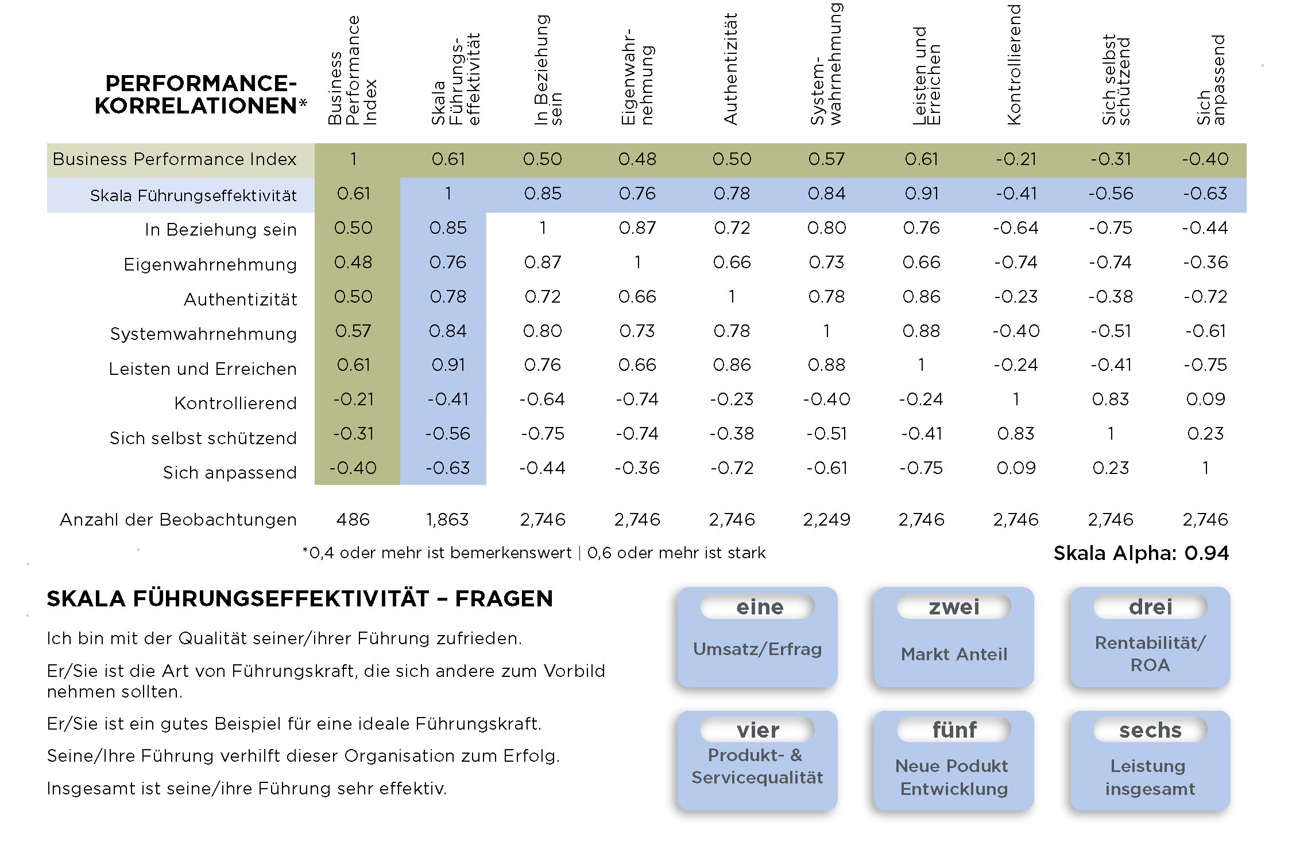

Slide 35
Business Performance Index
Studie auf Basis von 486 Organisationen und Organisationseinheiten.
Für die Evaluation der Business Performance wurden sechs Kategorien herangezogen:
Umsatz /
Ertrag
Markt Anteil
Rentabilität / ROA
Produkt- & Servicequalität
Neue Produkt Entwicklung
Leistung insgesamt
Notes:
Learning Objective 1: for participants to understand the methodology of the Business Performance Research Study. In this case, that a BPI was utilized that was made up of six measures of business performance.
Tech facilitator – have link ready for the study to share with cohort.
Learning Objective 2: for participants to understand that 486 leaders each took the LCP, attached to the LCP was the BPI. Then, just looking at the top 10% and the bottom 10% of the business performance results we aggregated those LCPs together (about 50 in each sample).

Slide 36
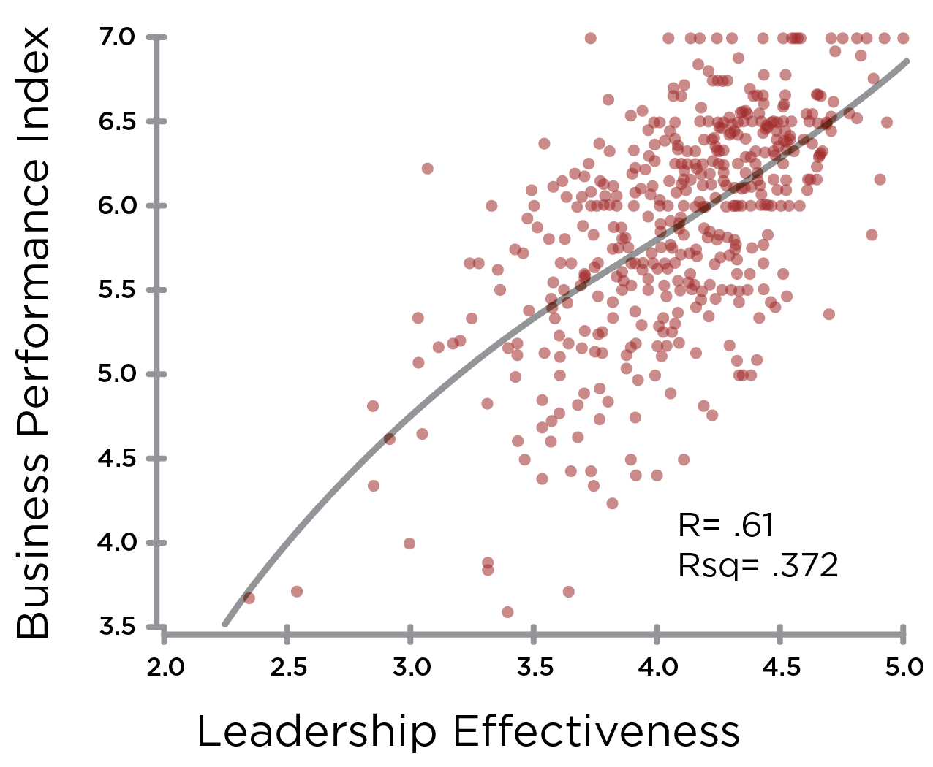
Führungseffektivität & Business Performance
Führungseffektivität
Notes:
Learning Objective 1: for participants to understand the correlation between Leadership Effectiveness (measured by the five ideal leader questions) and Business Performance (measured by the six elements of the Business Performance Index).

Slide 37
Führungseffektivität & Business Performance
Beste 10%
Schlechteste 10%
Führungseffektivität

Slide 38
Beste 10%
Gesamtprofil der Führungskräfte, deren Unternehmen als
am höchsten leistungsfähig
bewertet wurden
Notes:
Learning Objective 1: for participants to understand that sorting the data by just the Business Performance Index (here the top 10%) yielded this kind of highly Creative aggregate leadership profile (this is the rollup of the approximately 50 leaders in the top performing businesses.
Learning Objective 2: for participants to understand that this makes the business case for why pursue development with the LCP?
Learning Objective 2: for participants to understand that there may also be a halo effect bias in play. If the business is performing well our view of the effectiveness of the leaders can be positively influenced.

Slide 39
Schlechteste 10%
Gesamtprofil der Führungskräfte, deren Unternehmen als
am niedrigsten
leistungsfähig
bewertet wurden
Notes:
Learning Objective 1: for participants to understand that sorting the data by just the Business Performance Index (here the bottom 10%) yielded this kind of highly Reactive aggregate leadership profile (this is the rollup of the approximately 50 leaders in the worst performing businesses.
Learning Objective 2: for participants to understand that this makes the business case for why pursue development with the LCP?
Learning Objective 2: for participants to understand that there may also be a halo effect bias in play. If the business is performing poorly our view of the effectiveness of the leaders can be negatively influenced.

Slide 40
Schlechteste 10%
Beste
10%
Notes:
Learning Objective 1: for participants to understand that this is the developmental journey many senior teams and organizations are hoping to take (particularly once they understand the correlation between the LCP and Business Results).

Slide 41
Zusätzliche Folien

Slide 42

Der Leadership Circle 360 – Ein Türöffner für Entwicklung
SICH SELBST
TRANSFORMIEREND
VUKA
Volatilität
Unsicherheit
Komplexität
Ambiguität
Anforderung an die
Komplexität des Geistes
SICH SELBST
HERVORBRINGEND
Herausforderung an
Entwicklung
KOMPLEXITÄT
DES SELBST
KOMPLEXITÄT DES
KONTEXTS
ZWISCHEN-MENSCHLICHES
SELBST
Derzeitige Bewusstseinsschwelle
von Führungskräften
Stabilität
Sicherheit
Einfachheit
Eindeutigkeit
KINDHEITSSTUFEN
SSEE
Notes:
Learning Objective 1: for participants to understand that the LCP gives us data about how a person’s leadership is experienced at a particular point in time in a particular environment with particular level of VUCA conditions. It is person-in-context data.
Learning Objective 2: for participants to understand this contextual reality is why we can’t compare one person’s LCP to another’s LCP in an apples-to-apples kind of fashion. The LCP is powerfully contextual.
Learning Objective 3: for participants to understand that the LCP debrief is a developmental can opener, it opens the door to a transformational conversation pointed at the gap between a person’s current way of knowing the world and their contextual lived reality.

Slide 43
Zengers Beziehung zwischen Führungskompetenz & Ergebnissen
+
Ergebnisse—ROI
+2K
+1K
Top 20%
0
-1K
-
20%
50%
80%
Zusammengefasstes
360°-Feedback

Slide 44
Zengers Beziehung zwischen Führungskompetenz & Ergebnissen
+
Ergebnisse—ROI
+2K
+1K
Top 20%
0
-1K
-
20%
50%
80%
Zusammengefasstes
360°-Feedback

Slide 45
360º-Vorteile
Konzentriert die Entwicklung auf Schlüsselkompetenzen
Identifiziert Stärken, um darauf aufzubauen
Zeigt die Auswirkung Ihres Führungsstils auf andere
Bringt Lücken in der Wahrnehmung zum Vorschein
Verknüpft Denken und Verhalten
Reduziert die Gefahr von Entgleisungen

Slide 46
Design-Kriterien
Messung von Schlüsselkompetenzen der Führungsfähigkeit
Bewertung von Glaubensstrukturen und Annahmen
Hinweis auf den Stand der Entwicklung
Integration unseres Theoretischen Rahmenwerks
Anordnung von Ergebnissen – um die wichtigsten Entwicklungsmöglichkeiten sofort ans Tageslicht zu bringen

Slide 47
Theoretische Grundlagen
Die Kreative und Reaktive Orientierung – Fritz, Senge und Kiefer
Kognitive Psychologie – Rational-Emotionale Therapie: Burns, Ellis
Vision; Abhängigkeit und Ambition: Peter Block
* * * * * *
Charakterstruktur – Karen Horney
  hinwenden (Sich anpassend)
  abwenden (Kontrollierend)
  dagegenwenden (Sich selbst schützend)
Enneagramm – 9 verschiedene Persönlichkeitstypen, die jeweils nach einem Kernwahn organisiert sind– Sufi-Tradition
Ego/Schatten – Carl Jung
Körperpsychotherapie / Somatopsychologie – Riech, Kurtz, Lowen, Pirrakos
Entwicklungstufen – Kohlberg, Kegan, Wilber, Hall, Beck, Fowler, Cook-Greuter
Mystische Literatur/ Weisheitslehren
3 Paradigmen (Abhängig, Unabhängig, Wechselseitigkeit) – Covey
Literatur zu Führungspotential – Bennis, Drucker, Collins, Goleman, usw.
Leadership 360°Forschung – Zenger and Folkman, usw.

Slide 48

Die Reaktive Charakterstruktur
SICH ANPASSEND
KONTROLLIEREND
Beliebt
Erfüllt die
Erwartungen
Angenehm
Akzeptiert
Als Erstes
Am Besten
Brilliert
Dominiert
Kontrolliert
Gewinnt
IDENTITÄT
SICHERHEIT
WERT
SICH SELBST SCHÜTZEND
Überlegen
Rechthabend
Selbstgenügend
Distanziert
Notes:
Use mural. Can use as a recap (on mural or slide here) This is demonstrated very clearly through group learning on the mat.

Slide 49

Notes:
Learning Objective 1: for participants to have a visual model of the LCP that is holistic and normalizing—we all have roots in the Reactive, here lies the origins of our gifts. Our developmental task is to grow something on top of those roots—to have the gifts flower in a way that serves the world.

Slide 50
Der Identitätshaken
Wenn ich nicht_____________ bin, dann ______________
Befolgt Verfahren und Regeln, drängt auf Konformität
Makellose Ergebnisse, extrem hohe Standards
Konservatie
Perfektionistisch
Sucht Unterstützung und Zustimmung, vermeidet persönliche Ablehnung
Sich anpassend
Kontrollierend
Schnellgang, drängt andere, arbeitet für den Erfolg
Gefallen wollen
Getrieben
Passt sich an, geht auf Nummer sicher, erfüllt Erwartungen
Weiterkommen, nach oben kommen, besser sein als andere
Sich selbst schützend
Gibt Macht ab, sanftmütig, selbstzweifelnd, zurückhaltend
Durchsetzungsfähig, aggressiv, kontrollierend, mächtig
Dazugehören wollen
Ehrgeiz
Introvertiert, unnahbar, emotional unbeteiligt
Überlegen, egoistisch, egozentrisch
Sucht nach Fehlern, zynisch, macht andere nieder
Passiv
Autokratisch
Distanziert
Arroganz
Ich muss _____________ sein,
andernfalls ______________
Sein ist_____________
Nicht ______________zu sein, ist nicht sein
Kritisch
REAKTIV
Notes:
Learning Objective 1: for participants to understand that our identity can be deeply rooted in the Reactive—it can be our primary experience of our self or an aspect of identity that we experience quite frequently .
Learning Objective 2: for participants to understand that being able to see our Identity Hook, take perspective on it (versus just being hooked by it) is a specific example of witnessing the self in action and another example of a healthy subject/object differentiation.

Slide 51
Die Vier Versprechen von Führungsfähigkeit

Slide 52
38 % Wahrscheinlichkeit, dass eine verbesserte Führungseffektivität zu einer höheren Unternehmensleistung führt.
Führungseffektivität ist ein wichtiger Faktor für die Unternehmensleistung.
Eine Organisation kann nicht besser sein als die kollektive Effektivität ihrer Führung!

Slide 53
Ein Komplettes System zur Entwicklung
Universelles Leadership Modell
Gemeinsame Sprache
Grundlage für Coaching und kontinuierliches Feedback
Leadership Entwicklungspläne
Promise of Leadership Programm
Buch: Mastering Leadership
Peer Coaching und handlungsorientiertes Lernen

Slide 54
Misst tatsächlich das, was es messen soll
Durch Hunderttausende von Bewertern
gesicherte Daten
Notes:
With the LCP you get the full picture of your leadership. At last, you see, in one assessment, what you are missing in all the others. TLC is unique because it measures
-- (Click) Leadership competencies
--(Click) Assumptions that drive Behavior
Assumptions that lead to effectively developing key leadership competencies
Assumptions that run reactive, self-limiting behavior.
-- (Click) and LCP reveals style and personality…all at the same time.

Slide 55
Aufschlussreicher
Verknüpft Kompetenzen mit Grundüberzeugungen

Slide 56
Fortgeschrittener
Coaching beginnt bei einem Durchbruch

Slide 57
Mehr als nur
ein Assessment
Rahmenwerk bietet den Weg zur Transformation

Slide 58
Effizienter
Nutzerfreundlicher Bericht spart Coachingzeit

Slide 59
Weithin anerkannt
Verwendet von führenden Organisationen, Spitzenuniversitäten und Regierungsbehörden

Slide 60
Unterscheidungs
merkmale
Kreativ und Reaktiv
Kreis-Grafik
Forschung und Validität
Ausrichtung auf die Erwachsenenentwicklung
Engagement für den Dienst

Slide 61
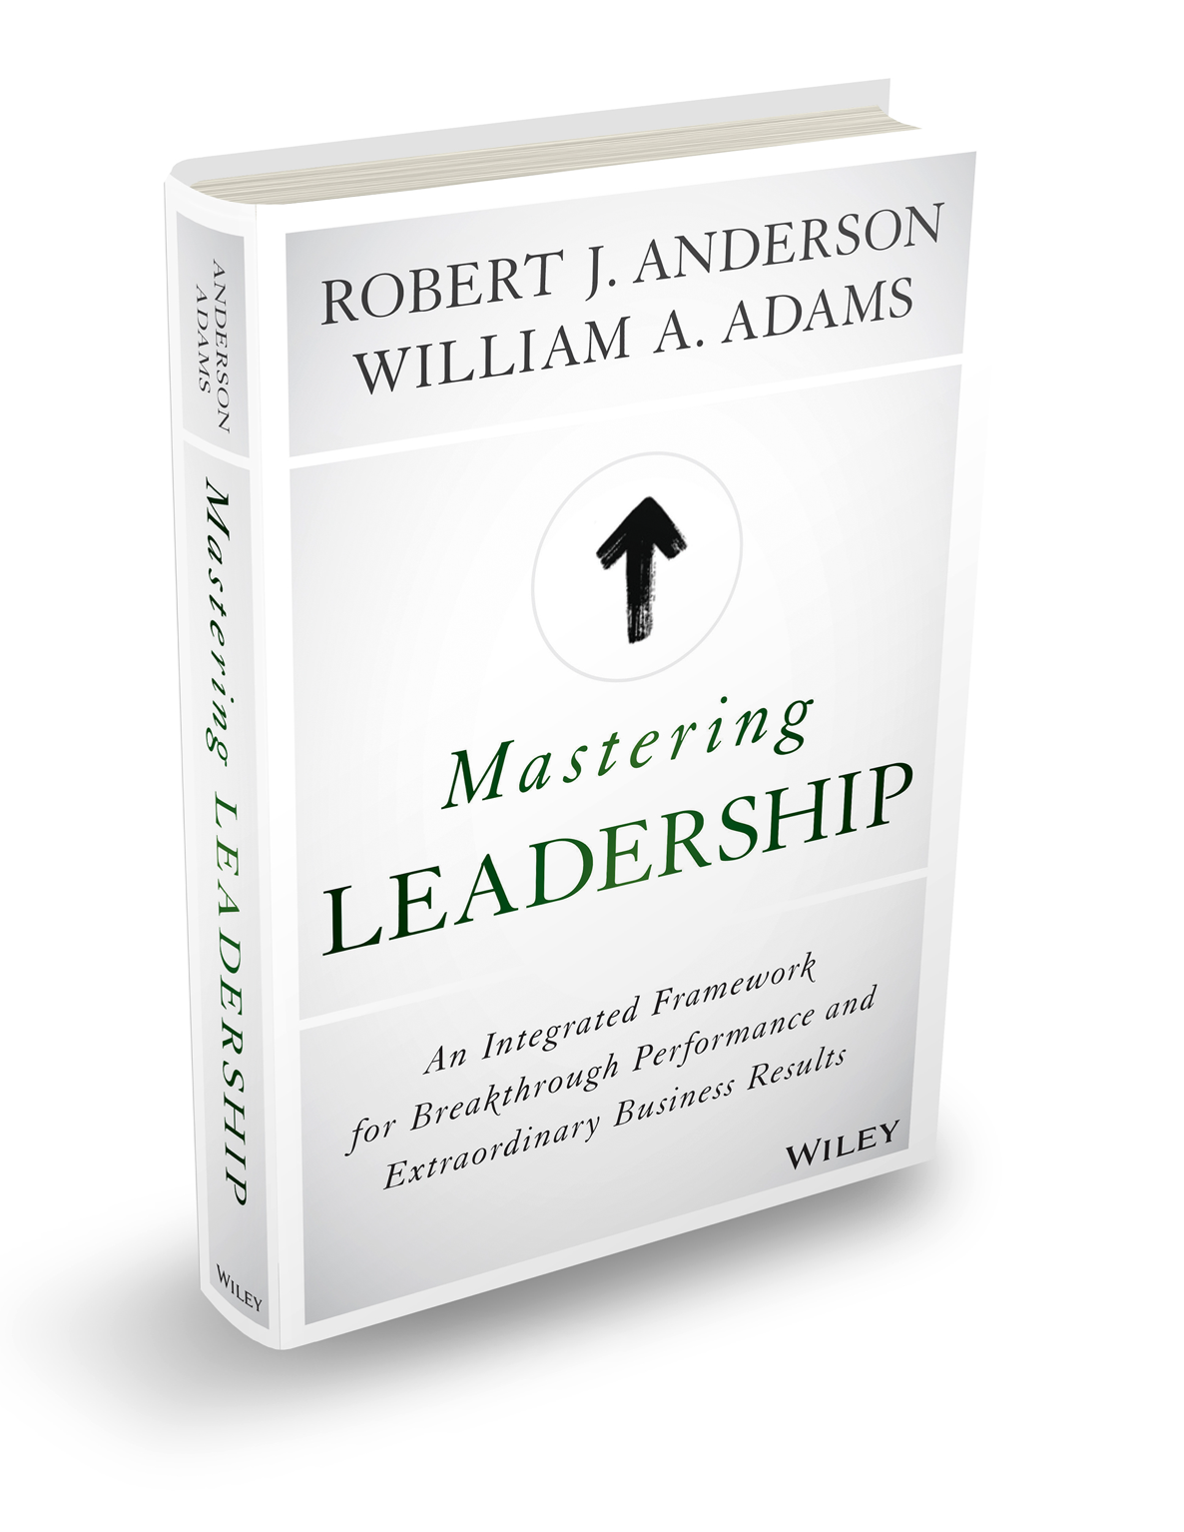
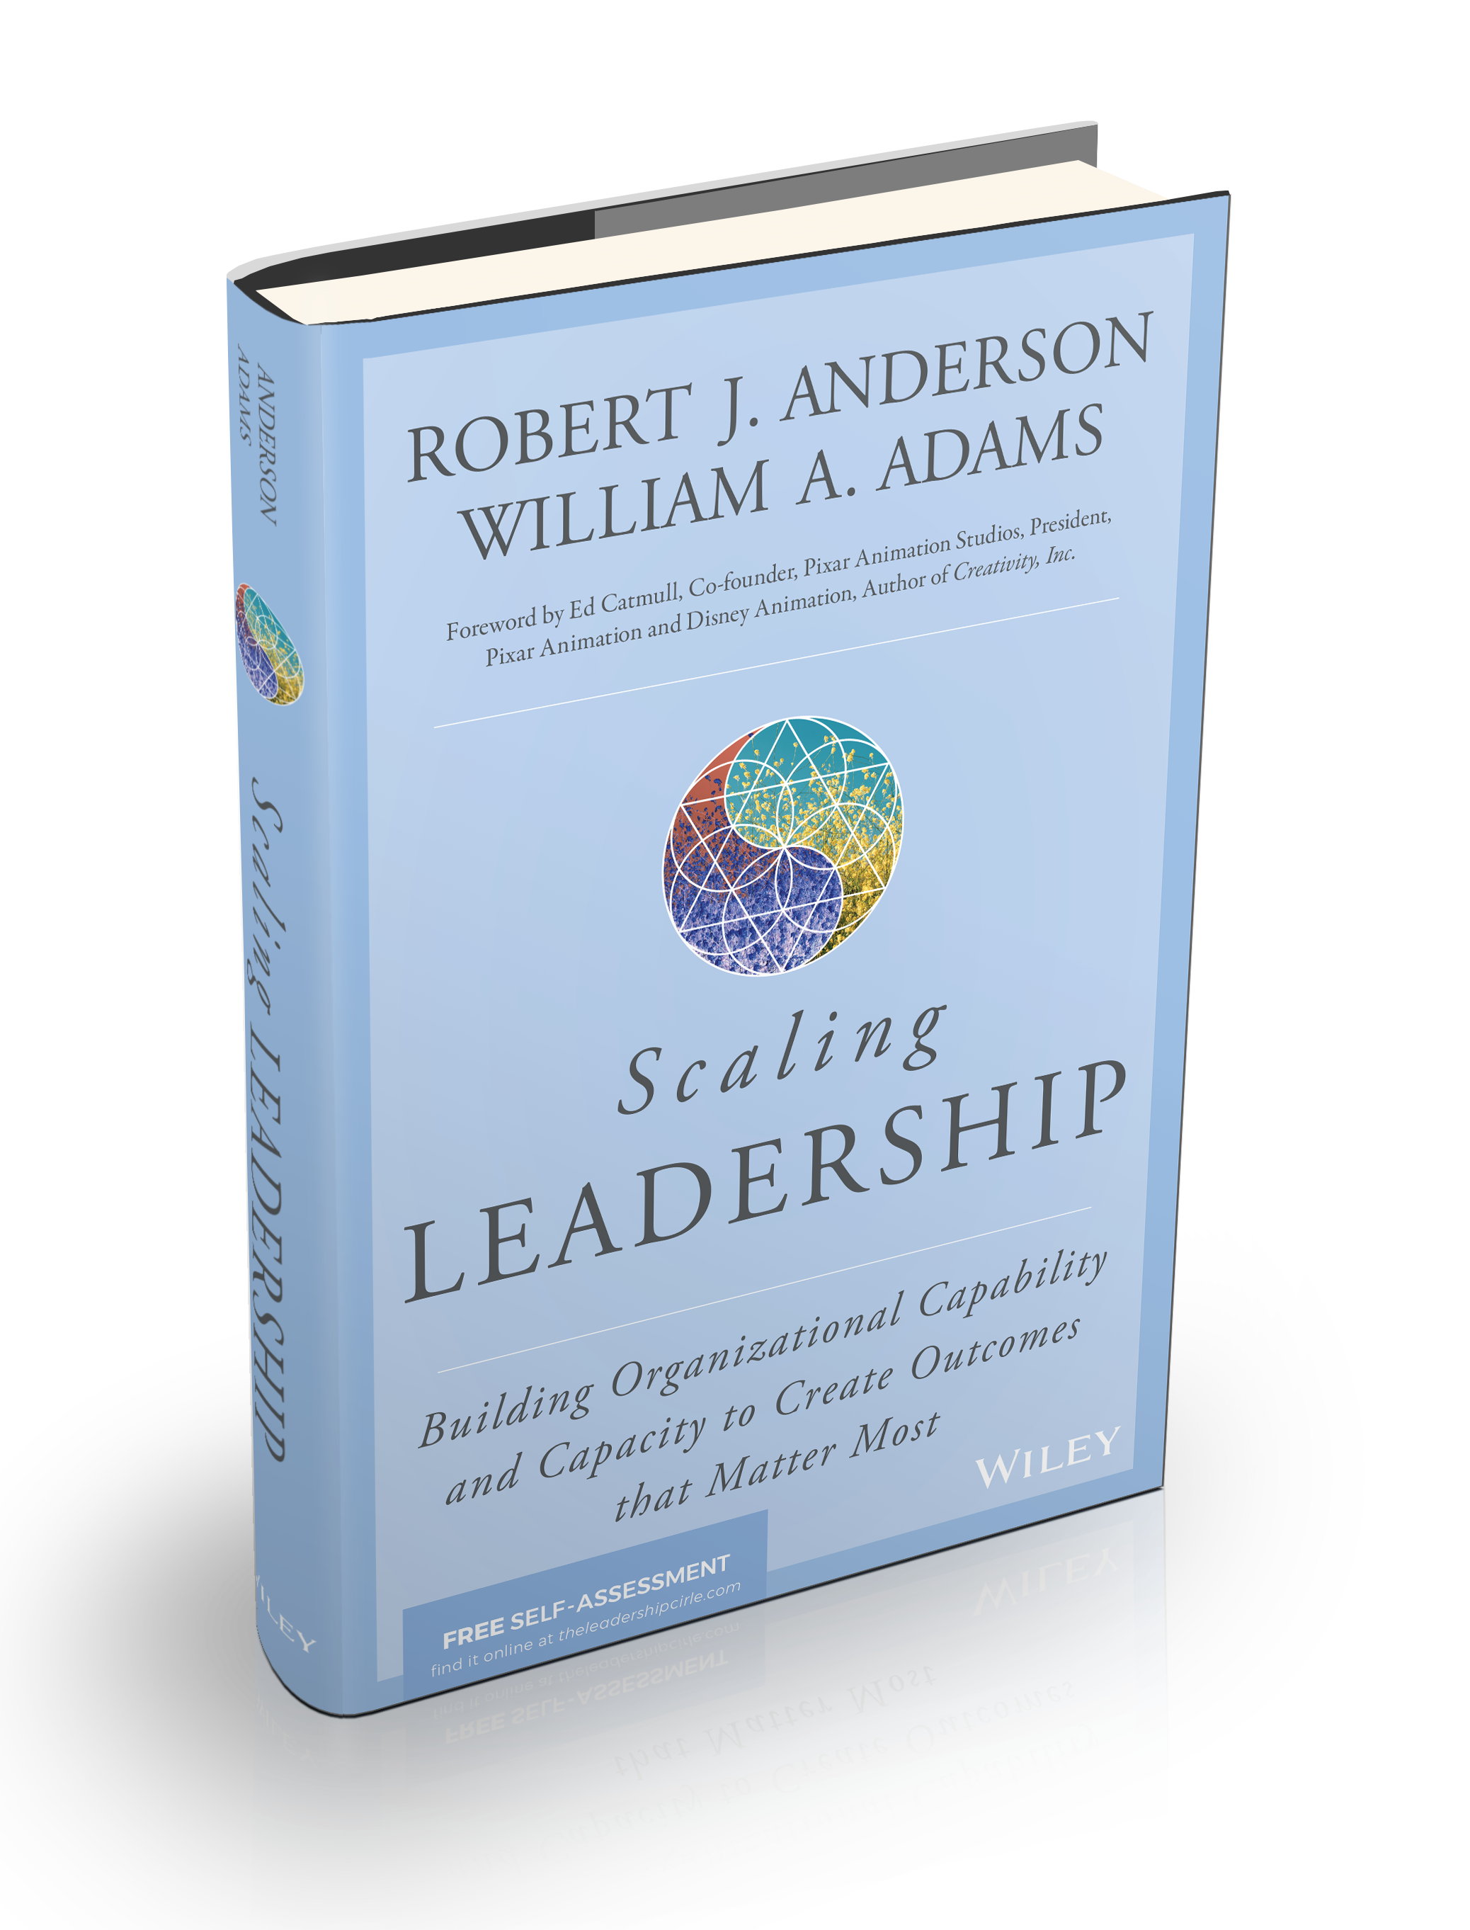
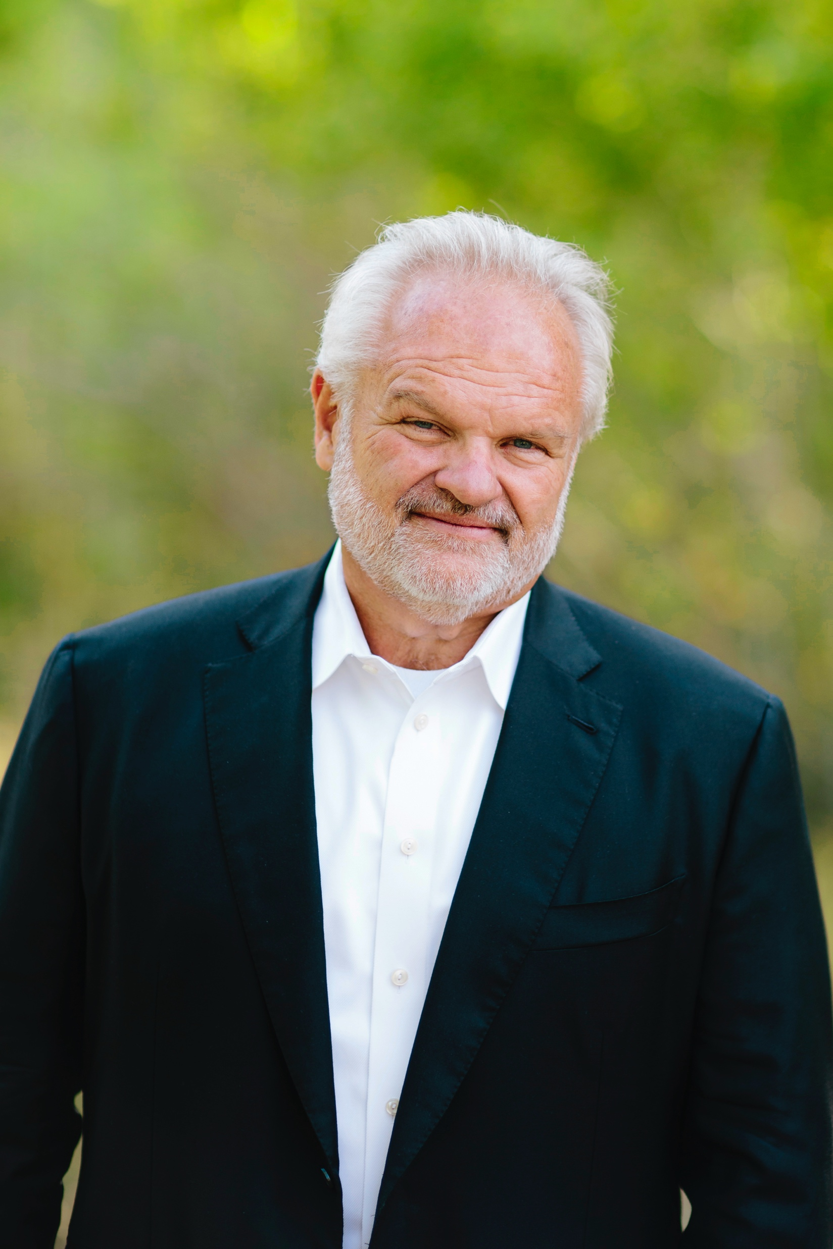
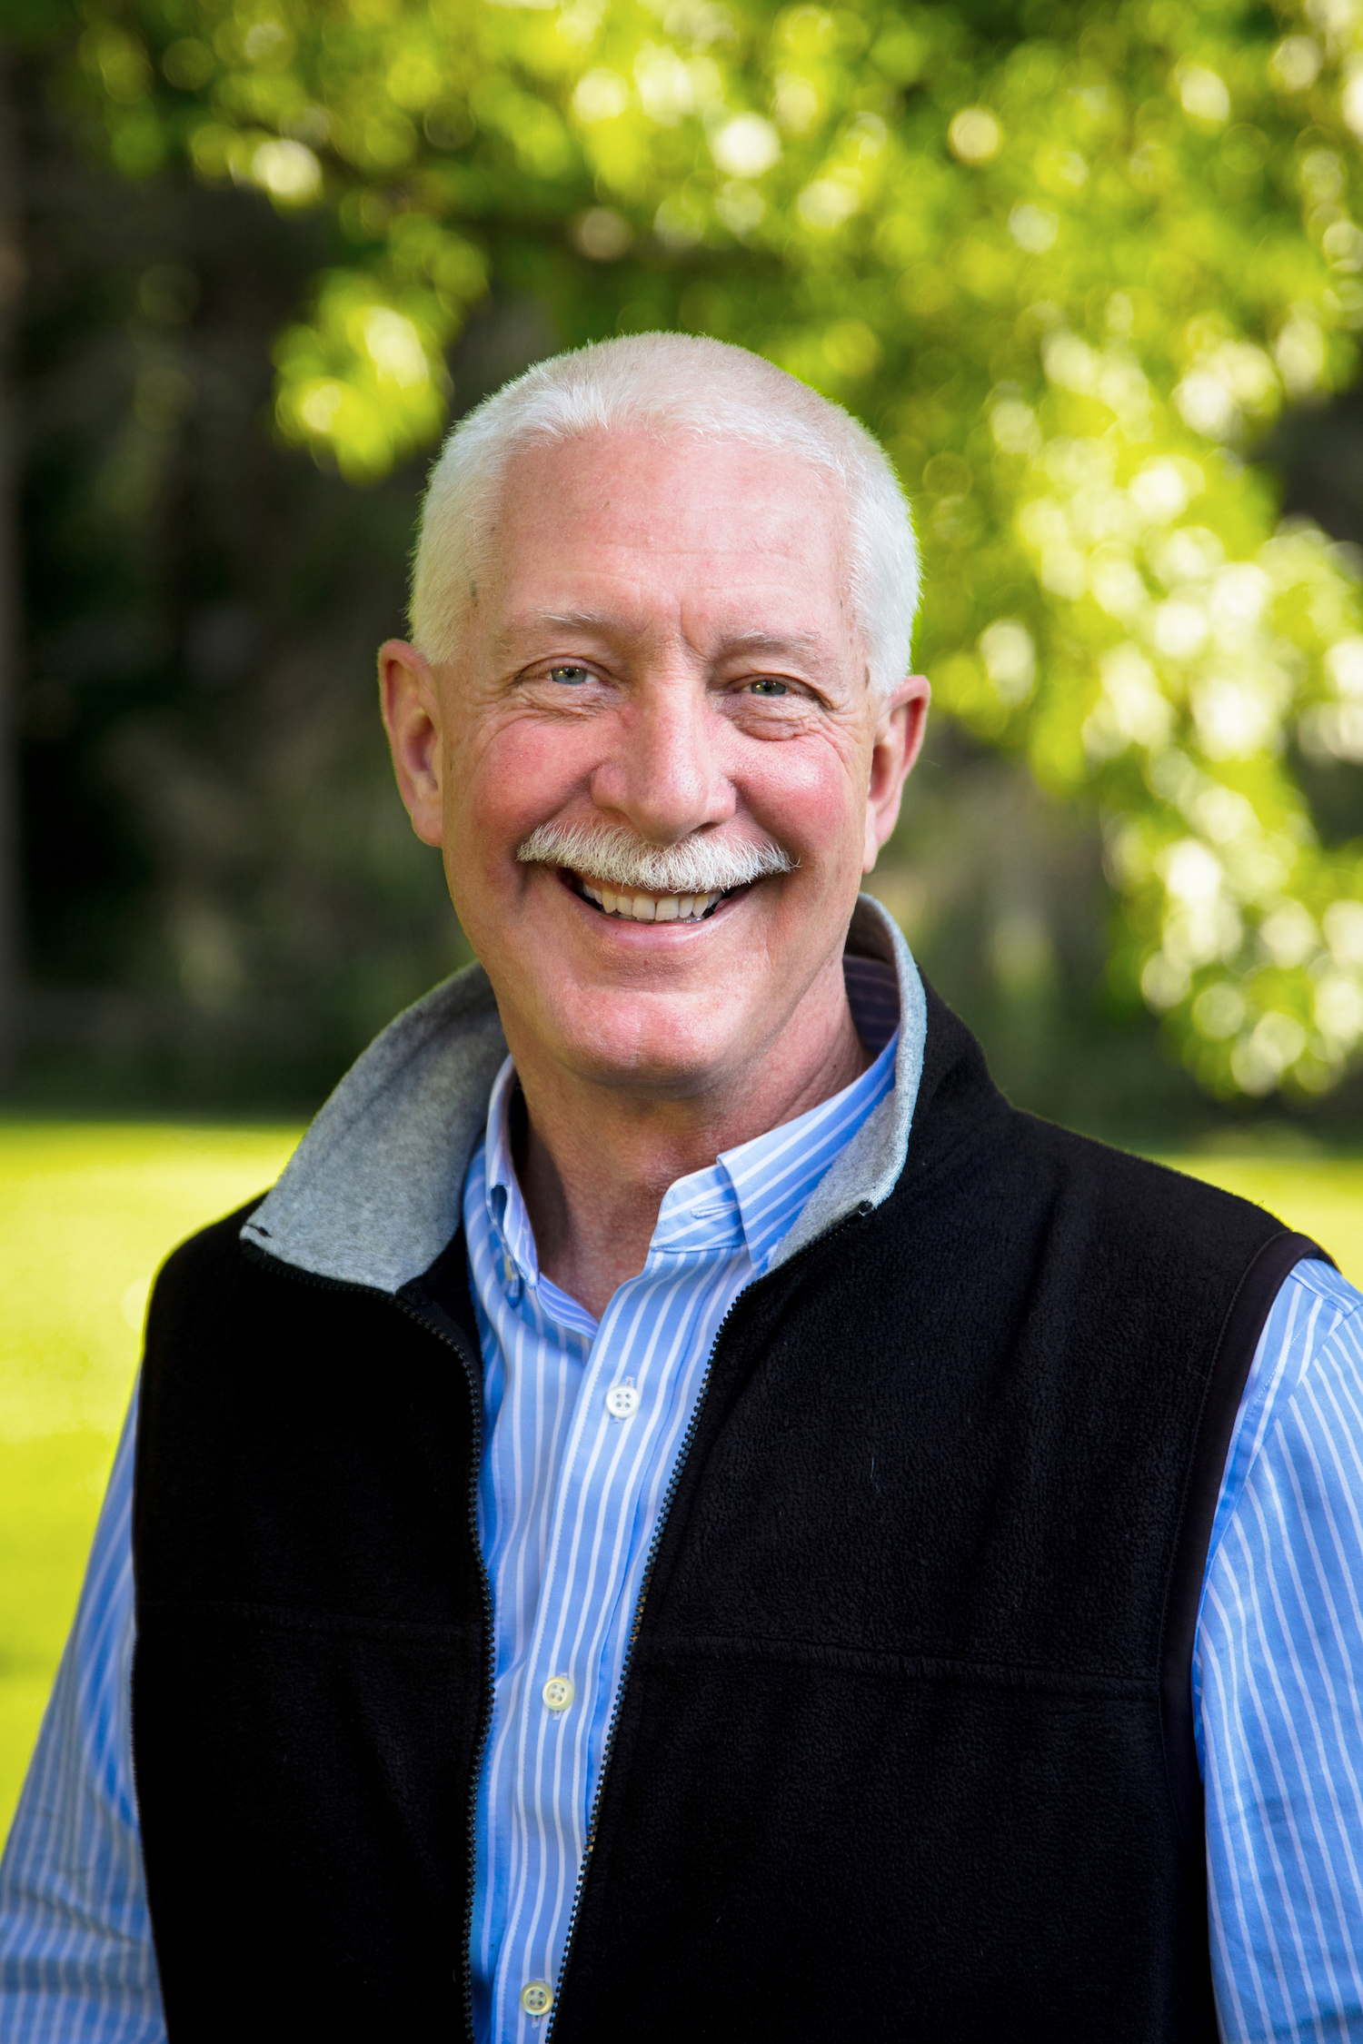
MASTERING LEADERSHIP:
Ein integriertes Rahmenwerk für
bahnbrechende Leistung und außergewöhnliche Geschäftsergebnisse
SCALING LEADERSHIP:
Aufbau von organisatorischen Fähigkeiten und Kapazitäten, um die Ergebnisse zu erzielen, um die es wirklich geht
Bill Adams
Bob Anderson

