Slide 1


Shine a Light on How Teams Work

Slide 2
The Future of Team Assessments is BRITE
BRITE is the most well-researched team assessment on the market. It measures the quality of team interactions while establishing a clear language, vision, and pathway to higher levels of team effectiveness.

Slide 3


Sometimes Dysfunctional Teams Look Like this
Notes:
What we think it looks like when teams don’t work well. https://www.skillpacks.com/how-to-resolve-team-conflict-examples-solutions/

Slide 4

More Often, It looks like this
Notes:
What we think it looks like when teams don’t work well. https://www.skillpacks.com/how-to-resolve-team-conflict-examples-solutions/

Slide 5






Modern Teams Face These Common Challenges
Lack of clarity in roles
Poor prioritization and processes
Communication issues
Insufficient collaboration
Unresolved conflict
Transactional leadership

Slide 6
Low Team Energy or High energy disruptors =
Poor Team Dynamics

Slide 7


Great Teams are In Short Supply
2015 Harvard Business Review: 75% of teams are dysfunctional
2017 Salesforce: 86% of employees say poor collaboration and communication results in workplace failure
McKinsey: 97% of executives believe poor alignment between team members impacts a project’s outcome
Notes:
Citations:
https://hbr.org/2015/06/75-of-cross-functional-teams-are-dysfunctional

Slide 8
ACCORDING TO A 2022 STUDY*, NEARLY 75% OF EMPLOYEES SEE TEAMWORK AS ESSENTIAL, YET MANY FEEL THEY LACK TRAINING AND UNDERSTANDING OF THEIR TEAM DYNAMICS. Understanding those dynamics and organically adapting to organizational needs significantly differentiate highly effective teams from the rest.
*Queens University of Charlotte

Slide 9
The Benefits of High-Performing Teams are Clear
Stanford: Great teams are 50% more productive
Harvard Business Review: Great teams are 87% more effective at decision making
Deloitte: Great teams are 5x more likely to be innovative
Gallup: Companies that foster teamwork lower turnover by 50%
McKinsey: Employees on great teams save 50 minutes per day due to more efficient collaboration
American Psychological Association: Companies with strong collaboration among teams are 20% more profitable
Notes:
Stats found here: https://zight.com/blog/collaboration-statistics/

Slide 10
The problem isn’t Just That Teams are Ineffective. The problem is that We don’t know How to Reliably Measure Team Effectiveness and create a plan to build a high-performing Team.
BRITE is Built to Solve this Exact Problem.

Slide 11
The unique design of BRITE and depth of research support the ability of teams to clarify, align, and connect more effectively around their shared mission and ultimately achieve more together.

Slide 12
BRITE: Shine a Light on How Your Team Works
We built BRITE to determine once and for all the exact components of how the best teams work. Here is what we did:
Surveyed over 26,000 global teams over 2 years
Assessed teams from an internal and external perspective
Leveraged our 30+ years of experience working with leaders to validate the model
Benchmarked the effectiveness of the model with organizations across major industries

Slide 13

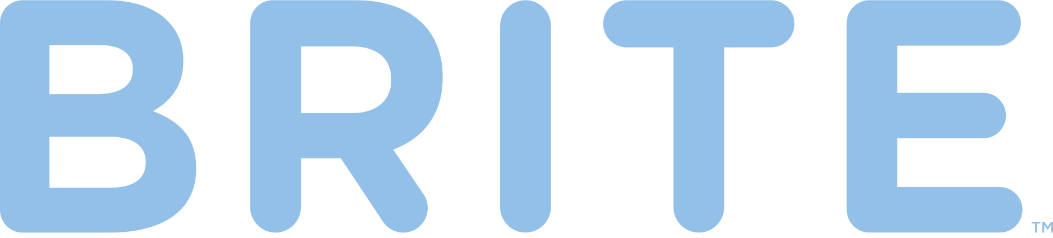

Why a Lightbulb?
The lightbulb filament either
Produces good energy flow, leading to illumination
Has a deficiency in energy flow, leading to reduced or dim output
The dynamic interaction of team members can either
Unleash creative energy leading to bright and innovative ideas
Disrupt team functioning, resulting in diminished performance

Slide 14
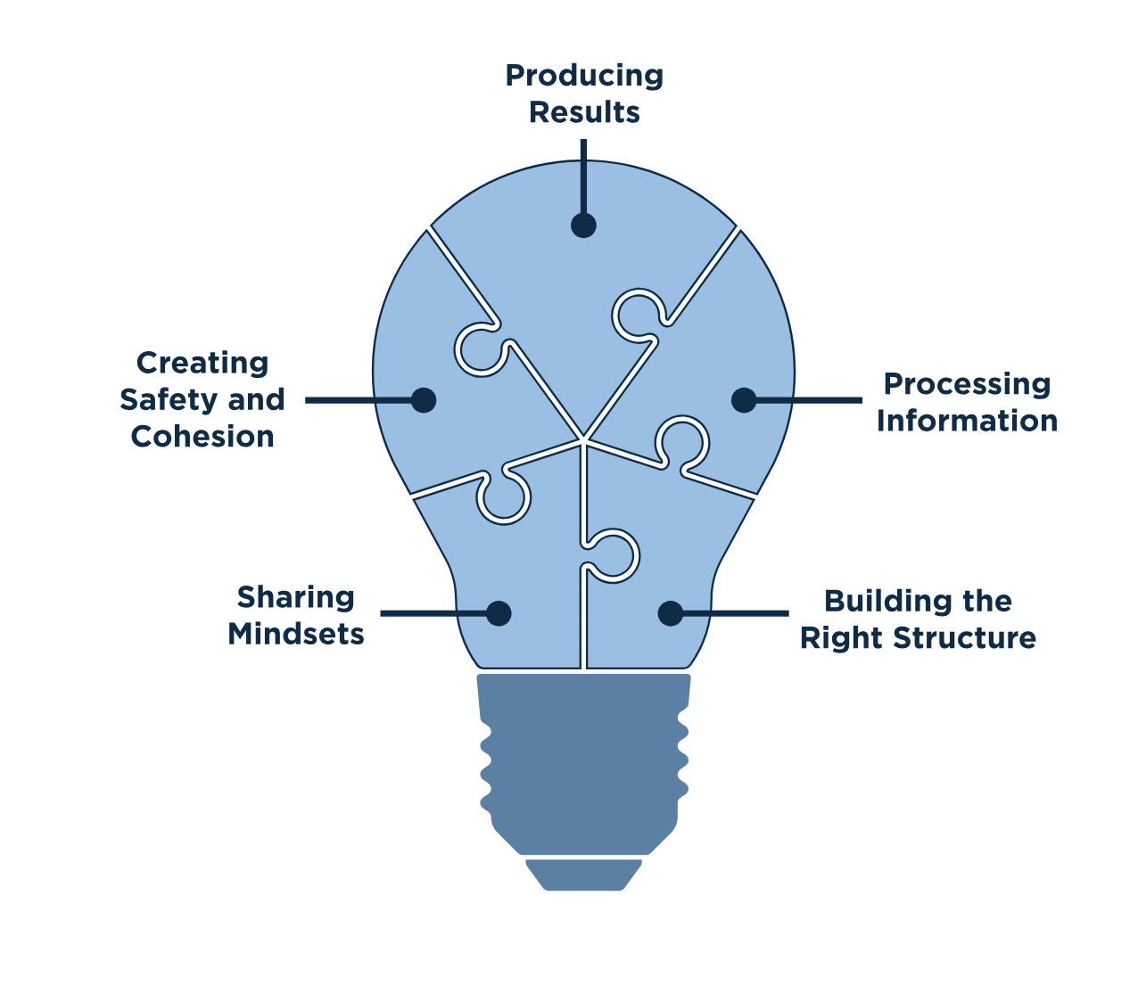
The BRITE Team Effectiveness Model

Slide 15
Viewing Team dynamics as A primary source of energy is the key to understanding and Elevating Team Effectiveness. When team energy is considered and managed like other tangible resources, team dynamics shift and important outcomes become achievable.

Slide 16
What the 5 Critical Elements Measure:
Sharing Mindsets – Assesses how well the fundamental beliefs and assumptions of each team member are aligned.
Building the Right Structure – Determines how well the team is organized and the clarity of roles and responsibilities.
Creating Safety and Cohesion – Evaluates the environment of the team including trust levels and interconnectedness.
Processing Information – Establishes the effectiveness of interpersonal communication among team members.
Producing Results – Reveals the skills and abilities of the team that lead directly to business outcomes.

Slide 17
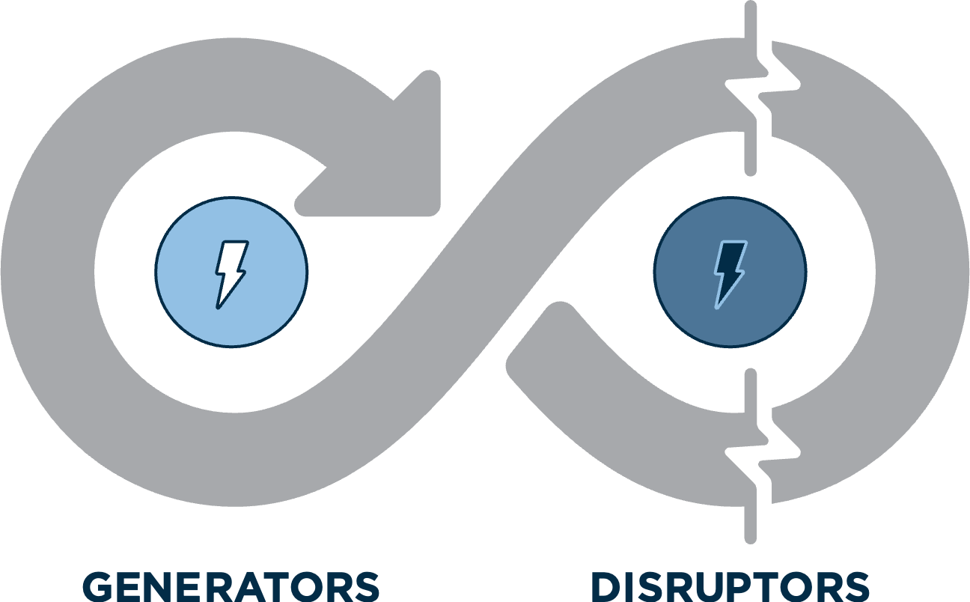
Key Idea: Generators and Disruptors
Generators increase the flow of energy in the team and among team members leading to positive team dynamics.
Disruptors drain energy leading to team dysfunction.
Notes:
Need to adjust the image to say Generators and Disruptors

Slide 18
SAMPLE BRITE REPORT
*Slides with a couple of sample reports are in the index but it does not contain the full report

Slide 19
The Expected Impact of BRITE
Increased Productivity – BRITE helps teams align around a shared mindset, helping teams produce outcomes the business needs to be successful.
Retain Top Talent – By identifying a specific development path, the team becomes more effective encouraging the best employees to stay committed.
Unlock Innovation – With BRITE, teams discover how to add additional creative energy leading to greater innovation.
Lower the Risk of Burnout – Identifying energy disruptors through BRITE allows teams to proactively create an environment that helps team members stay engaged.
Boost Morale – With a deep understanding of strengths and challenges, BRITE helps teams chart a clear path to success, keeping team energy high and the business moving forward.

Slide 20
BRITE reveals the precise reasons great teams achieve more. Unleash your team’s true potential by taking a BRITE assessment today.

Slide 21
Logistics
BRITE works similar to other assessments.
Assessments are anonymously sent to team members and take about 20-25 minutes to complete.
Once all assessments are complete, results can be delivered directly to a coach, a team lead or both.
The process is easy to implement and results are delivered quickly, easily and clearly.

Slide 22
Appendix: OPTIONAL SLIDES To Use

Slide 23
How Teams Grow
Using BRITE accelerates a team
Dynamic Approach
High Team Energy
Integrated Systems
Continuous Improvement
Focus
Innovation and Organizational Outcomes
Strategic Focus
Communication
Culture
Cohesion
Focus
Long-term goals
Tactical Application
Process
Structure
Priorities
Focus
Short-term objectives
Exceptional Teams
Low to Moderate Performing Teams
Moderate to High Performing Teams

Slide 24
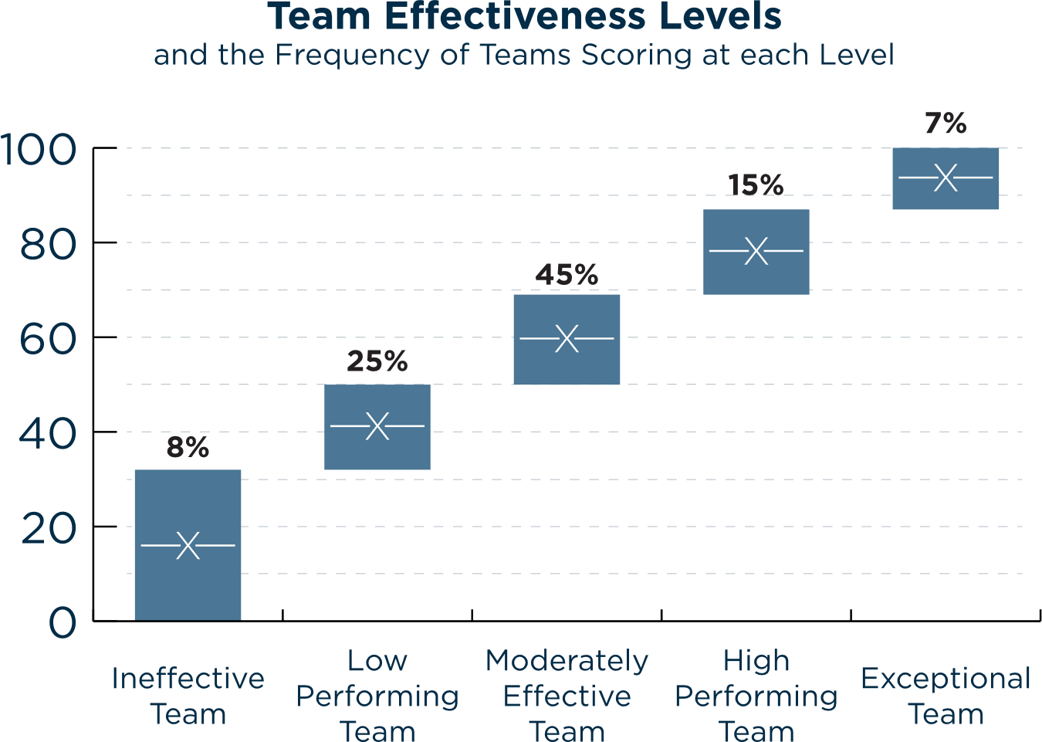

Slide 25

The Predictive Validity of the 5 Generative Factors
Producing Results
r = .58
Processing Information
r =.72
Creating Safety and Cohesion
r =.82
Each of the BRITE elements has been correlated with a separate measure of team effectiveness.
Building the Right Structure
r =.71
Sharing Mindsets
r = .65
Overall Team Effectiveness
r = .76

Slide 26
Report Basics
Each of the 5 elements has 3-4 specific generators and disruptors that contribute to a team’s overall score in that factor.
Generators and Disruptors are scored on a 1-100 scale. High scores for generators and low scores from disruptors indicate good energy and an effective team.
Each of the generators and disruptors also comes with in-depth analysis that gives more context on the importance of each element.
Finally, each report benchmarks the total score and provides a team alignment scale, indicating if the entire team feels one way or those feelings are distributed.

Slide 27
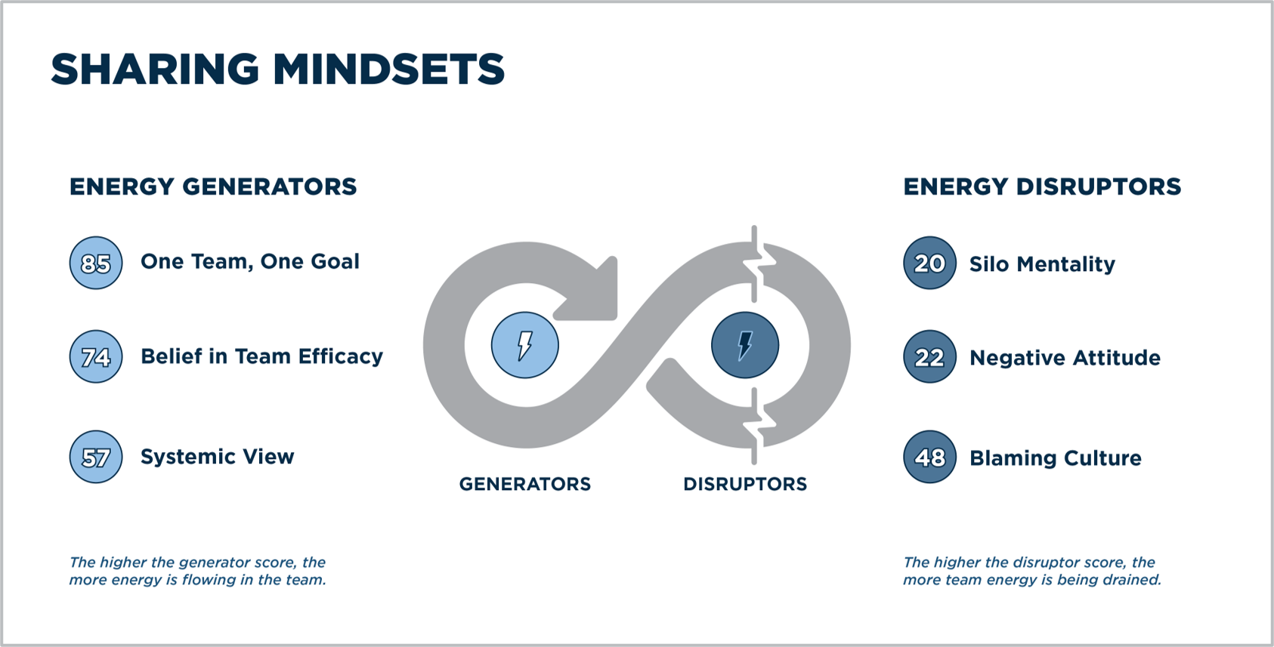

Slide 28
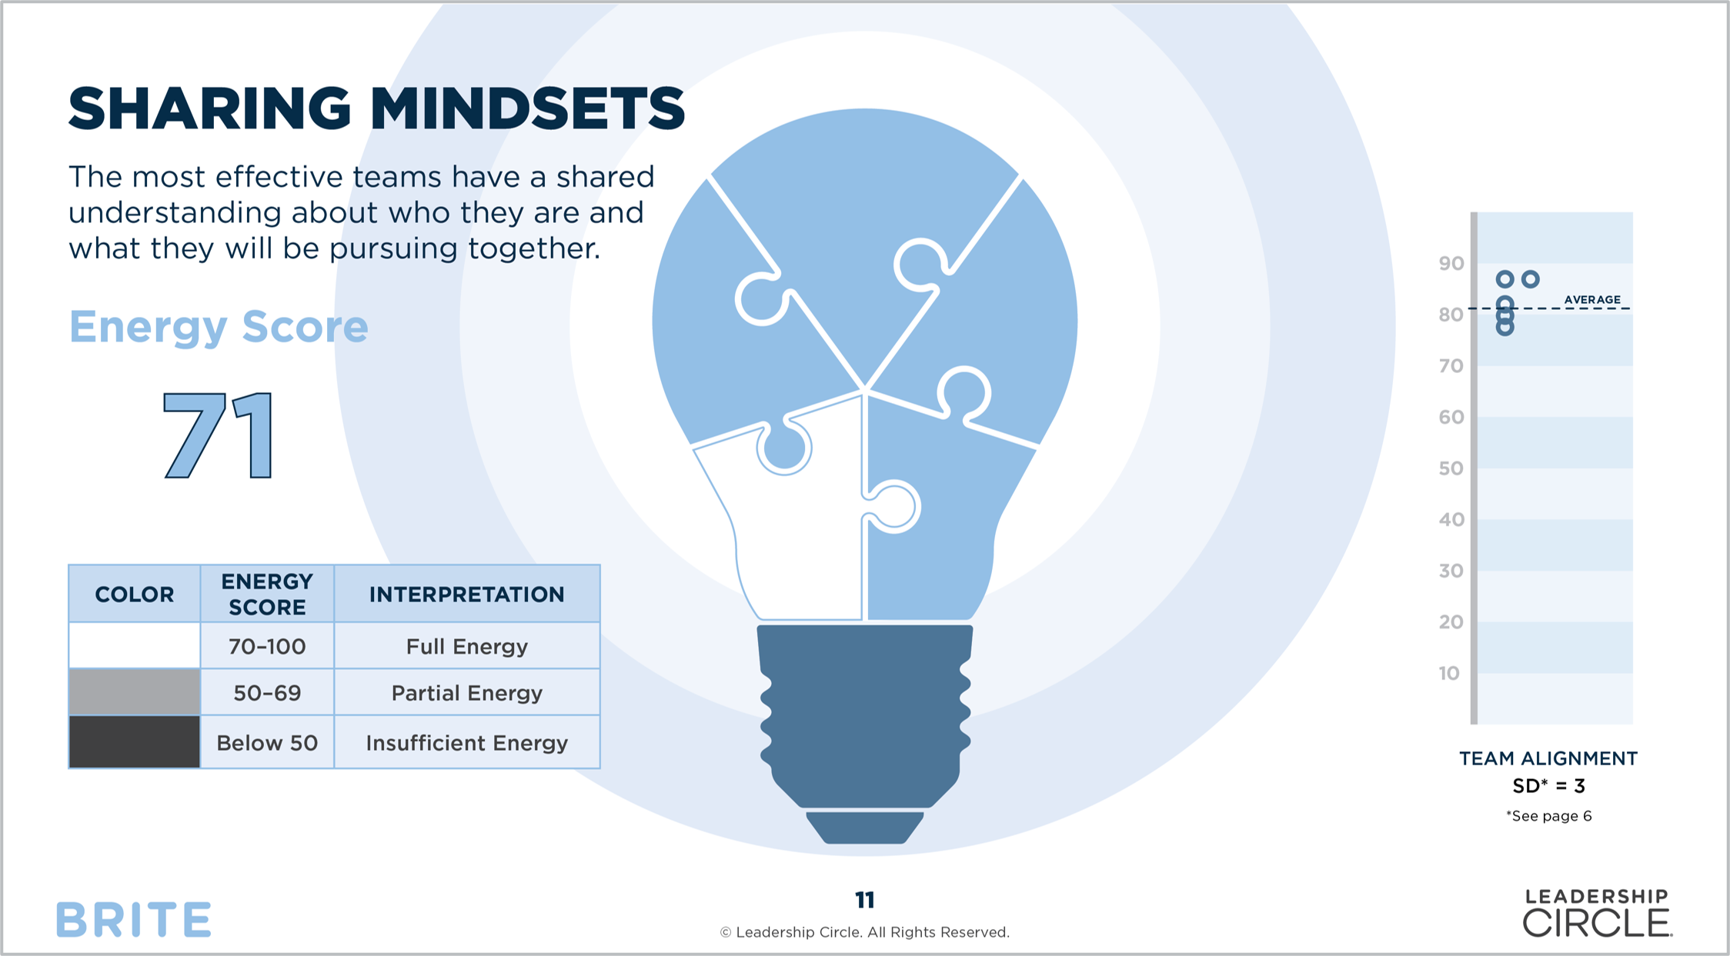

Slide 29
CASE STUDY

Slide 30

Pricing
$ 1,500 USD
+ [Optional] Coaching
Accommodates teams of all sizes
Automatic online delivery ​
An 80-page, expert developed Strategic Facilitation Guide​
BRITE + Team Coaching:
Custom built for the needs of the team
Pricing varies

Slide 31



LC Organizational System
Can measure leadership Skills
Focus on leadership Skills
Measures gap between current and desired leadership
Rated by others
Does not assess teaming aspects measured in BRITE
Measures Individual development.
Doesn’t provide insight to team synergy.
Assesses generative and disruptive factors related to team effectiveness
Diagnostic tool that shows where energy is or is not flowing on a team
Self-rated by team members
Used for any intact team
Use the skills – for further development
BRITE Tells you where the Team
Measures Leadership Synergy and other aspects

Slide 32
Shine a Light on How Your Teams Work

