Slide 1

推动领导者的
意识进化

Slide 2

Notes:
Learning Objective 1: for participants to understand the Reactive Creative scale measures the degree that a person’s leadership is experienced by others primarily through their Creative Competencies (high score) or through their Reactive Tendencies (low score) or some combination of the two (medium score).
Learning Objective 2: for participants to understand that this summary measure is a good indication of where a person spends their leadership energy and bandwidth.
Learning Objective 3: for participants to understand that this score reflects the visual of the graph. Lots of green on the top with little green on the bottom (high score). Little green on the top with lots of green on the bottom (low score). Mix of green on both top and bottom (medium score).

Slide 3
全景领导力测评
通用领导力发展模型
全球唯一全方位整合型领导力模型与工具
已有超 125,000 名领导者使用LCP助力自身发展
北美有超过 2000 名认证教练
已在全球1400多家组织中应用，包括财富500强企业、非营利机构，覆盖各个行业
Notes:
MO

Slide 4
360º 测评工具
什么是360°测评工具？
优势
以实证研究所证实的领导力特质和维度为基础的测评工具
通过问卷收集领导者本人（自评）及他人（评估者）的反馈
保密反馈
为持续性的领导力教练与发展奠定基础
聚焦于关键能力的发展
识别值得放大的优势
揭示领导风格对他人的影响
指出认知不足
找出思维模式与行为表现之间的联系
降低发展方向走偏的可能性
Notes:
MO

Slide 5


两种心智结构
问题 – 反应
成果 – 创造
问题
威胁
使命
愿景
浸染焦虑
维持身份
释放潜能
进化身份
反应
恐惧
行动
激情
结果
结果
时间
时间
平衡/振荡回路
成长/生发回路
Notes:
Land the depth of personal impact of each

Slide 6
领导力测评的3个维度
能力
Competencies
假设
Assumptions
Style-Type-Personality
风格-类型-个性
Notes:
First, You can measure Competencies—this is the most common choice for organizations.
Competencies tell you what is going on with key behaviors that impact your ability to achieve results. An example of a competency might be Strategic Focus or Collaboration. A competency describes a positive leadership behavior, but does not answer the question ‘”What it going on under the surface that supports or inhibits these key behaviors”? Examples of competency assessments include Benchmarks, PDI and Lominger.
(Click) The next choice for assessments measure what’s going on under the surface. These are self-awareness tools that measure the internal motivations that drive behavior. These tools are very useful if they help managers get insight into why they are behaving in certain ways. However, these tools seldom show any direct connection to competencies or measures of effectiveness in leadership. Tools in this category include Hogan, FIRO-B, and Emotional Intelligence.
(Click) And finally, in the third category you have Tools that measure Style and Personality. These tools are mostly used to help managers and teams understand their differences, but these tools fail to clarify how Style and Personality impacts competencies or business results. Tools in this category include Meyers Briggs or Disc.
With any of these tools, used separately, you are getting, at best, a third of the whole picture. If you are serious about leadership development—you need to help managers get the whole story. Otherwise, It’s like trying to see with one eye closed…. (CLICK) With the LCP you get the full picture of your leadership – 3 assessments in one

Slide 7
什么在发生
为何发生
变革路径
Notes:
With the LCP you get the full picture of your leadership. At last, you see, in one assessment, what you are missing in all the others. TLC is unique because it measures
-- (Click) Leadership competencies
--(Click) Assumptions that drive Behavior
Assumptions that lead to effectively developing key leadership competencies
Assumptions that run reactive, self-limiting behavior.
-- (Click) and LCP reveals style and personality…all at the same time.

Slide 8

模型基础：
两种心智结构

Slide 9

创造性能力
相处能力
系统意识
关爱
培养团队合作
协作者
辅导与培养
人际交往智慧
关心社会
持续性产出
系统思考者
自我觉察
成就
无私的领导者
平衡
沉着
学习者
战略关注
使命与愿景
取得成果
决断力
本真性
正直
勇敢真实

Slide 10


反应性倾向
顺从
保守
取悦
归属
被动
防卫
距离感
挑剔
傲慢
控制
专制
野心
工作狂
完美

Slide 11
关系及任务

Slide 12
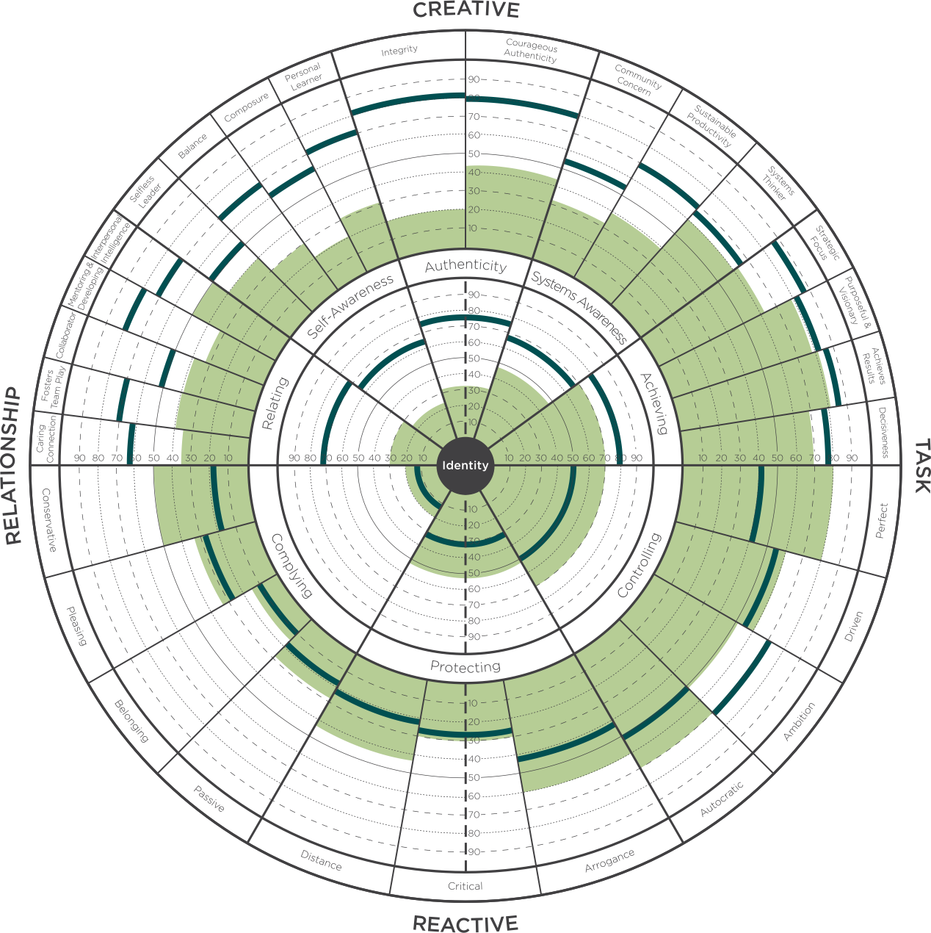
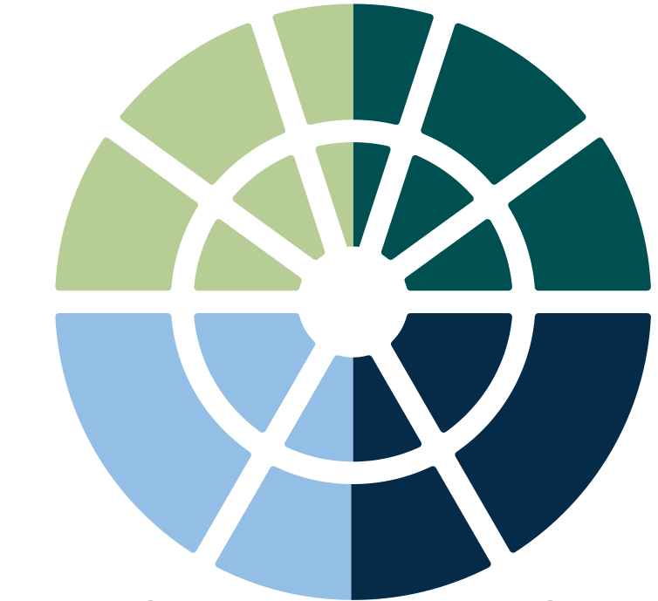
四大象限
创造性
关系
创造性
任务
反应性
关系
反应性
任务

Slide 13
5个内圈
核心领导力维度
18项外圈
创造性能力

Slide 15
3个内圈
反应性维度
11项外圈
反应性倾向

Slide 17
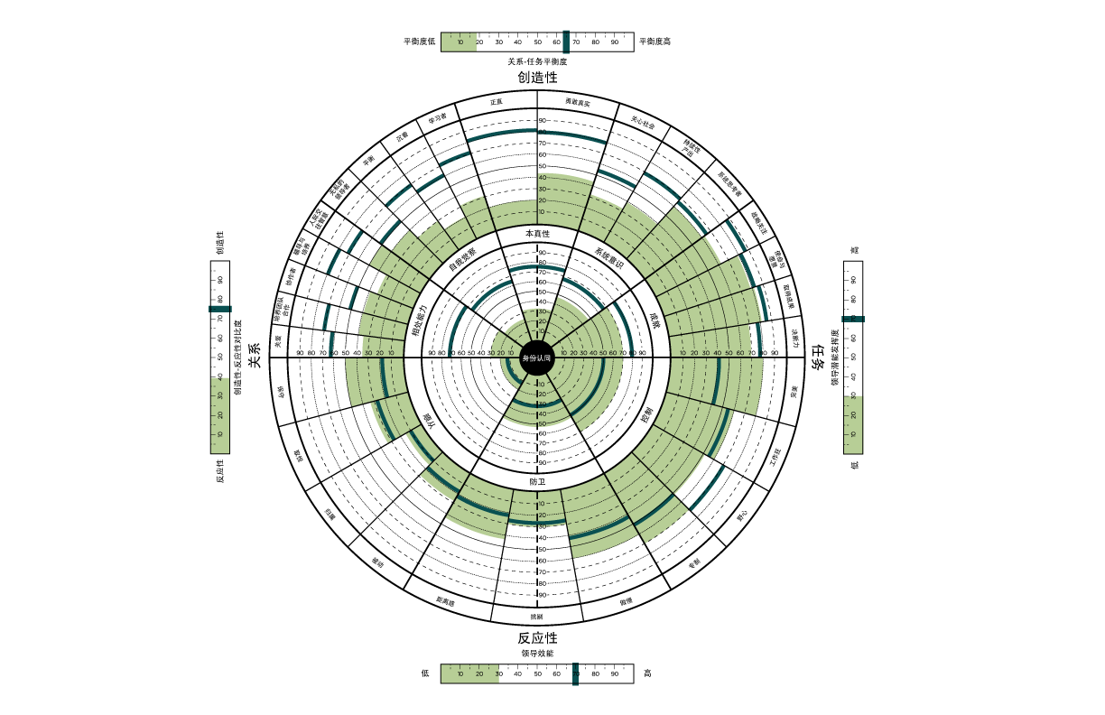
创造性-
反应性对比度标尺
Notes:
Learning Objective 1: for participants to understand the Reactive Creative scale measures the degree that a person’s leadership is experienced by others primarily through their Creative Competencies (high score) or through their Reactive Tendencies (low score) or some combination of the two (medium score).
Learning Objective 2: for participants to understand that this summary measure is a good indication of where a person spends their leadership energy and bandwidth.
Learning Objective 3: for participants to understand that this score reflects the visual of the graph. Lots of green on the top with little green on the bottom (high score). Little green on the top with lots of green on the bottom (low score). Mix of green on both top and bottom (medium score).

Slide 18
关系-任务平衡度标尺
Notes:
T
Learning Objective 1: for participants to understand the Relationship Task Balance Summary Scale, in particular, that the scale is measuring the relative balance between the Achieving competencies and the Relating competencies and it is not measuring the strength of either dimension.
Learning Objective 2: for participants to understand the sensitivity of this scale increases as the scores for Relating and Achieving reach the higher percentiles. A difference of a very small amount between those two dimensions at the higher ends of the percentile scale (80th percentile or above) will report what seems like an exaggerated lack of balance in the R-T scale. In these cases, it is easy to just look at the inner circle graph and look at Achieving and Relating.

Slide 19
领导潜能发挥度标尺
Notes:
A
Learning Objective 1: for participants to understand that Scoring high here means that when all the dimensions are taken together, the strengths outweigh the weaknesses. High scores indicate there is significant strength in the Creative dimensions and relatively low scores in the Reactive dimensions as well as good balance between people competencies and task competencies. Scoring low suggests that when all the dimensions are taken together, the weaknesses outweigh the strengths. It means that there is more energy going in the reactive direction than in the creative and/or that there is an imbalance in people and task competencies.
Learning Objective 2: for participants to understand the Leadership Potential Utilization Scale is mathematically derived by multiplying the Relationship Task Balance score by the Reactive Creative score and showing the result as a percentile.
Learning Objective 3: for participants to understand that a useful developmental lens on this score is how much development should I consider in my current role? A low score suggests there are lots of developmental opportunities in current role and the challenge will be choosing the most relevant ones. A middle score suggests there are a few critical areas of development that if leveraged successfully would make a big difference in leadership effectiveness in the current role. A high score here may indicate that it would be beneficial to imagine the challenges of the next role (one with more scale, scope, and complexity) and focus developmental effort there.

Slide 20
领导效能标尺
Notes:
T
Learning Objective 1: for participants to understand the Leadership Effectiveness Scale reflects the answers to the five ideal leader questions on page 86 of the Profile Interpretation Manual and Slide 57 in this deck. The raw scores are shown on page 2 of the LCP report and the percentile scores are shown on page 3 of the LCP report.
Learning Objective 2: for participants to understand that this score is often a significant attention getter in a debrief particularly when the Self score is significantly different from the All Evaluators score and/or when the score is quite low.

Slide 21
领导效能
与业绩成果

Slide 22



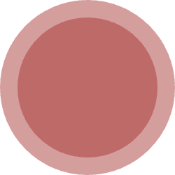



反应性与创造性领导力
合一性
对应成人意识发展层次
整合性
内观自变
创造性
自主导向
反应性
规范主导
唯我性
22
© Leadership Circle | All Rights Reserved

Slide 23
反应性与创造性领导力
合一性
对应成人意识发展层次
整合性
内观自变
5%
整合性
创造性
自主导向
15%
创造性
领导效能
反应性
反应性
规范主导
80%
领导层级
唯我性

Slide 24
针对领导效能标尺的测评问题
我对他/她的领导力感到满意。
他/她是那种别人立志成为的领导。
他/她是好领导的模范。
他/她的领导能力让组织得以繁盛发展。
总体而言，他/她的领导力行之有效。
Notes:
Learning Objective 1: for participants to understand that when a person completes a LCP, they answer each of the 119 questions against the backdrop of their (perhaps unconscious) tacit belief in what makes someone an effective leader. The 5 questions explicitly ask evaluators to rate the leader directly against their picture of the ideal leadership.
Learning Objective 2: for participants to understand that these additional five questions constitute a “survey within a survey,” in that they answers are not used to compute any part of the graph other than this Leadership Effectiveness Scale.

Slide 25
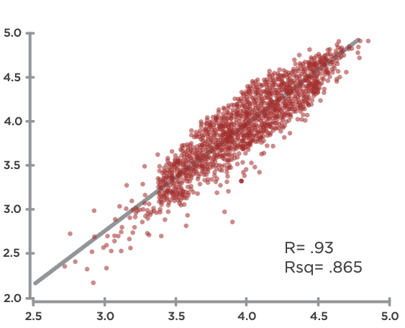
领导效能与创造性
领导效能
创造性能力
Notes:
Learning Objective 1: for participants to understand that an initial research question was the degree to which the LCP model actually measured what is commonly understood to be effective leadership. We found a strong positive correlation between the Creative aspects of the LCP and the LE questions indicating that the battery of 18 Creative competencies in the LCP are tracking with what it takes to be an effective leader across many contexts.
Learning Objective 2: for participants to understand that r = the relationship between the two variables or the line of best fit through the data—so how much of the movement of one variable is described by movement of the other. In this case, r = 0.93 means that if the Average Creative Score increases 1.00 (one unit of measure), the Leadership Effectiveness score will likely increase on average by 0.93. This is a very strong correlation.
Learning Objective 3: for participants to understand that rsq = the degree to which the data tightly cluster around the line of best fit. A high rsq means that the data don’t vary much and fit tightly together around the line of best fit (the prediction of the model). A low rsq means that the data are more scattered around the line of best fit. (Technically, rsq measures the amount of variability among the data points that can be explained by the model or predicted by the line of best fit).

Slide 26
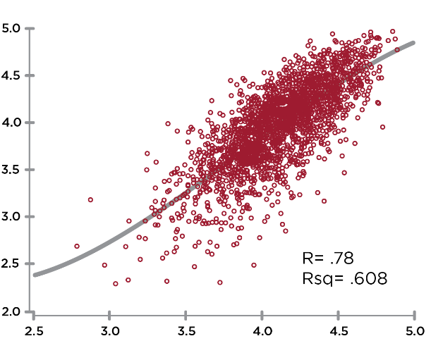
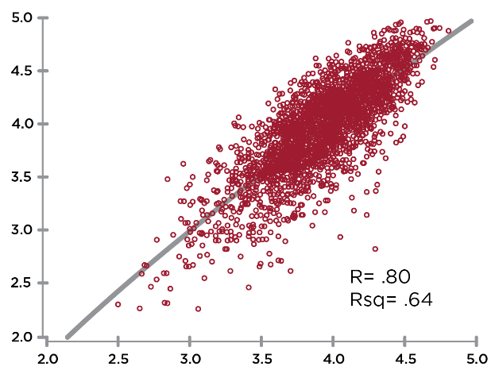
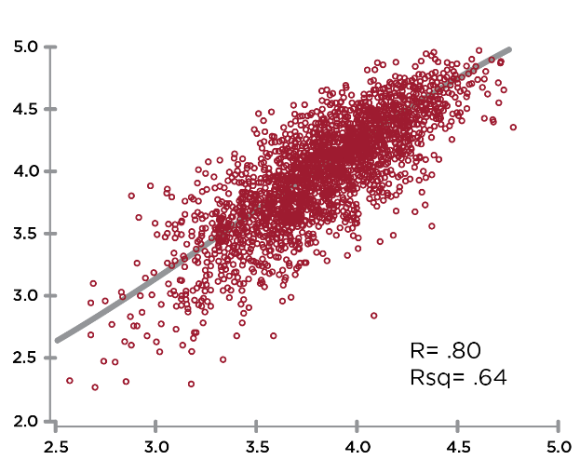
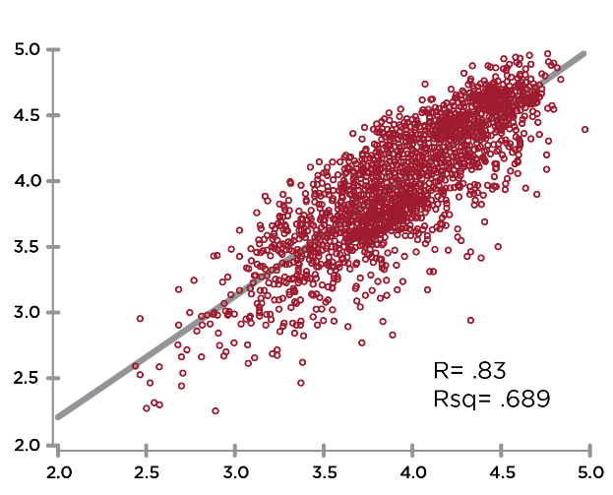
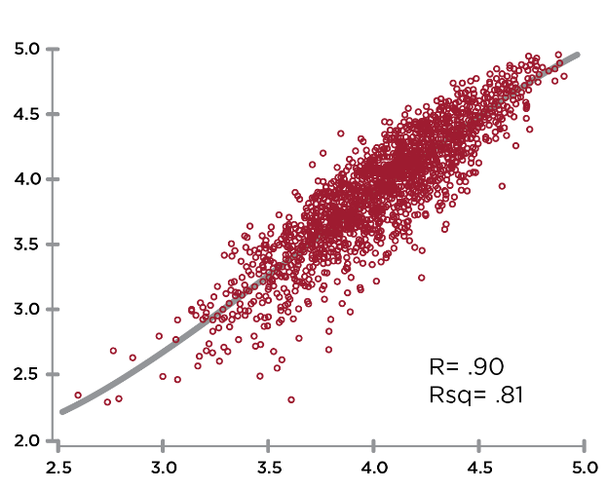
创造性维度与领导效能的相关性
领导效能
领导效能
领导效能
R=.78
本真性
R=.76
R=.84
自我觉察
系统意识
领导效能
领导效能
R=.85
R=.91
相处能力
成就
Notes:
Learning Objective 1: for participants to understand that perceptions of Leadership Effectiveness (the 5 questions on the scale) are strongly correlated with the Creative Competencies.

Slide 27
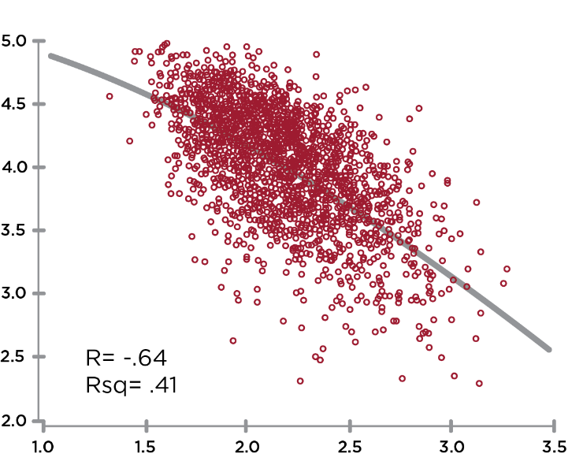
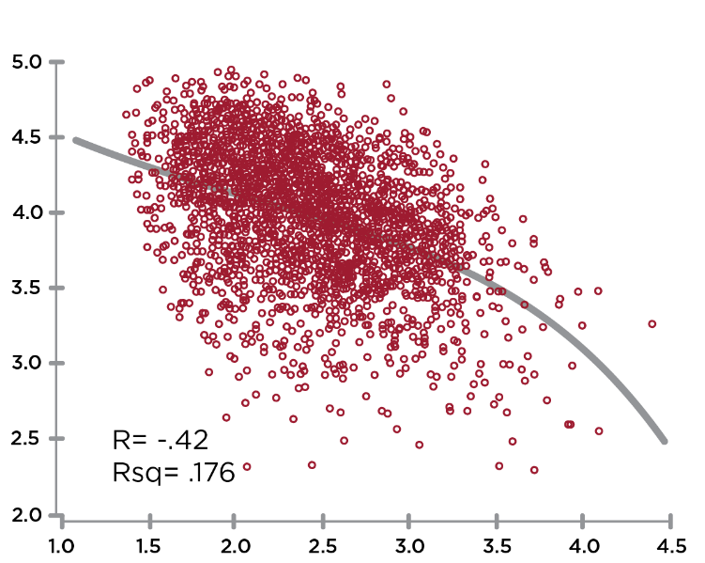
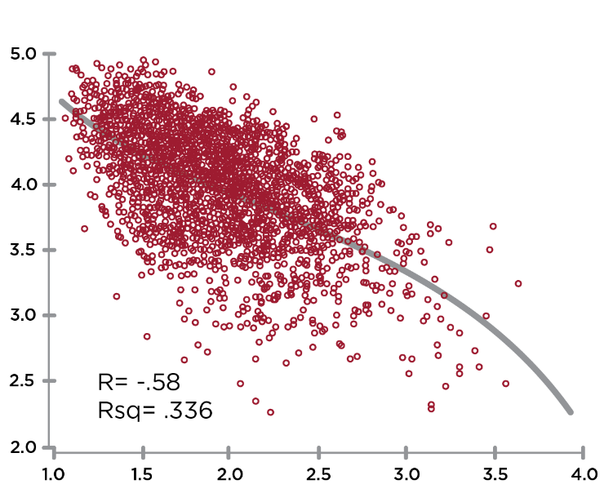
反应性维度与领导效能的相关性
领导效能
领导效能
R= -.63
R= -.41
顺从
领导效能
控制
R= -.56
防卫
Notes:
Learning Objective 1: for participants to understand that perceptions of Leadership Effectiveness (the 5 questions on the scale) are strongly correlated with the Creative Competencies.

Slide 28
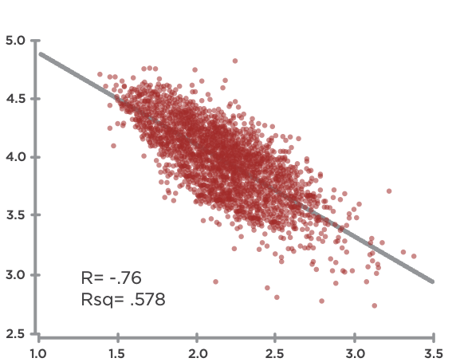
创造性能力和反应性倾向之间的相关性
创造性
反应性
Notes:
Learning Objective 1: for participants to understand that the Creative Competencies are strongly negatively correlated (-.76) with the Reactive Tendencies.
Learning Objective 2: for participants to understand that the implication of this correlation is that Reactive Tendencies significantly block/cancel the expression of Creative Competencies.

Slide 29



相邻维度
Notes:
Learning Objective 1: for participants to understand that the elements right across the border from each other (Neighbors) are Relating-Complying, Protecting-Authenticity, Achieving-Controlling. These are anchored in the same kind of energy (heart, head, will) and have lower negative correlations than other relationships across the graph.

Slide 30
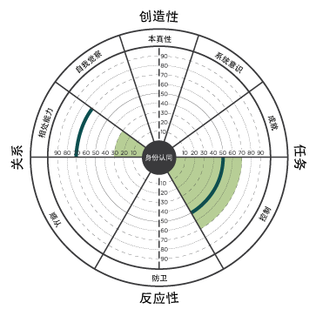
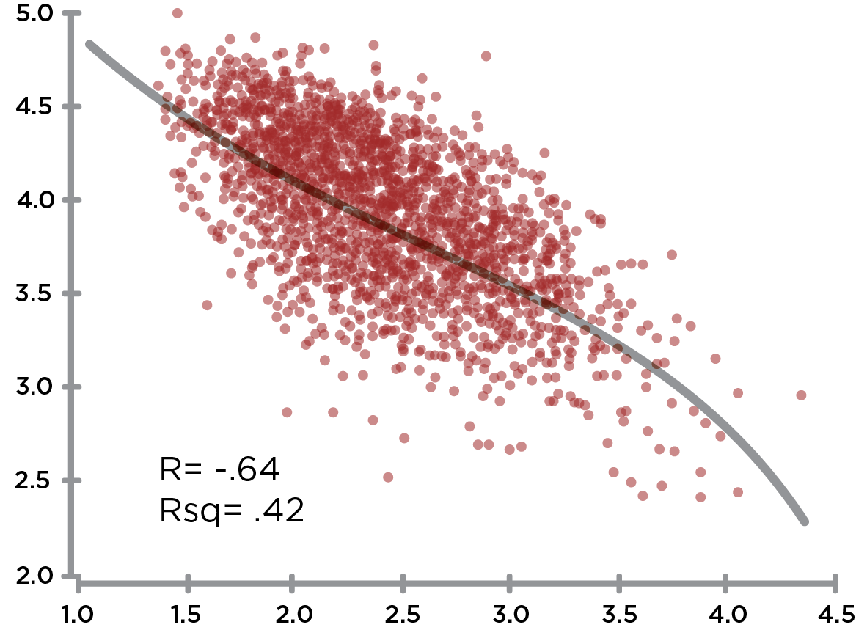
相对维度：控制与相处能力
相处能力
控制
Notes:
Learning Objective 1: for participants to understand that Controlling has a large negative effect on Relating (-.65) and thus they are opposite one another on the graph.
Learning Objective 1: for participants to understand that Controlling also has a large negative effect on Self Awareness (-.66) and thus they are also opposite one another on the graph.
Learning Objective 3: for participants to understand that a typical developmental trajectory for someone with high Controlling would be up and across the graph working on improving Relating and/or improving Self Awareness.
Learning Objective 4: for participants to understand that Controlling is negatively correlated with Relating (-.65).

Slide 31
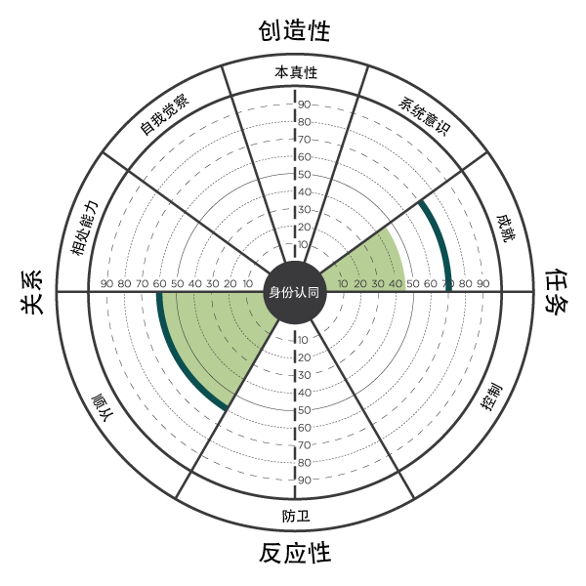
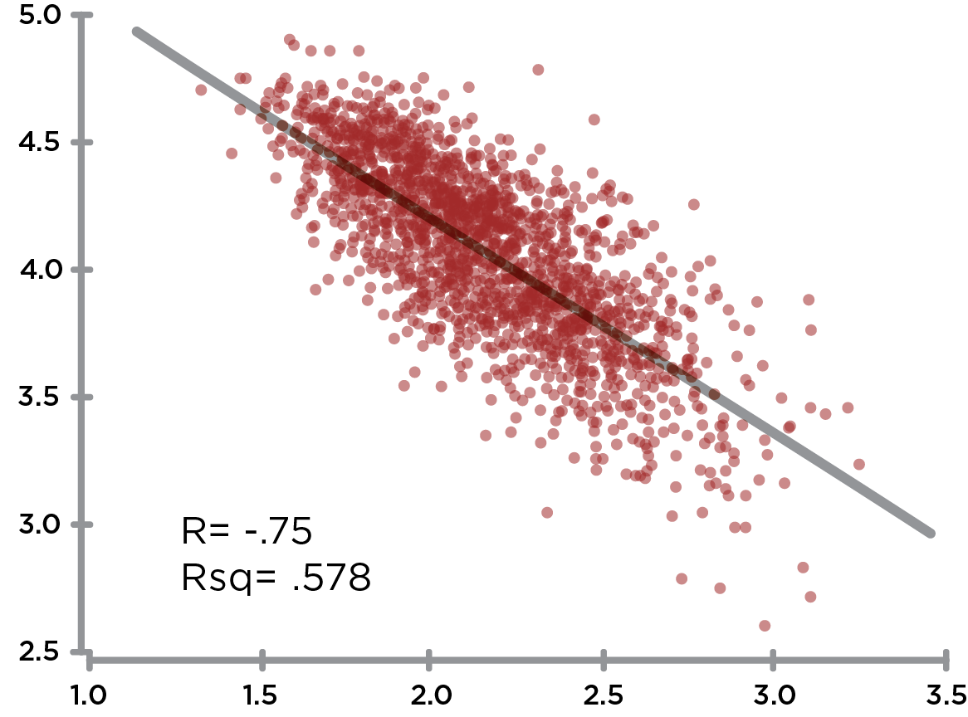
相对维度：顺从与成就
成就
顺从
Notes:
Learning Objective 1: for participants to understand that Complying has its biggest negative effect on Achieving (-.76) and thus they are opposite one another on the graph.
Learning Objective 2: for participants to understand that a typical developmental trajectory for someone with high Complying would be up and across the graph working on improving Achieving.
Learning Objective 3: for participants to understand that Complying has its second biggest negative effect on Authenticity (-.62) and this is also another common developmental trajectory (particularly working on Courageous Authenticity).
Learning Objective 4: for participants to understand that Complying is negatively correlated with Achieving (-.76).

Slide 32
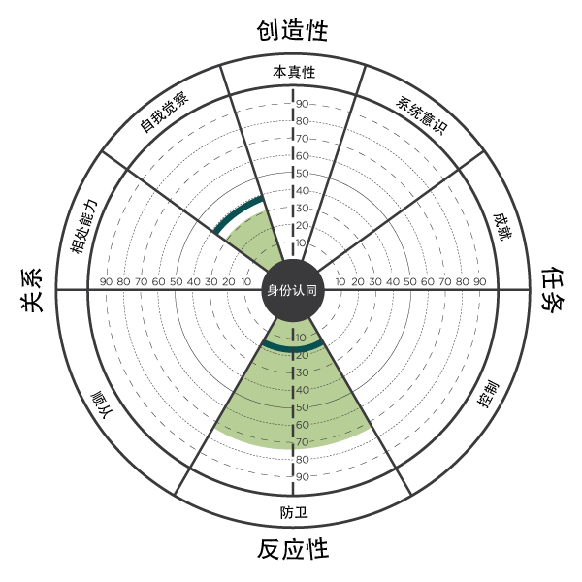
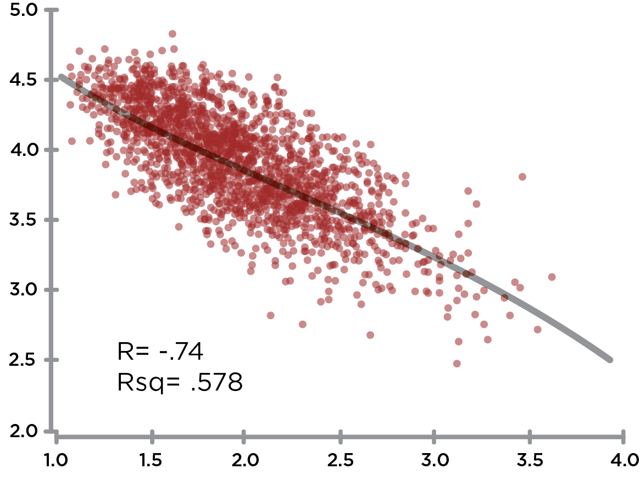
相对维度：防卫与自我觉察
自我觉察
防卫
Notes:
Learning Objective 1: for participants to understand that Protecting has a large negative effect on Self Awareness (-.70) and thus they opposite on the graph.
Learning Objective 2: for participants to understand that Protecting has a large negative effect on Relating as well (-.73).
Learning Objective 3: for participants to understand that a typical developmental trajectory for someone with high Protecting might be up and to the left across the graph working on improving Self Awareness and Relating.
Learning Objective 4: for participants to understand that Protecting is negatively correlated with Self Awareness (-.76).

Slide 33
全景领导力测评（LCP）
与领导效能的相关性
我对他/她的领导力感到满意。
他/她是那种别人立志成为的领导。
他/她是好领导的模范。
他/她的领导能力让组织得以繁盛发展。
总体而言，他/她的领导力行之有效。
Notes:
Learning Objective 1: for participants to understand that each of the 29 Creative/Reactive dimensions of the LCP have their own unique correlation to Leadership Effectiveness (the five Ideal Leader questions).
Learning Objective 2: for participants to look at their own LCP data through the lens of these more granular correlations to see if it generates any new developmental understanding or insight.
Learning Objective 2: for participants to imagine/brainstorm how they might use these correlations with their clients.

Slide 35
业绩表现指数
基于486个组织和组织部门的研究。
通过6个分类来评估业绩表现：
销售额 / 收入
市场
份额
盈利能力/
资产回报率
产品&服务
质量
新产品开发
总体业绩表现
Notes:
Learning Objective 1: for participants to understand the methodology of the Business Performance Research Study. In this case, that a BPI was utilized that was made up of six measures of business performance.
Learning Objective 2: for participants to understand that 486 leaders each took the LCP, attached to the LCP was the BPI. Then, just looking at the top 10% and the bottom 10% of the business performance results we aggregated those LCPs together (about 50 in each sample).

Slide 36
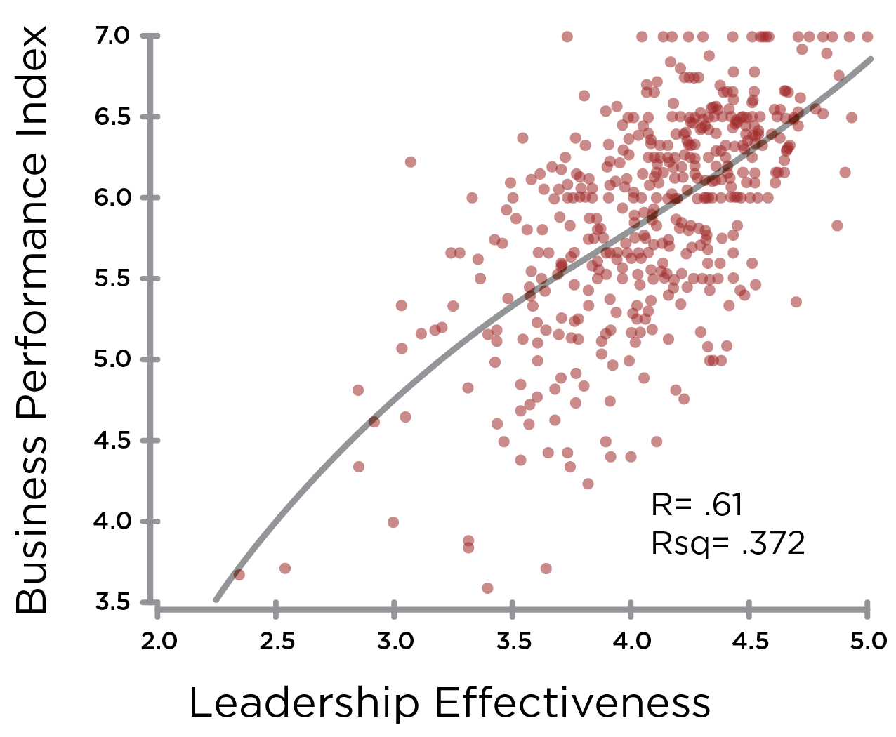
领导效能 vs 业绩表现
业绩表现指数
领导效能
Notes:
Learning Objective 1: for participants to understand the correlation between Leadership Effectiveness (measured by the five ideal leader questions) and Business Performance (measured by the six elements of the Business Performance Index).

Slide 37
领导效能 & 业绩表现
业绩表现指数
头部10%
底部10%
领导效能

Slide 38
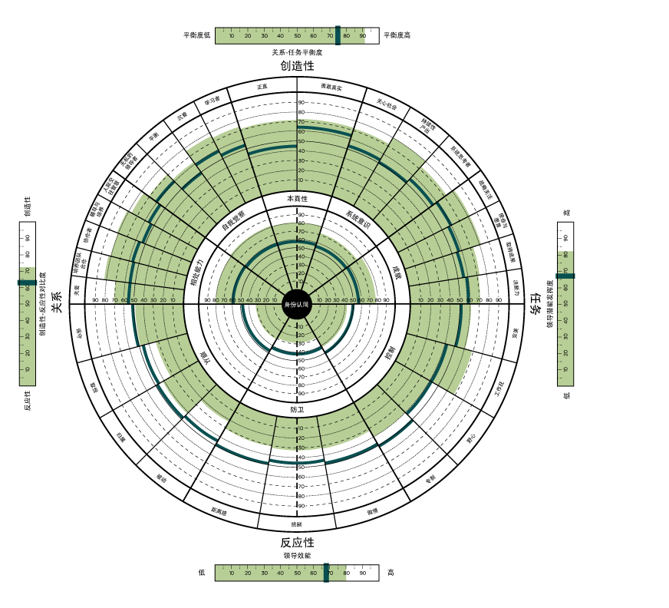
头部10%
被评为
业绩表现最佳
的企业的领导者的总体测评结果
Notes:
Learning Objective 1: for participants to understand that sorting the data by just the Business Performance Index (here the top 10%) yielded this kind of highly Creative aggregate leadership profile (this is the rollup of the approximately 50 leaders in the top performing businesses.
Learning Objective 2: for participants to understand that this makes the business case for why pursue development with the LCP?
Learning Objective 2: for participants to understand that there may also be a halo effect bias in play. If the business is performing well our view of the effectiveness of the leaders can be positively influenced.

Slide 39
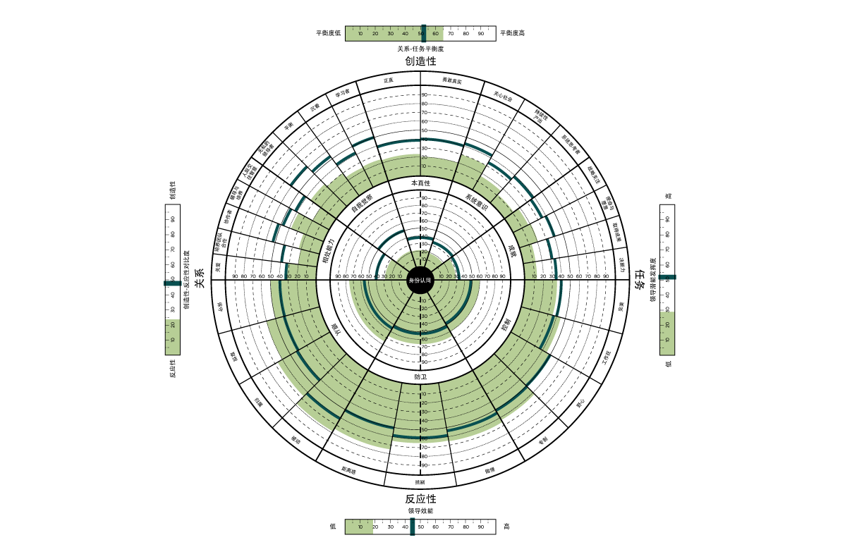
底部10%
被评为
业绩表现最差
的企业的领导者的总体测评结果
Notes:
Learning Objective 1: for participants to understand that sorting the data by just the Business Performance Index (here the bottom 10%) yielded this kind of highly Reactive aggregate leadership profile (this is the rollup of the approximately 50 leaders in the worst performing businesses.
Learning Objective 2: for participants to understand that this makes the business case for why pursue development with the LCP?
Learning Objective 2: for participants to understand that there may also be a halo effect bias in play. If the business is performing poorly our view of the effectiveness of the leaders can be negatively influenced.

Slide 40
底部10%
头部10%
Notes:
Learning Objective 1: for participants to understand that this is the developmental journey many senior teams and organizations are hoping to take (particularly once they understand the correlation between the LCP and Business Results).

Slide 41
补充内容

Slide 42

全景领导力（LCP）360度 — 意识发展的开罐器
VUCA
内观自变
V-易变性
U-不确定性
C-复杂性
A-模糊性
对心智复杂程度的要求
自主导向
Developmental
Challenge
自我复杂性
环境复杂性
规范主导
当前领导力意识的临界值
S-稳定性
C-确定性
S-简单性
C-清晰性
儿童时期
SCSC

Slide 43
曾格（Zenger）的研究发现
领导能力与业绩成果之间的关系
成果 - 投资回报率
+
+2K
+1K
头部20%
的企业
0
-1K
-
20%
50%
80%
汇总360°反馈

Slide 44
曾格（Zenger）的研究发现
领导能力与业绩成果之间的关系
成果 - 投资回报率
+
+2K
+1K
头部20%
的企业
0
-1K
-
20%
50%
80%
汇总360°反馈

Slide 45
360°测评的优势
聚焦于关键能力的发展
识别值得放大的优势
揭示领导风格对他人的影响
指出认知不足
找出思维模式与行为表现之间的联系
降低发展方向走偏的可能性

Slide 46
设计标准
衡量关键领导能力
评估信念体系与假设
指出发展阶段
整合理论框架
对结果进行梳理，使关键的发展机会一目了然

Slide 47
理论基础概述
创造性和反应性导向： 弗里茨、圣吉与基弗
认知心理学 — 理性情绪疗法： 伯恩斯、埃利斯
愿景；依赖与野心；政治脚本： 彼得·布洛克
* * * * * *
人格结构: 卡伦·霍妮
  趋向 (complying)
  回避 (controlling)
  对抗 (protecting)
九型人格 – 9种人格类型，每个类型都围绕一种核心错觉而建立
自我/阴影：卡尔·荣格
身体心理治疗/躯体心理学：赖希，库尔兹，洛温，皮拉科斯
发展阶段框架： 科尔伯格、凯根、威尔伯、 托伯特、 库克·格鲁特
神秘文化/ 传统智慧
柯维成长三阶段 （依赖、独立、互赖）
领导力文献：班尼斯、德鲁克、柯林斯、戈尔曼 等
领导力 360° 研究：曾格、福克曼 等

Slide 48

反应性性格结构
顺从
控制
第一名
卓越
成就
支配
控制
赢
受人喜爱
满足他人期待
取悦他人
被他人接纳
身份认同
安全感
价值
防卫
优越
正确
自给自足
保持距离
Notes:
Use mural. Can use as a recap (on mural or slide here) This is demonstrated very clearly through group learning on the mat.

Slide 49

Notes:
Learning Objective 1: for participants to have a visual model of the LCP that is holistic and normalizing—we all have roots in the Reactive, here lies the origins of our gifts. Our developmental task is to grow something on top of those roots—to have the gifts flower in a way that serves the world.

Slide 50
身份挂钩
如果我不是 _____________ 那么 ______________
遵守程序和规则，竭力主张循规蹈矩
要求完美无瑕的成果，极高的标准
保守
完美
寻求支持与认可，避免遭人拒绝和拒绝别人
顺从
控制
用力过猛，强力推动，为成功而卖力
取悦
服从他人，明哲保身
满足他人的期待
工作狂
先人一步，力争上游，超越其他人
防卫
让渡自己的权力，恭顺，
自我怀疑，小心谨慎
强硬，咄咄逼人，控制他人，强大
归属
野心
退缩，远离他人，
不投入情感
挑剔，冷嘲热讽，
贬低他人
高人一等，任性自负，自我中心
被动
专制
活着就是成为_____________
不能成为_____________ 就意味着毁灭。
傲慢
距离感
我必须得是_____________
否则 ______________
挑剔
反应性
Notes:
Learning Objective 1: for participants to understand that our identity can be deeply rooted in the Reactive—it can be our primary experience of our self or an aspect of identity that we experience quite frequently .
Learning Objective 2: for participants to understand that being able to see our Identity Hook, take perspective on it (versus just being hooked by it) is a specific example of witnessing the self in action and another example of a healthy subject/object differentiation.

Slide 51
领导力的四项承诺

Slide 52
提升领导效能，有38%的几率会带来业绩增长
领导效能是推动业绩表现的关键力量
一个组织的业绩上限，
取决于其领导团队的整体领导效能 ！

Slide 53
一套完整的发展体系
领导力通用模型
共通的领导力语言
奠定教练与持续反馈的基础
领导力发展计划
“领导力承诺”项目
参考著作：《孕育青色领导力》
同侪教练与行动学习

Slide 54
实际测量内容符合其设计目标
拥有数十万名评估者的评分数据支持
Notes:
With the LCP you get the full picture of your leadership. At last, you see, in one assessment, what you are missing in all the others. TLC is unique because it measures
-- (Click) Leadership competencies
--(Click) Assumptions that drive Behavior
Assumptions that lead to effectively developing key leadership competencies
Assumptions that run reactive, self-limiting behavior.
-- (Click) and LCP reveals style and personality…all at the same time.

Slide 55
更深入
揭示能力与核心信念间的
联系

Slide 56
更先进
从突破点开始教练

Slide 57
不止于测评
全方位框架，
提供转型路径

Slide 58
更高效
用户友好型报告，使教练工作更加便捷高效

Slide 59
广受认可
受到领先企业、顶尖大学和政府机构的青睐

Slide 60
独特优势
创造性与反应性并重
使用圆形图表直观呈现
科学研究与验证支撑
与成人发展阶段理论一致
致力于提供优质服务

Slide 61
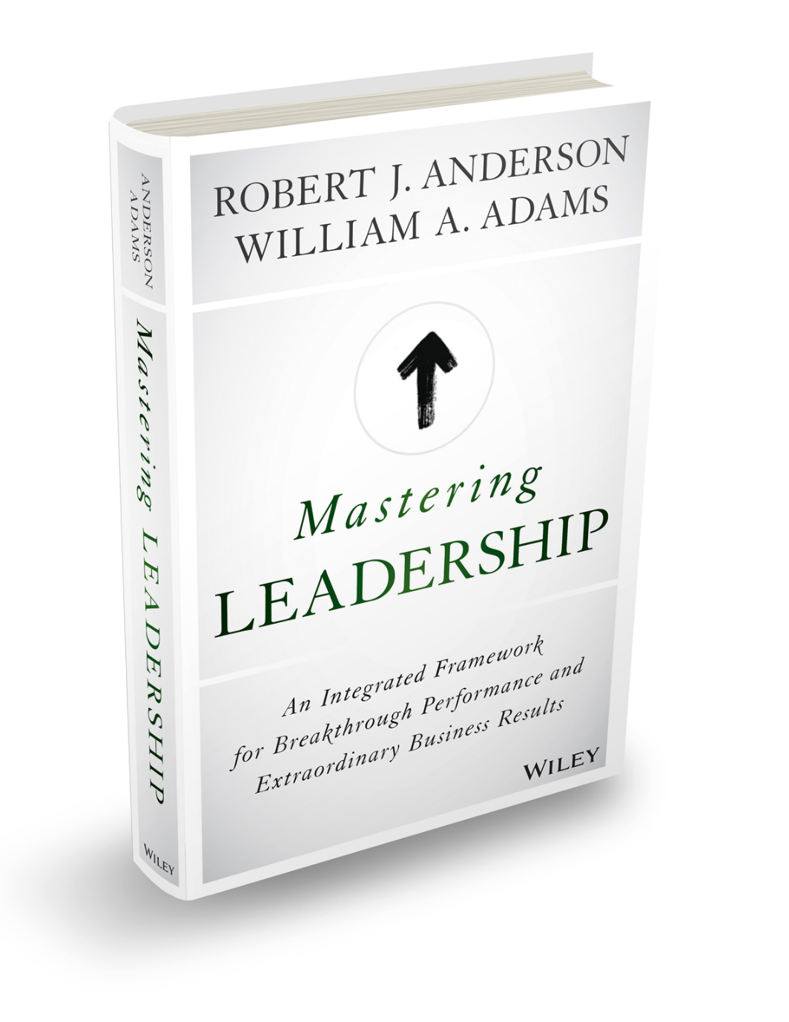
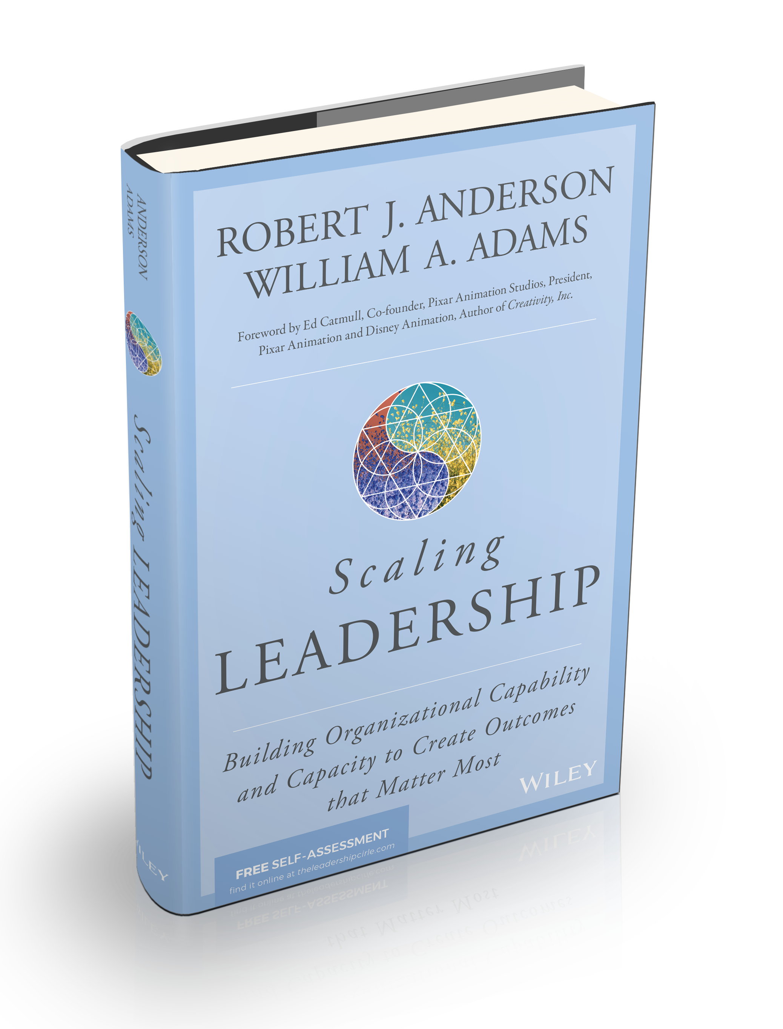
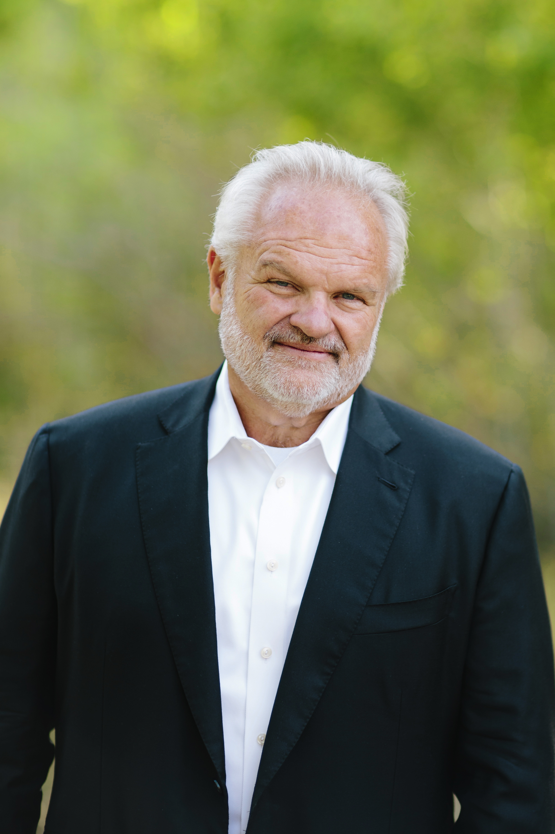
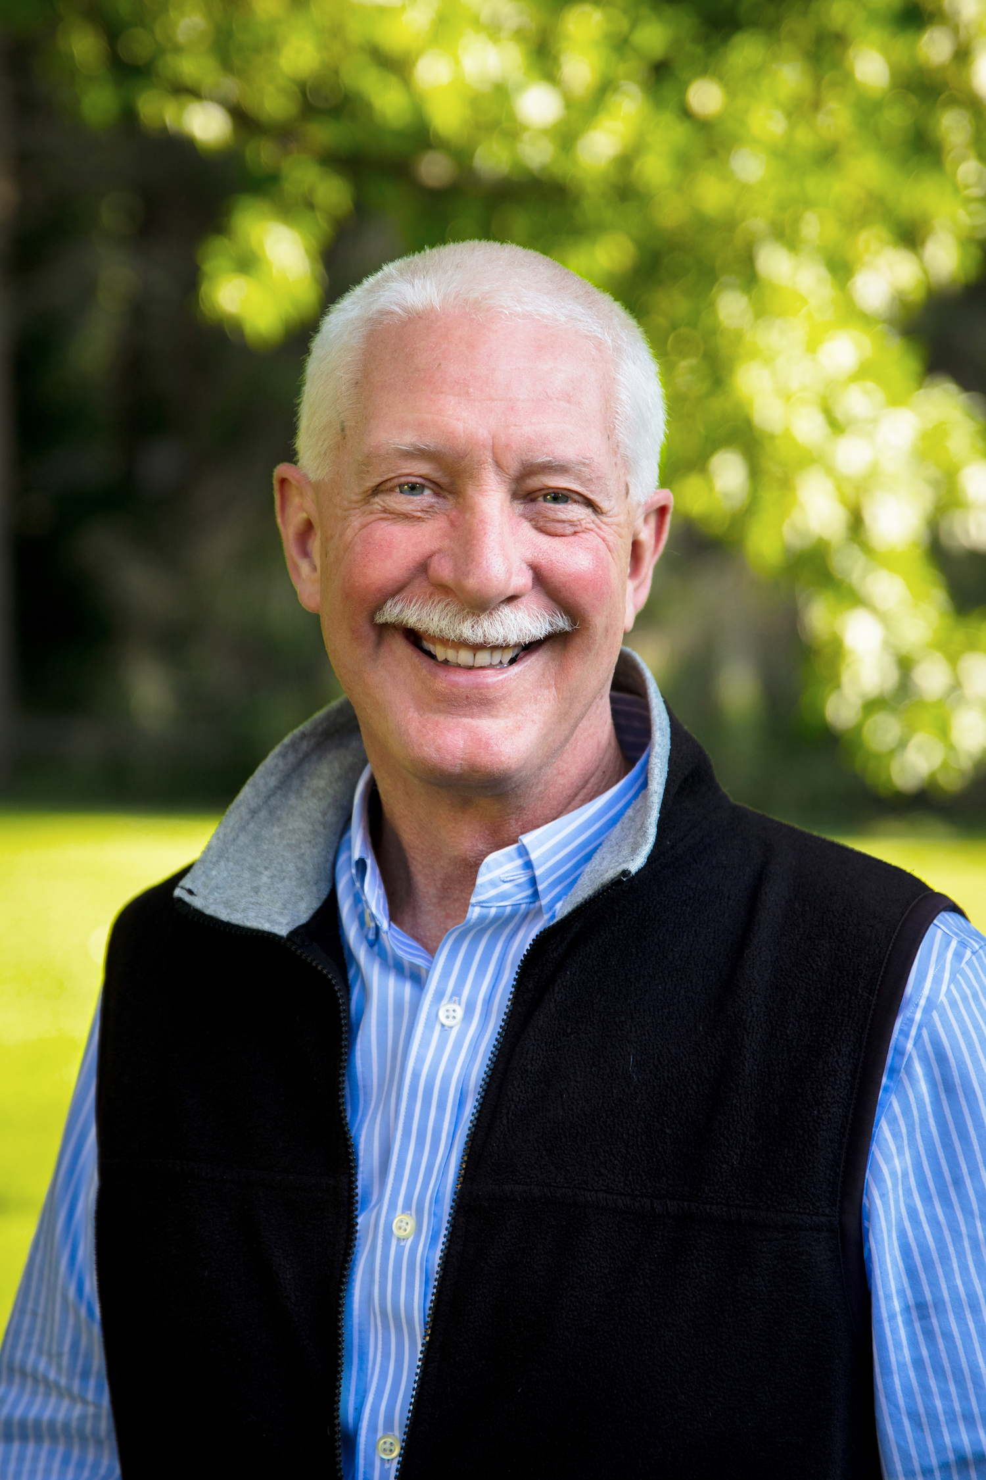
MASTERING LEADERSHIP:
（中译本：《孕育青色领导力》）
领导力通用模型与案例
SCALING LEADERSHIP:
提升组织能力与实力，
创造最重要的成果
Bill Adams
比尔·亚当斯
Bob Anderson
鲍勃·安德森

